Slide 1

Tertiary structure assessment
CASP15 meeting, Antalya
Dan Rigden et al.

Slide 2
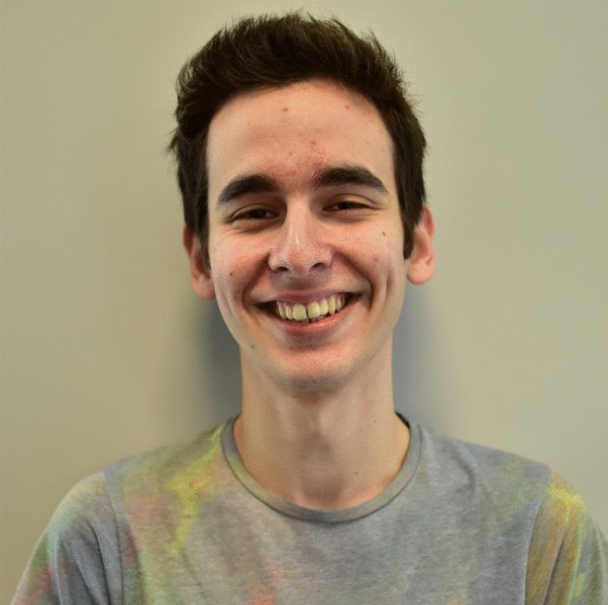

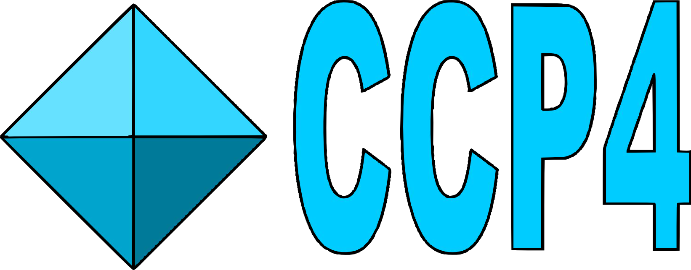
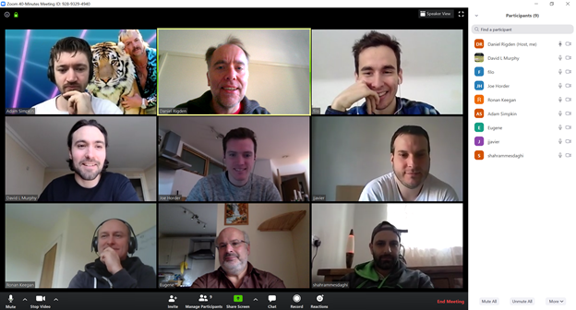
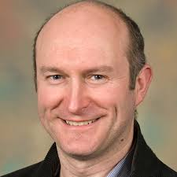

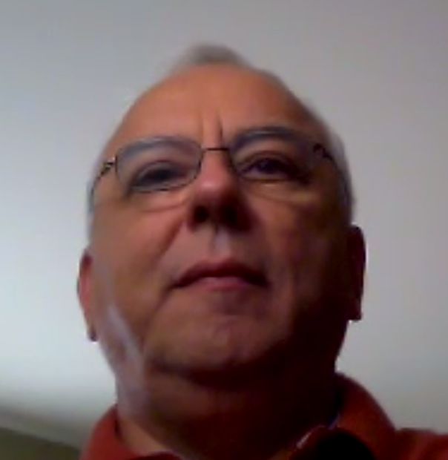
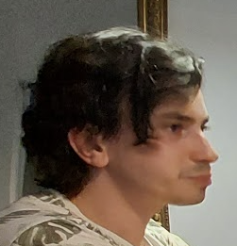

Filomeno Sanchez Rodriguez Adam Simpkin
Shahram Mesdaghi, David Murphy Ronan Keegan
Andriy Kryshtafovych
Luc Elliott

Slide 3
Contents
What should the S_{CASP15} score be?
Should we change the way we score side chains?
Should we include reLLG in the calculation
Resulting S_{CASP15} ranking of groups
What makes a target hard, and CASP14 to CASP15 comparison
How well do different kinds of approaches fare? Can they self-assess well?
Are biological interfaces and crystal lattice contacts still problematic? Where are remaining local errors?
Side chains
Molecular Replacement, CryoEM map fitting and Function prediction

Slide 4
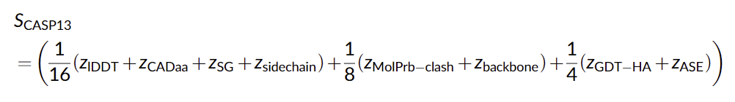
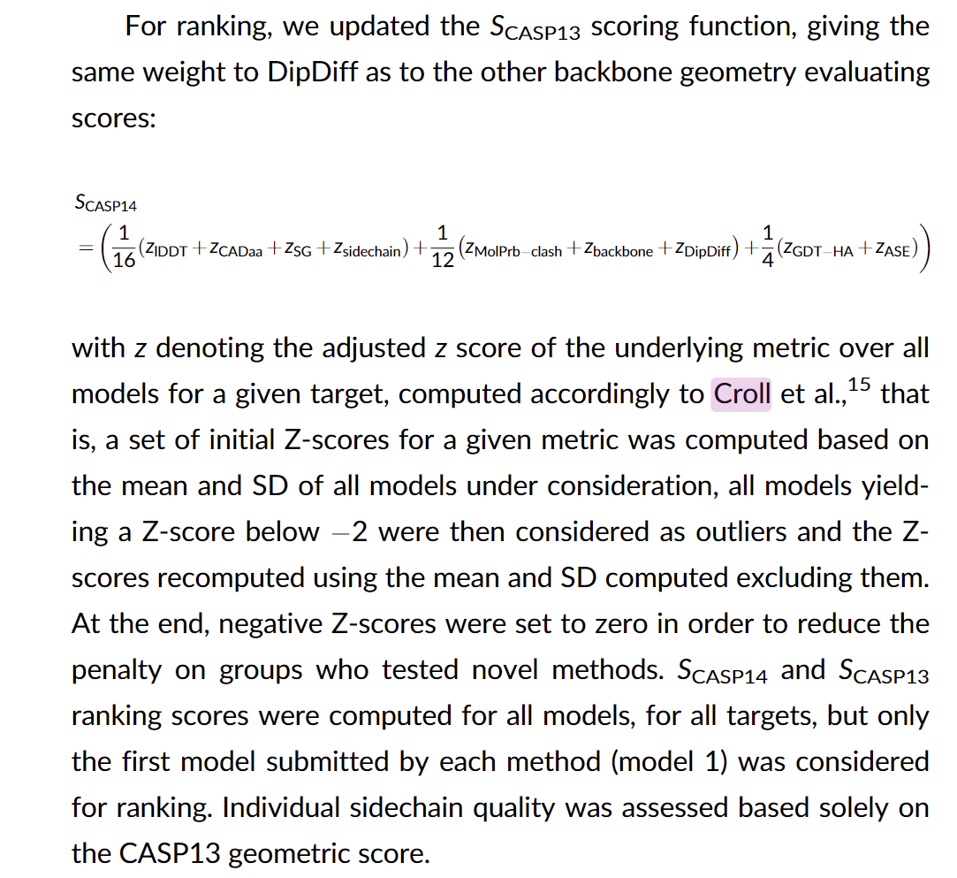
Basic rankings, existing scores for TBM modelling
Given progress it seemed right to ‘tighten’ the scoring and rate models of hard cases using the formulae previously reserved for easy cases

Slide 5
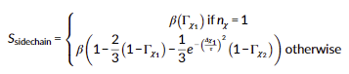
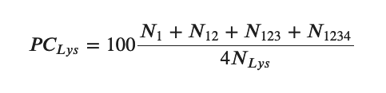
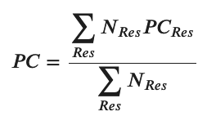
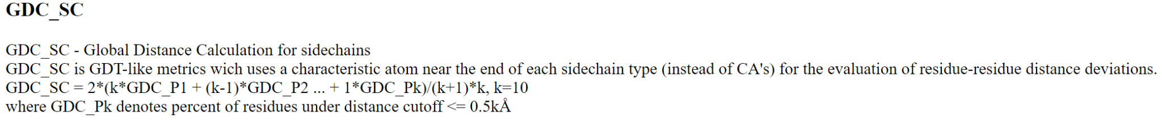
Should we change the ranking score? Side chains
Only looks at χ₁ and χ₂
Downweights χ₂ when χ₁ is out “ contribution of Γχ₂ becomes negligible when Δχ₁>≈50° ”
Considers burial - side chains at surface often have no single correct conformation
Options
Upweight the existing z_{sidechain}
Add in additional side chain metrics eg Average Absolute Accuracy (AAA) from SCWRL4
Maybe GDC_SC

Slide 6
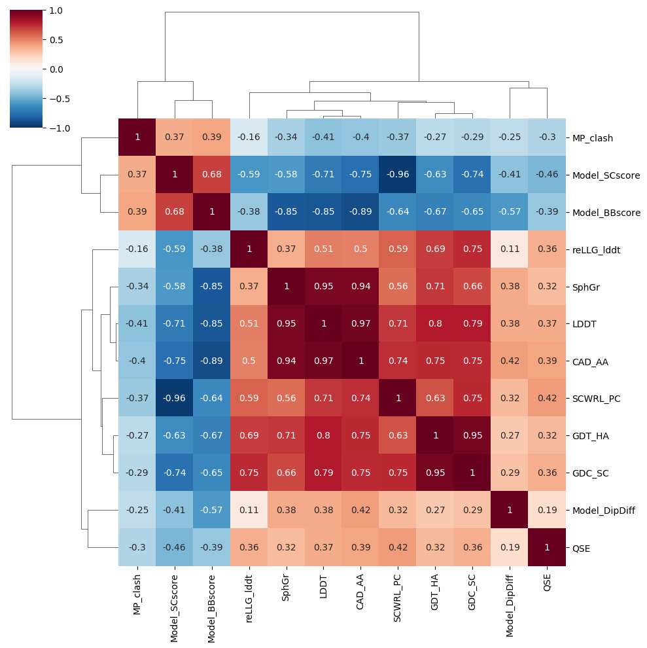
Potential new metrics correlate too well with existing measures
-0.96 CC existing SC_score vs AAA
0.95 CC GDC_SC vs GDT_HA
We also considered changing the weight of the existing side chain component but this made little difference. Same top 5 even with a quadrupling

Slide 7
Should we change the ranking score? reLLG
Designed as coordinate-only method that predicts model’s value in MR
Only moderately correlated with other metrics hence include (max correlation is 0.75 with GDC_SC)
Use reLLG variant that includes atomic pLDDT but what weight to give it?
Logically belongs in global metric part
Same weight as GDT_HA? Would make last term ⅙ (z_{GDT-HA} + z_{ASE} + z_{reLLG})
Included but checked order of top groups not too sensitive to addition

Slide 8

The CASP15 score
S_{CASP15}
“a set of initial Z-scores for a given metric was computed based on the mean and SD of all models under consideration, all models yielding a Z-score below 2 were then considered as outliers and the Zscores recomputed using the mean and SD computed excluding them. At the end, negative Z-scores were set to zero in order to reduce the penalty on groups who tested novel methods.”
For the overall ranking we use the sum, to reward groups who try all targets, but you will see median in places too

Slide 9
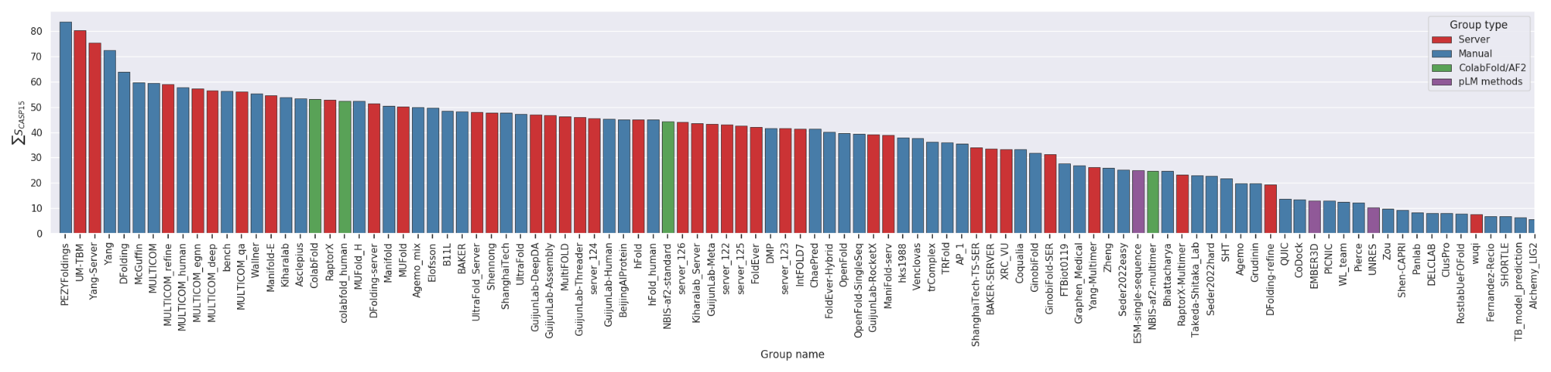
The CASP15 rankings
#1 PEZYFoldings AF2-based. Diverse MSAs. Custom, fine-tuned AF2 refinement
#2 UM-TBM Diverse MSAs. Threading then AF2 predictions guide I-TASSER REMC
#3 Yang-Server Diverse MSAs. AF2 predictions fed to trRosettaX2
ColabFold and NBIS-af2-standard
ESM-singlesequence is the top pure pLM method by this metric
BAKER top non-AF2 method

Slide 10
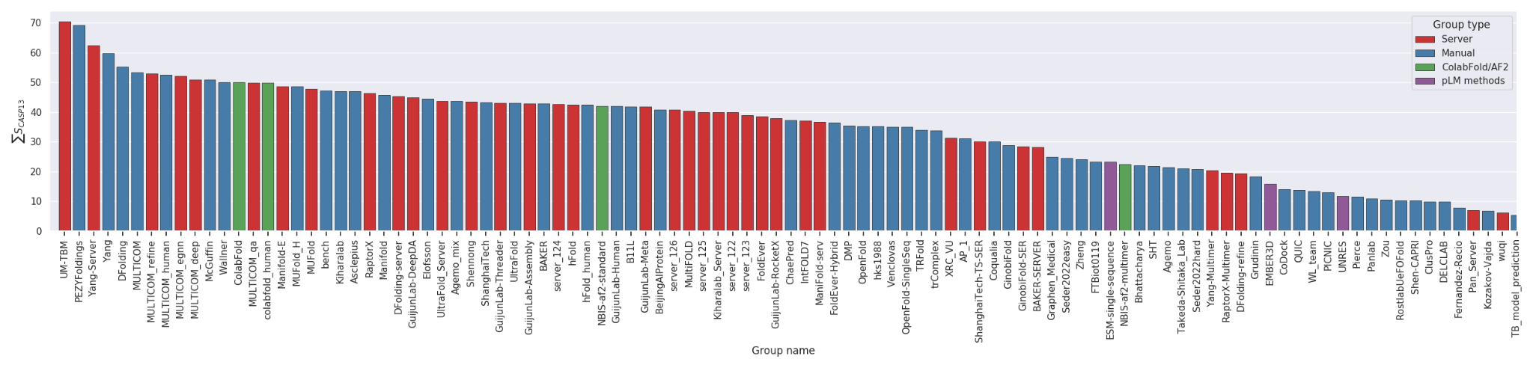
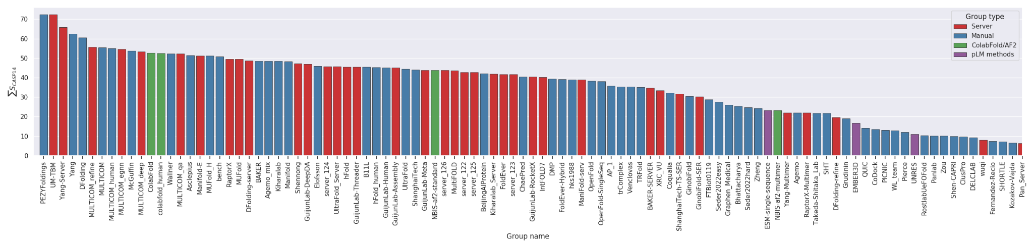
CASP15 results by CASP13 (above), CASP14 scores

Slide 11
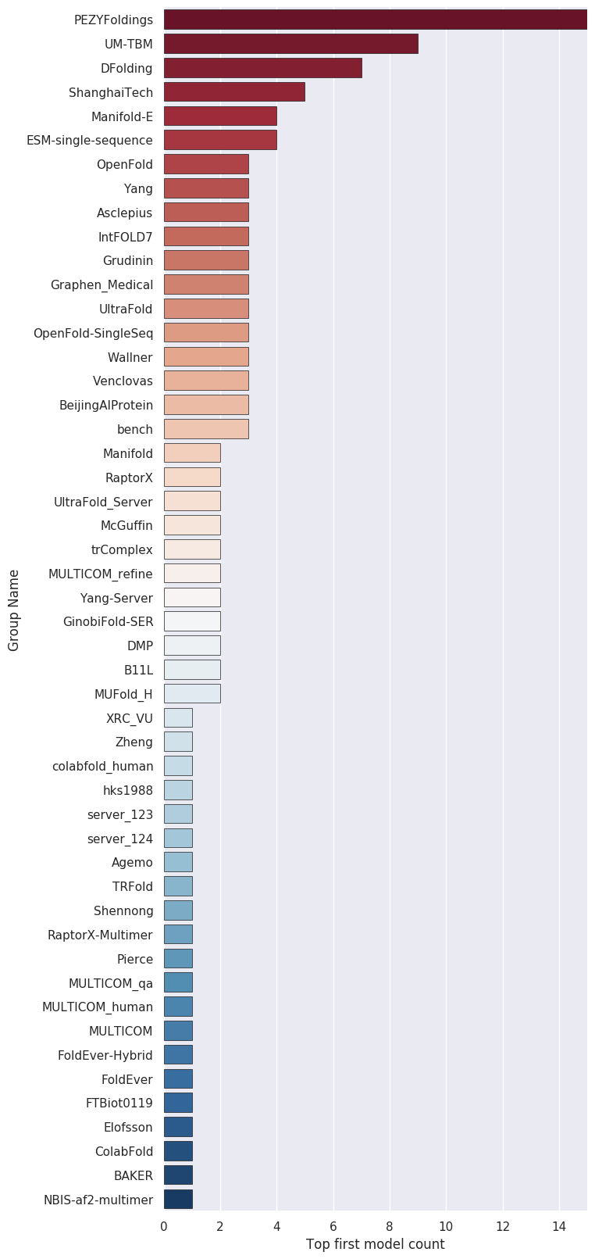
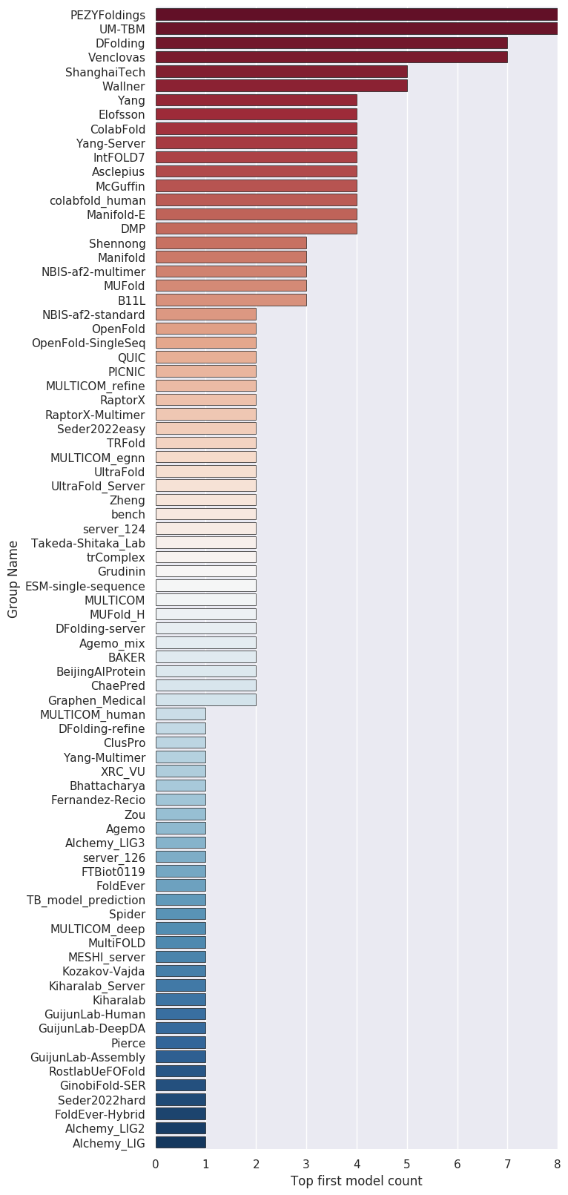
Ranked by CASP15 score
Ranked by GDT_TS score

Slide 12
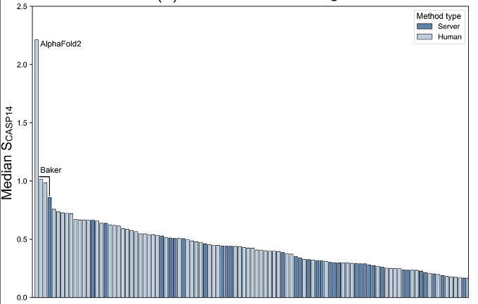
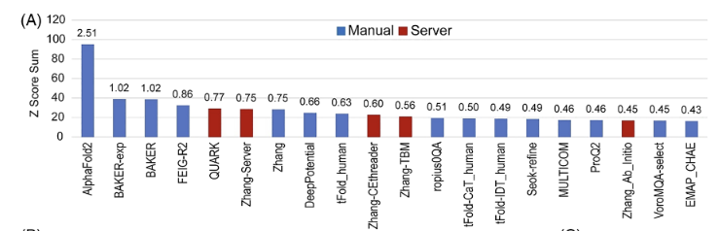
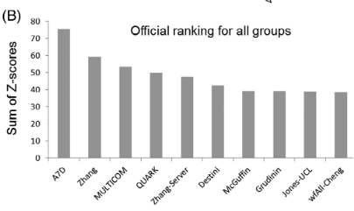
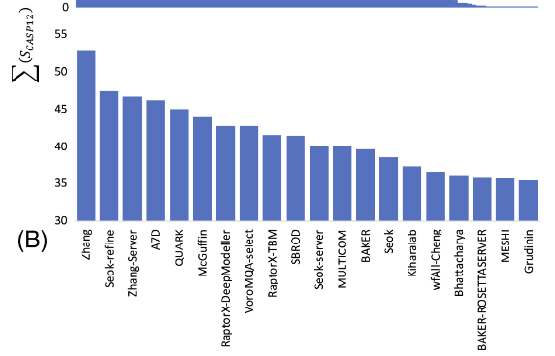
Servers move up vs manual
CASP15
CASP 14 hard
CASP 14 easy
CASP 13 hard
CASP 13 easy

Slide 13
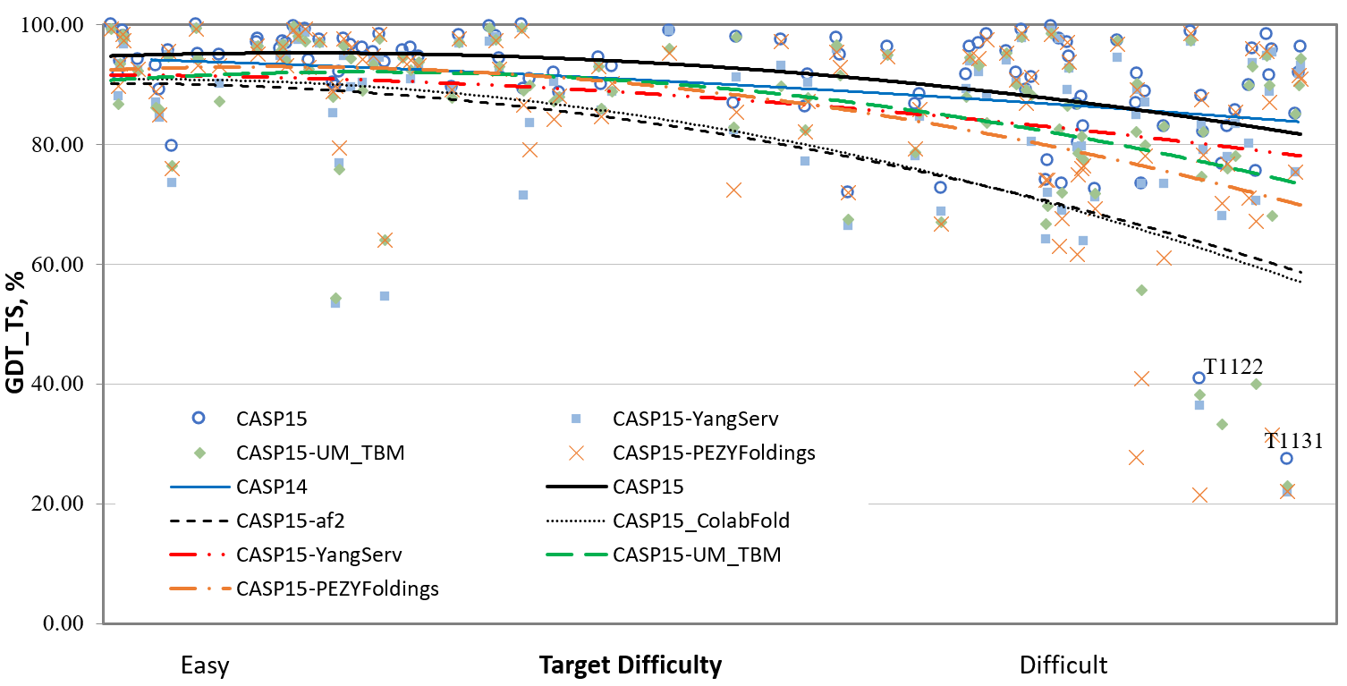
CASP14 vs CASP15 comparison
Best CASP15 broadly in line with best CASP14 but …
… best CASP14 (mainly AF2) consistently a little higher than best CASP15 groups
NBIS-af2-standard and ColabFold not performing at level of CASP14 DM AF2 submission
CASP invited DeepMind to informally model the set. Broadly this brings performance up to the best official CASP15 groups. vs AF2 ‘controls’ they have
retrained on current PDB
increased sampling and crop size
made some human interventions
So why persistent gap? Are CASP15 targets harder in ways not captured by this scale?

Slide 14
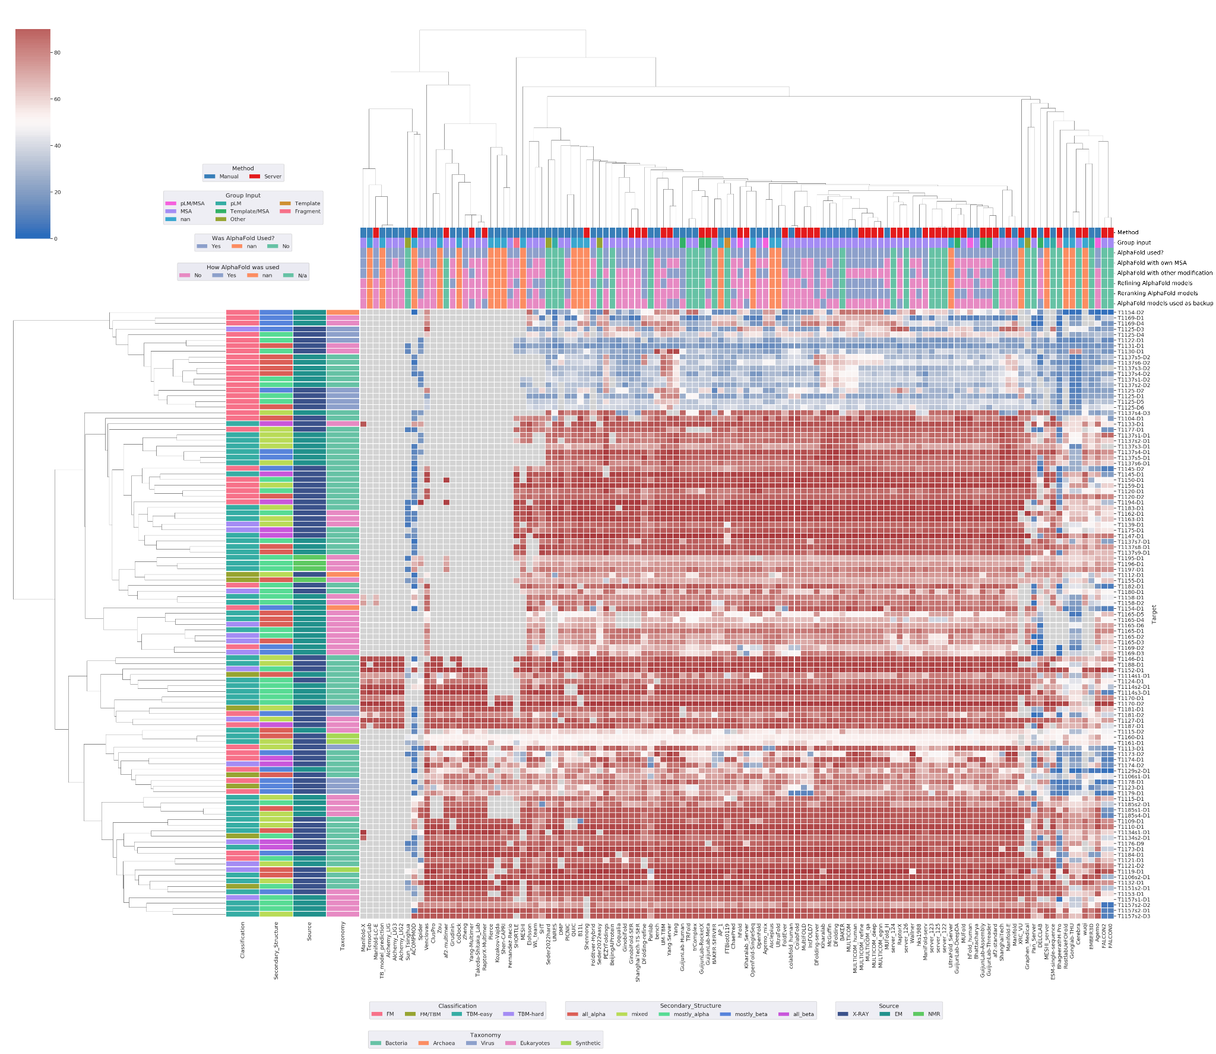




Harder targets mostly FM so template availability still relevant for most methods, but also …
… harder targets enriched in virus sequences
GDT_TS

Slide 15
CASP14 vs CASP15 in terms of target category
 | TBM easy | TBM hard | FM/TBM | FM
CASP14 | 27 | 31 | 15 | 23
CASP14, redefined automatically as per CASP15 | 39 | 21 | 15 | 21
CASP15 | 47 | 15 | 8 | 39
Reminder. Difficulty here based on sequence and structural similarity to nearest PDB entry: does not include any measurement of MSA depth eg Neff

Slide 16
What makes a target hard and does that explain any of the apparent drop from CASP14 to CASP15

Slide 17
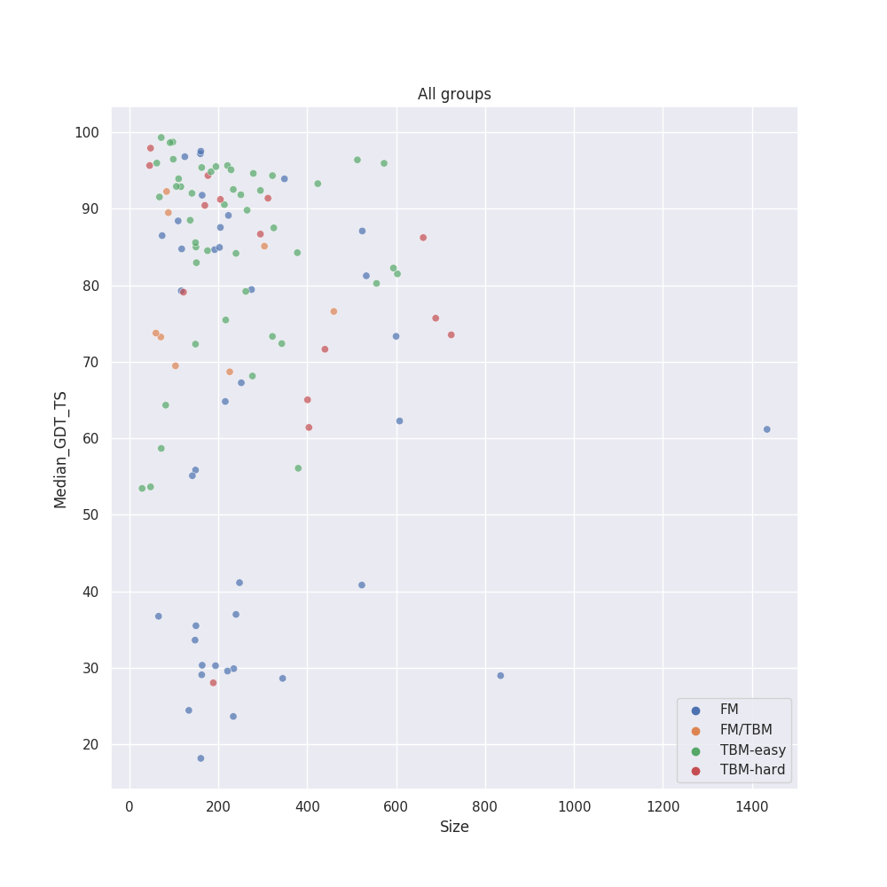
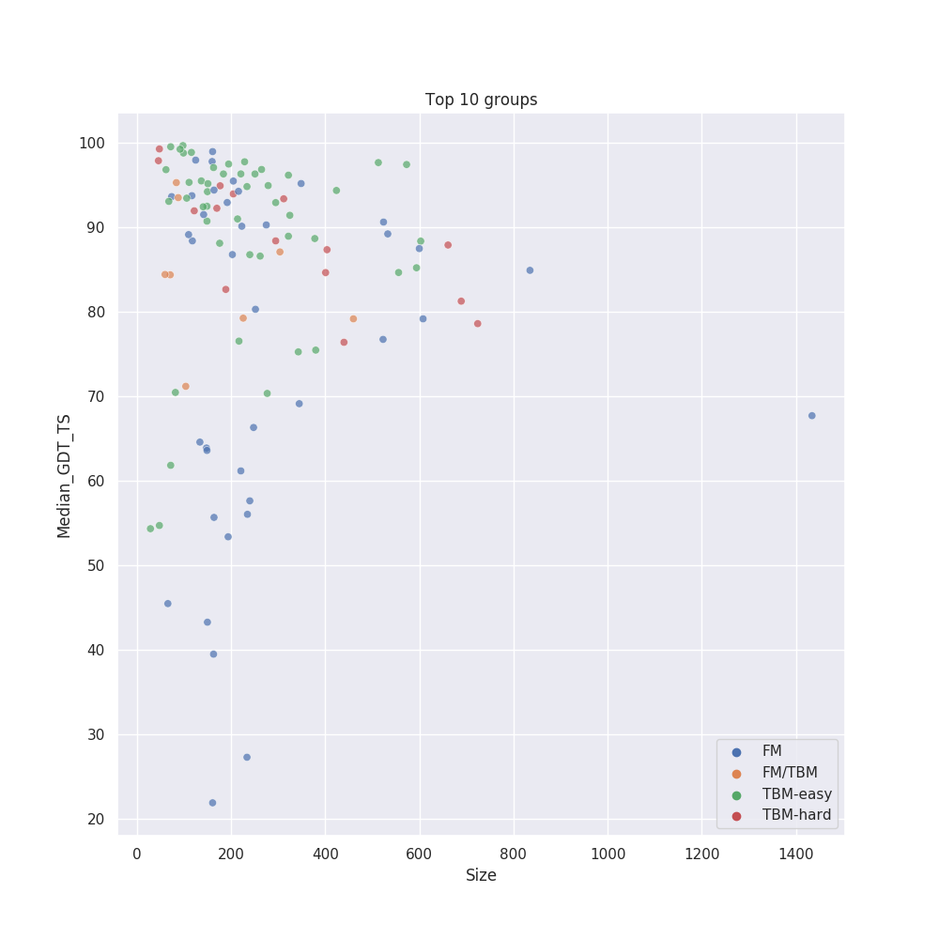
Is size an issue?

Slide 18
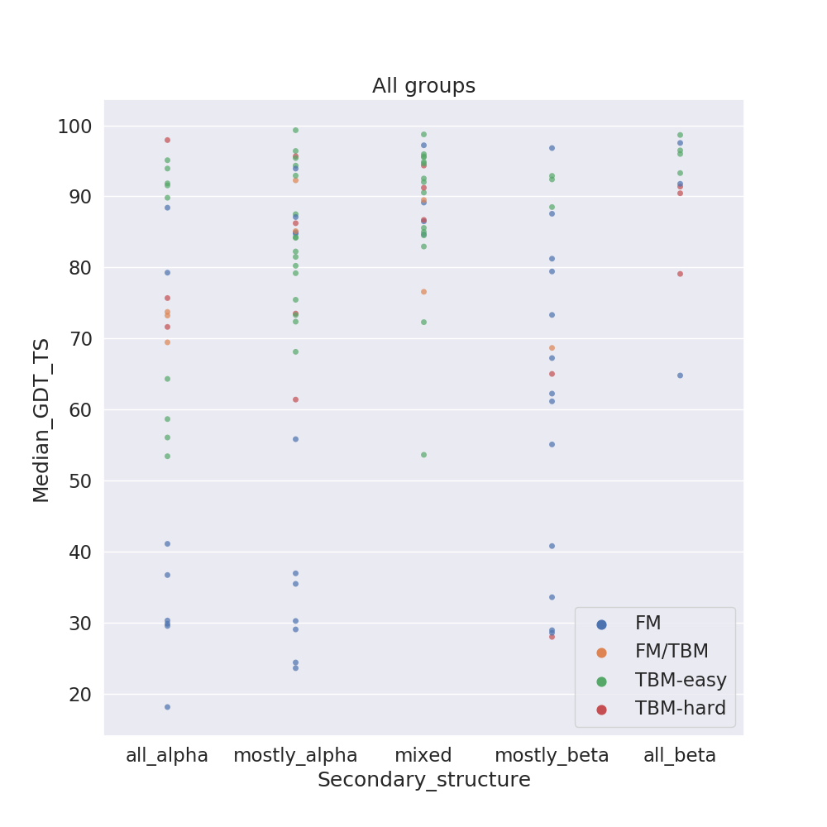
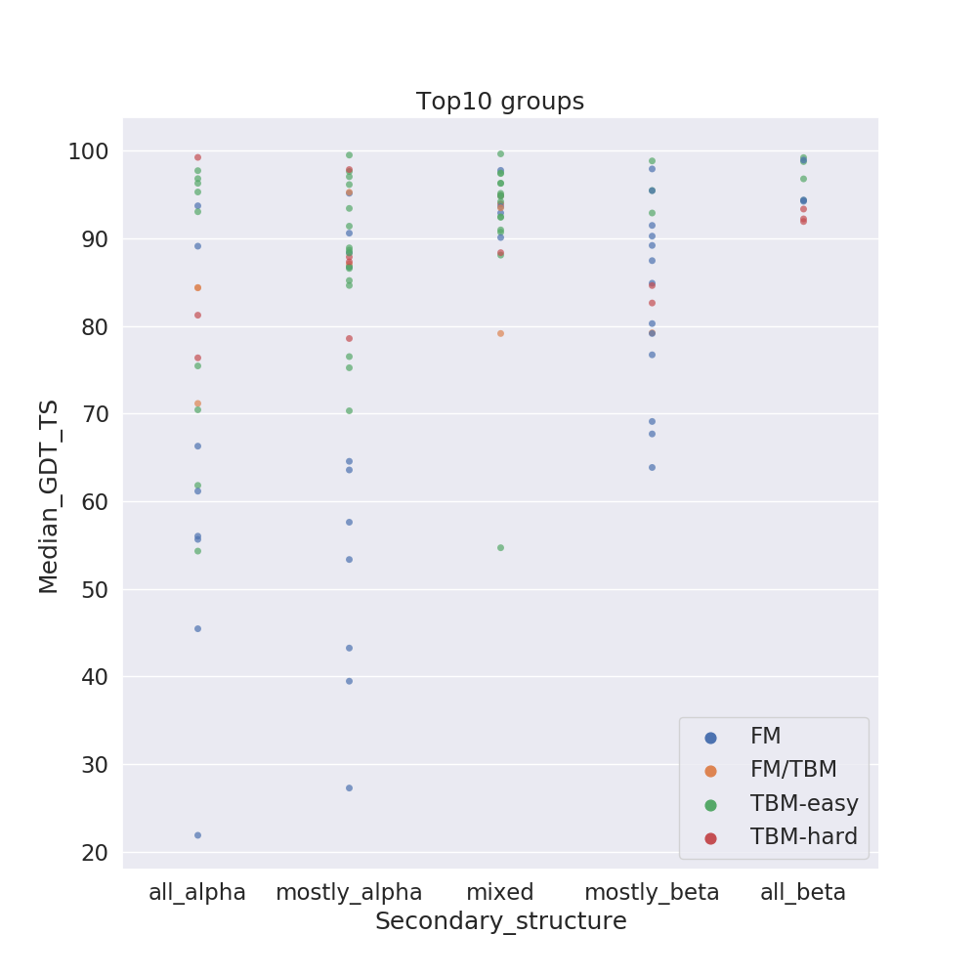
Is secondary structure relevant?

Slide 19
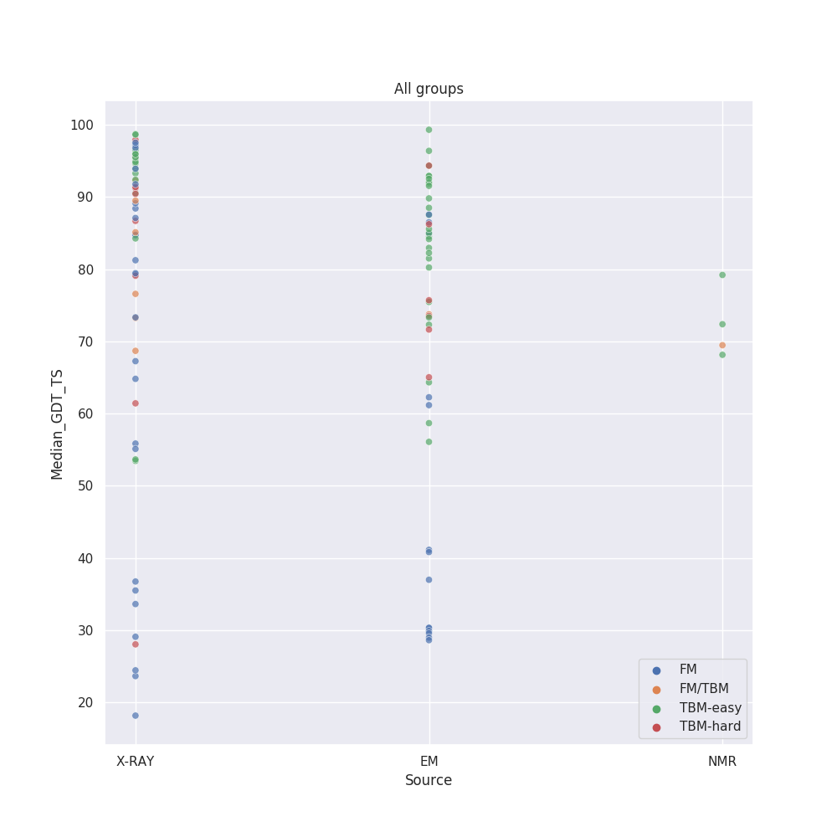
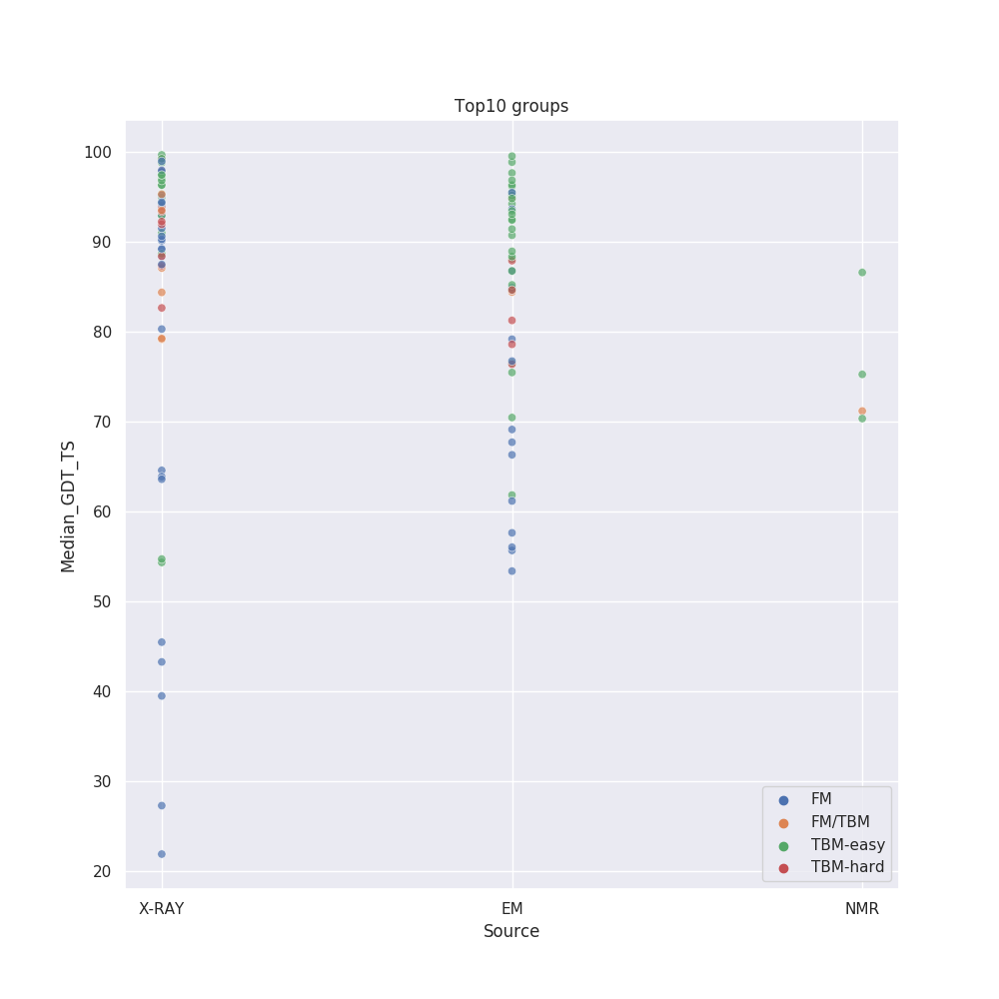
Is experimental method relevant?

Slide 20
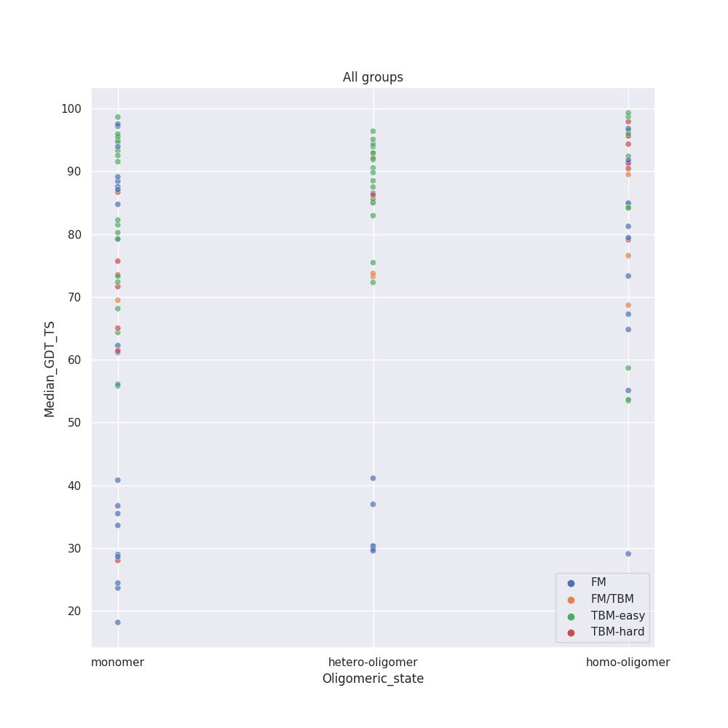
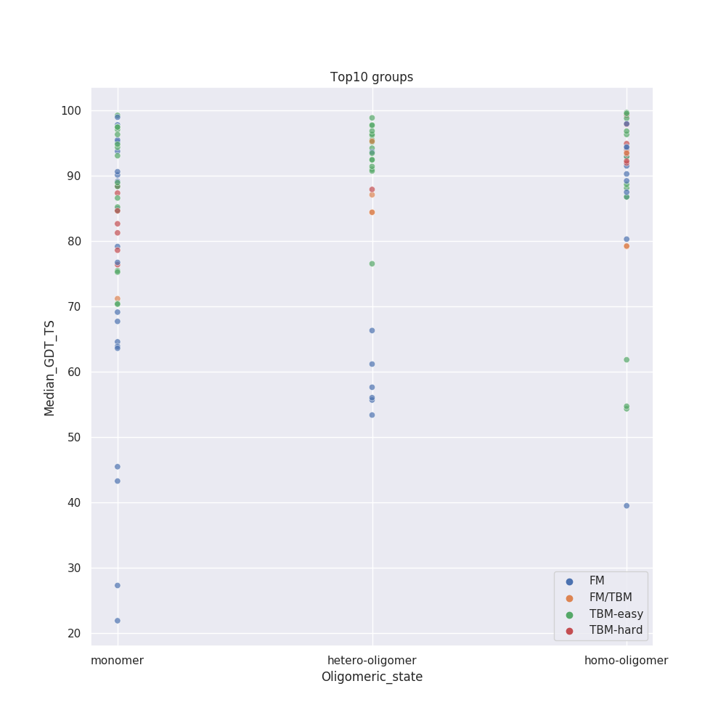
What about oligomeric status?
n=47 n=29 n=33

Slide 21
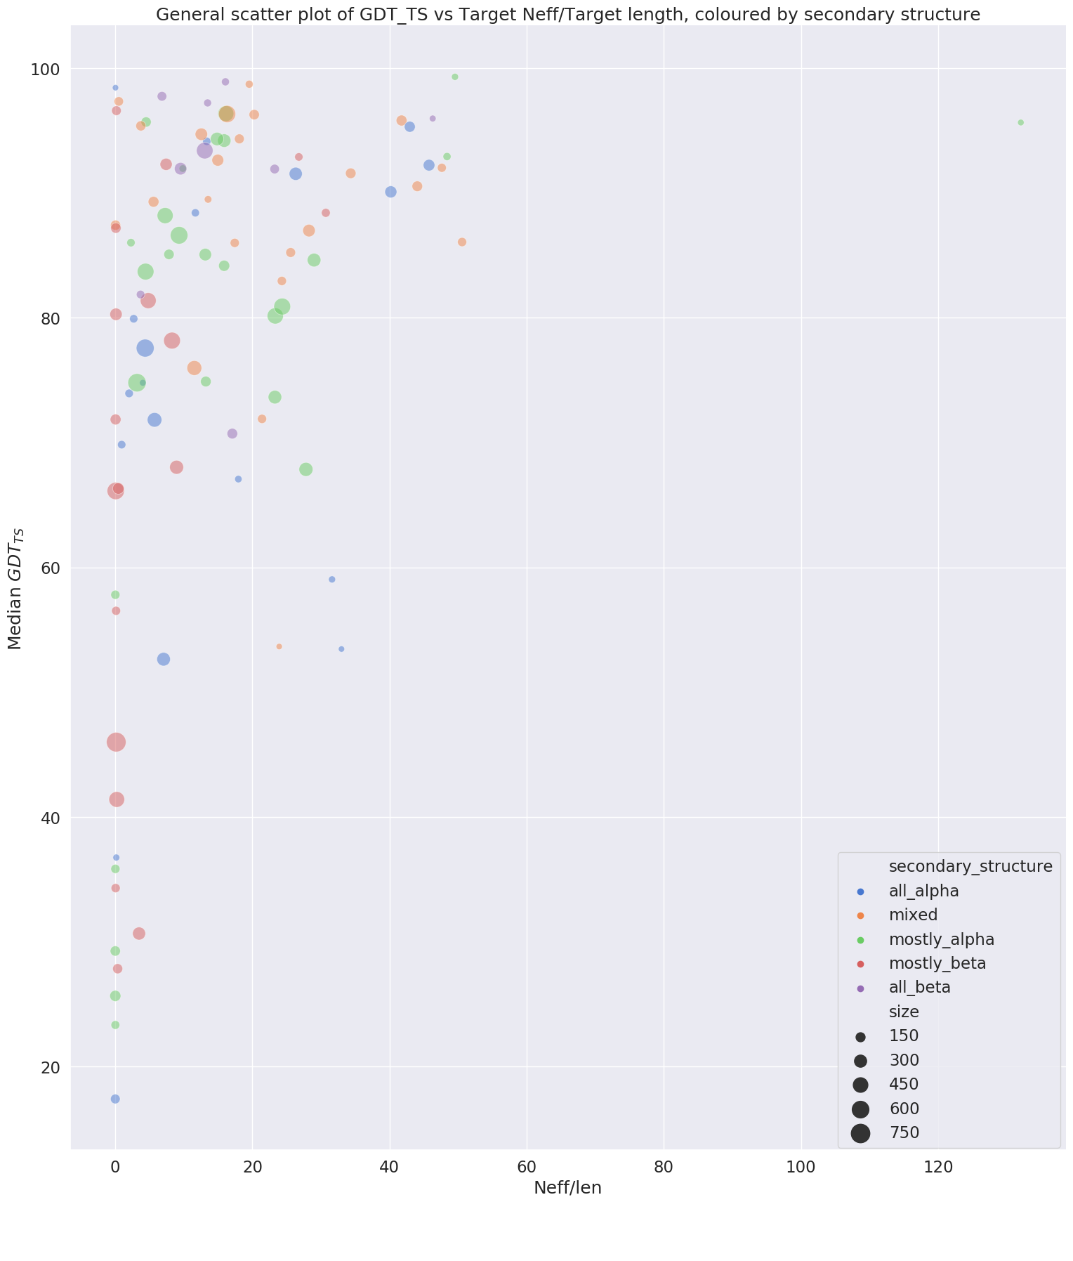
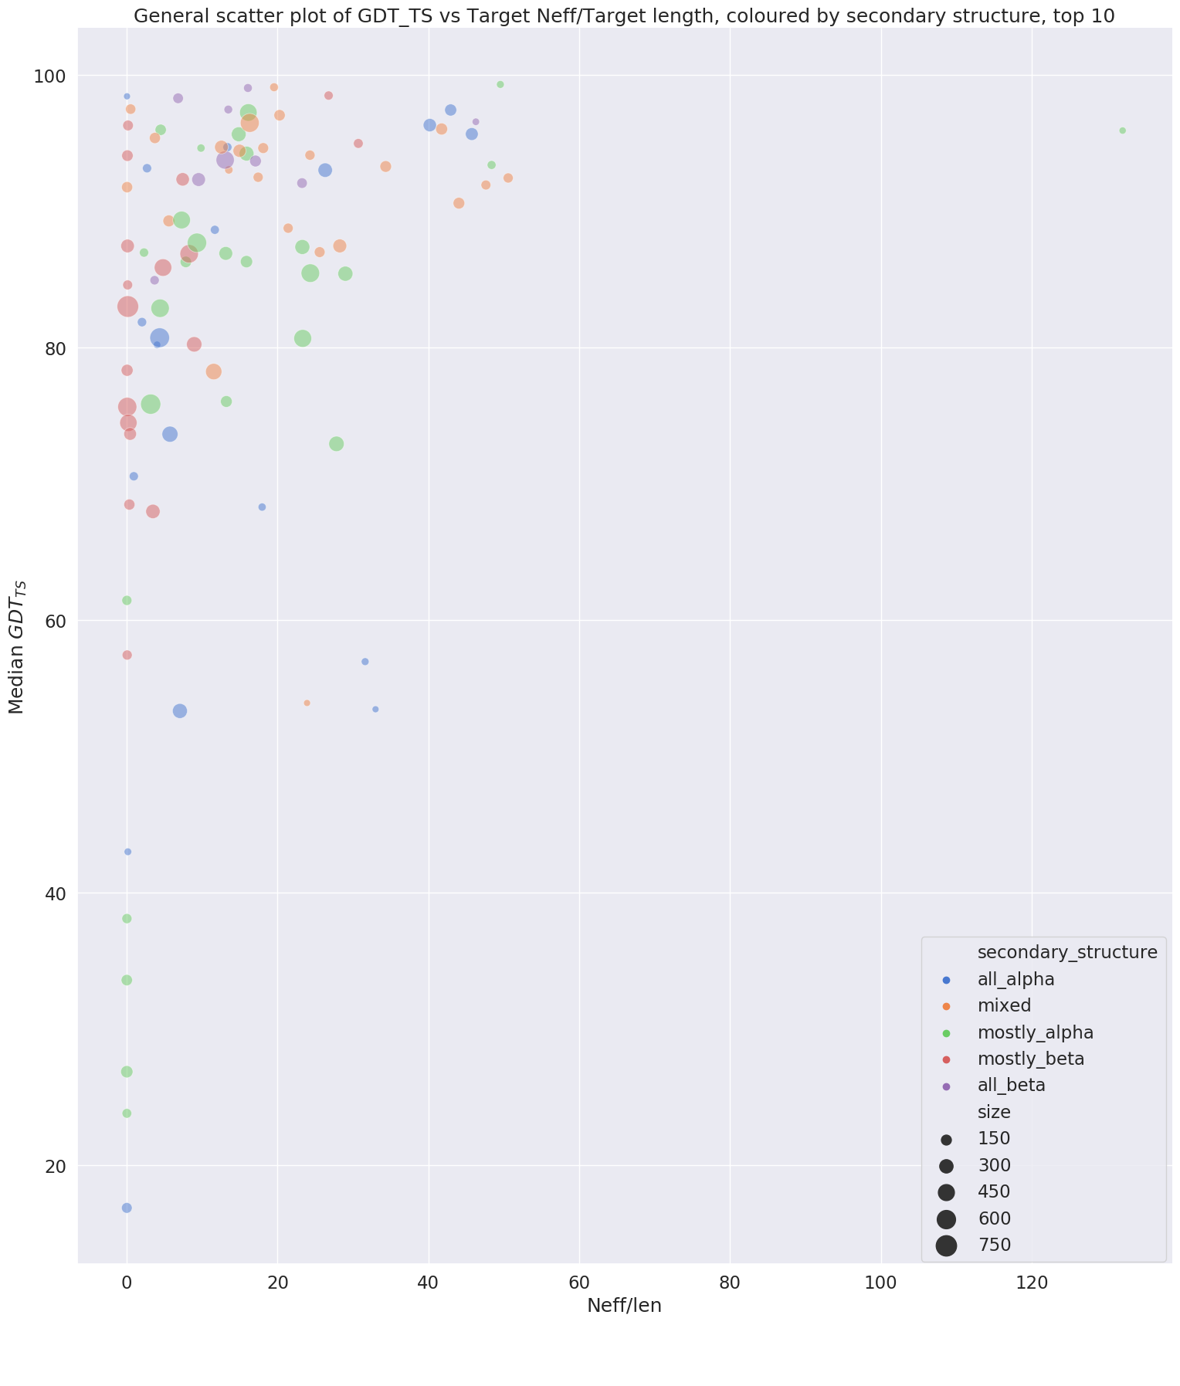
Neff is clearly an issue
T1125-D5
T1130
T1122
T1125-D1
T1131

Slide 22
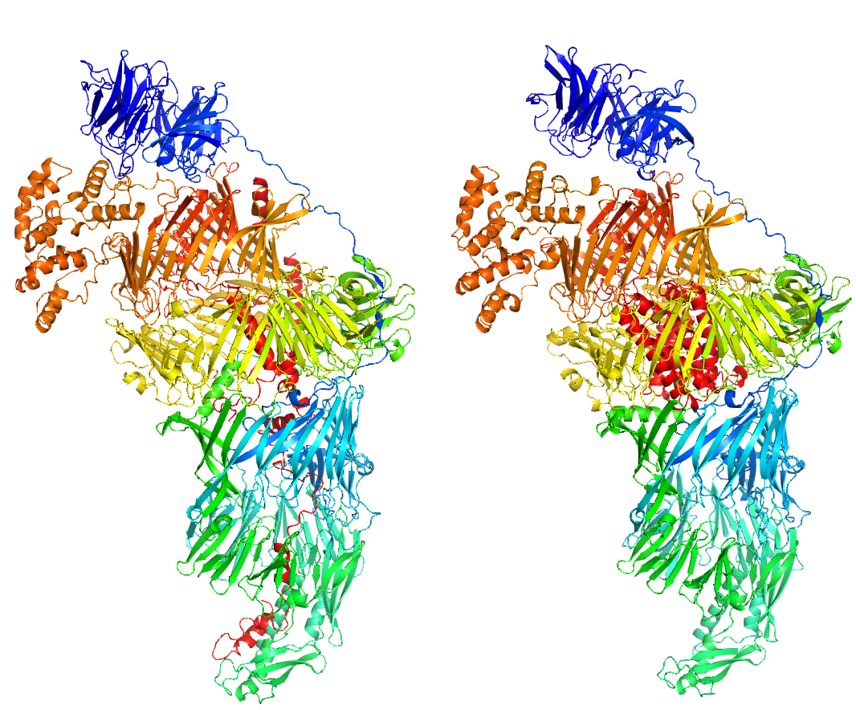
Before we look at the failures…
T1169 has almost 3000 residues
Four assessment units, three FM, one TBM-hard
Yang-server model, for example, is extraordinarily accurate. GDT_TS 58 overall
target
T1169TS229_1

Slide 23
The hardest targets in CASP15 - T1130 and T1131.
These are aphid proteins, thought to be distantly homologous
T1131 is the hardest target. Both singletons. Apparently, decent AF2 models of both can be built with sequences from Supp Material and/or further still-private targeted sequencing
Small (159 and 172 residues) and helical. T1131 has two repeating sub-domains. Tried older methods and methods claiming advantage on shallow MSAs

Slide 24
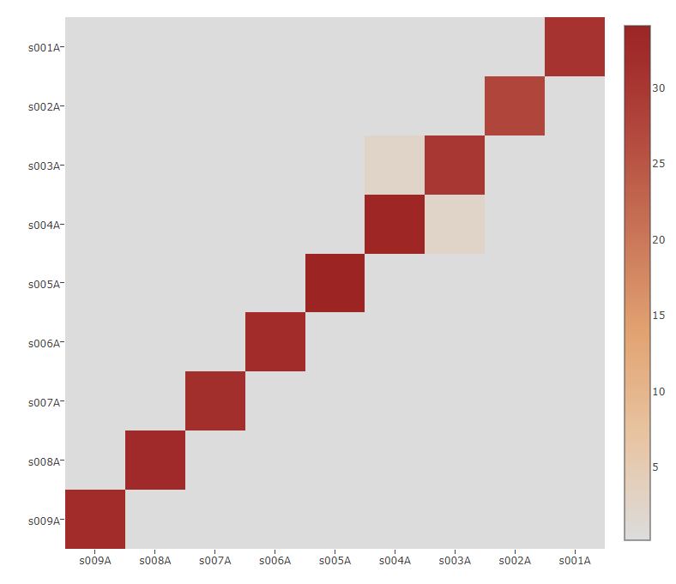
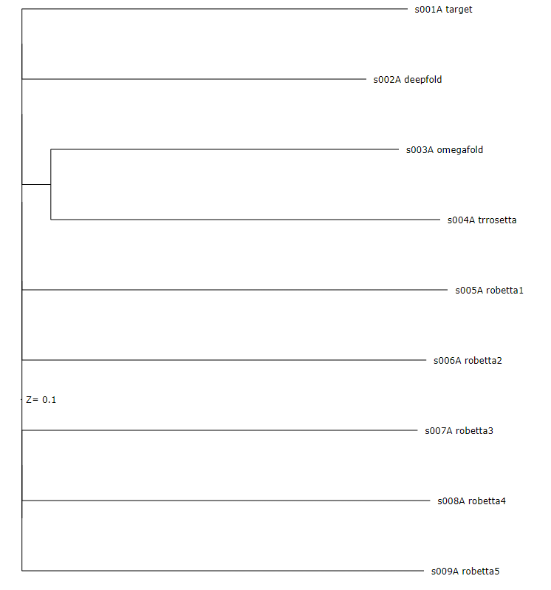
Nothing tried predicts T1131 well

Slide 25
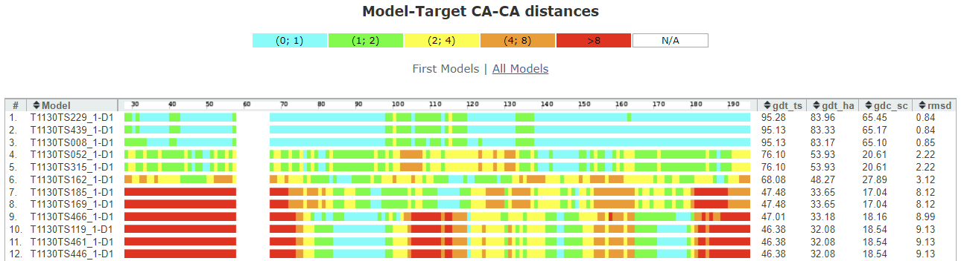
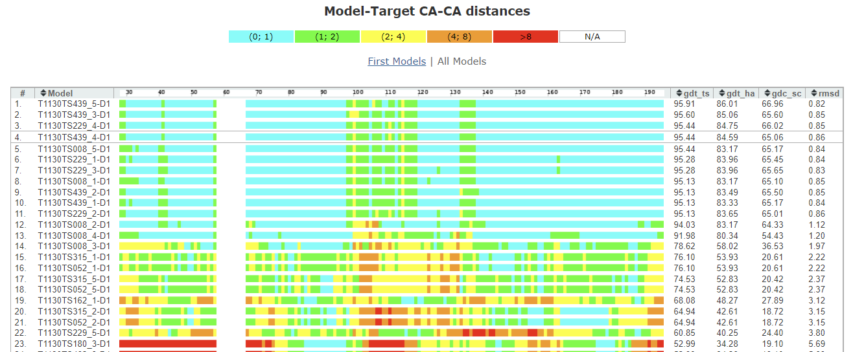
Only Yang group methods made a decent fist of T1130

Slide 26
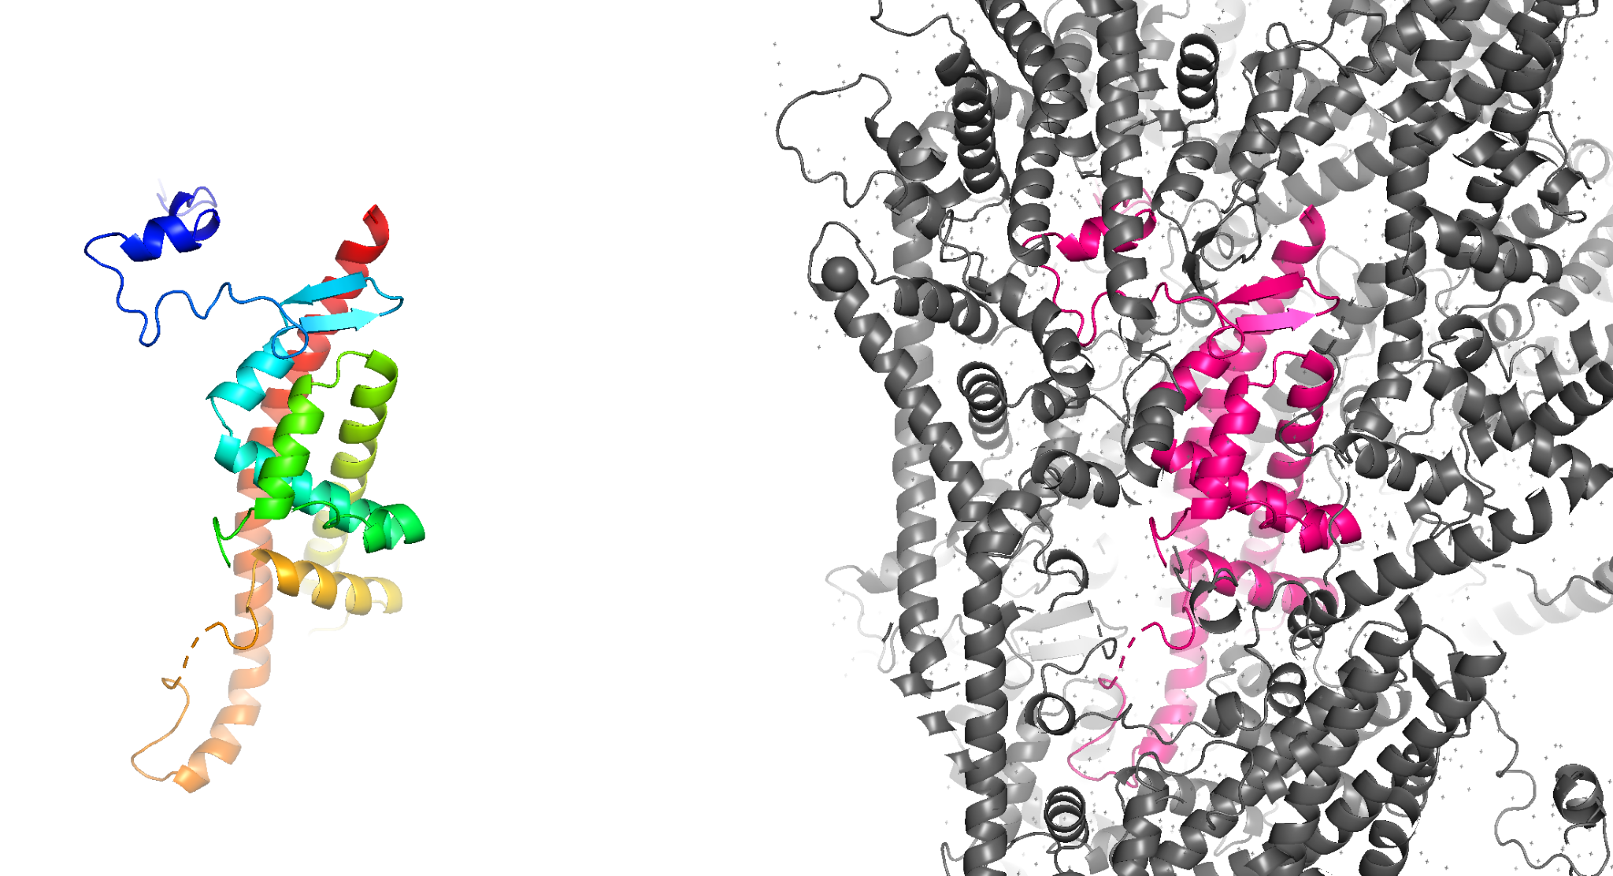
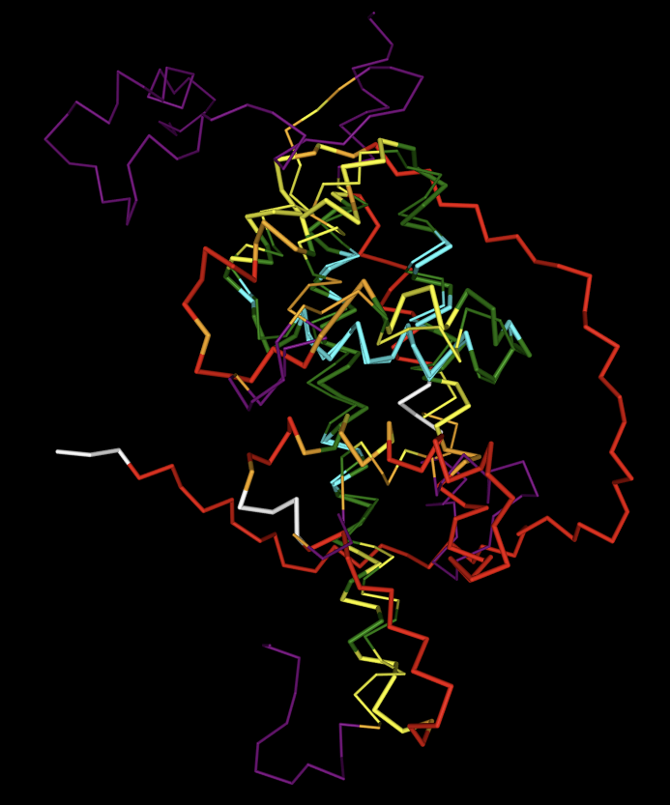
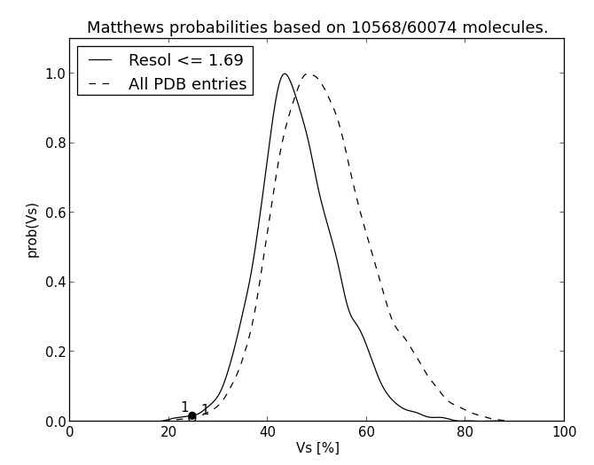
T1122 Cranefly nudivirus protein
Derived from viral polyhedra. Crystals stable since the 1950s! Only 25% solvent content. “Dissolving the crystals denatures the protein”
Solvent content at the extreme of what is possible
QUIC model, GDT_TS 39

Slide 27
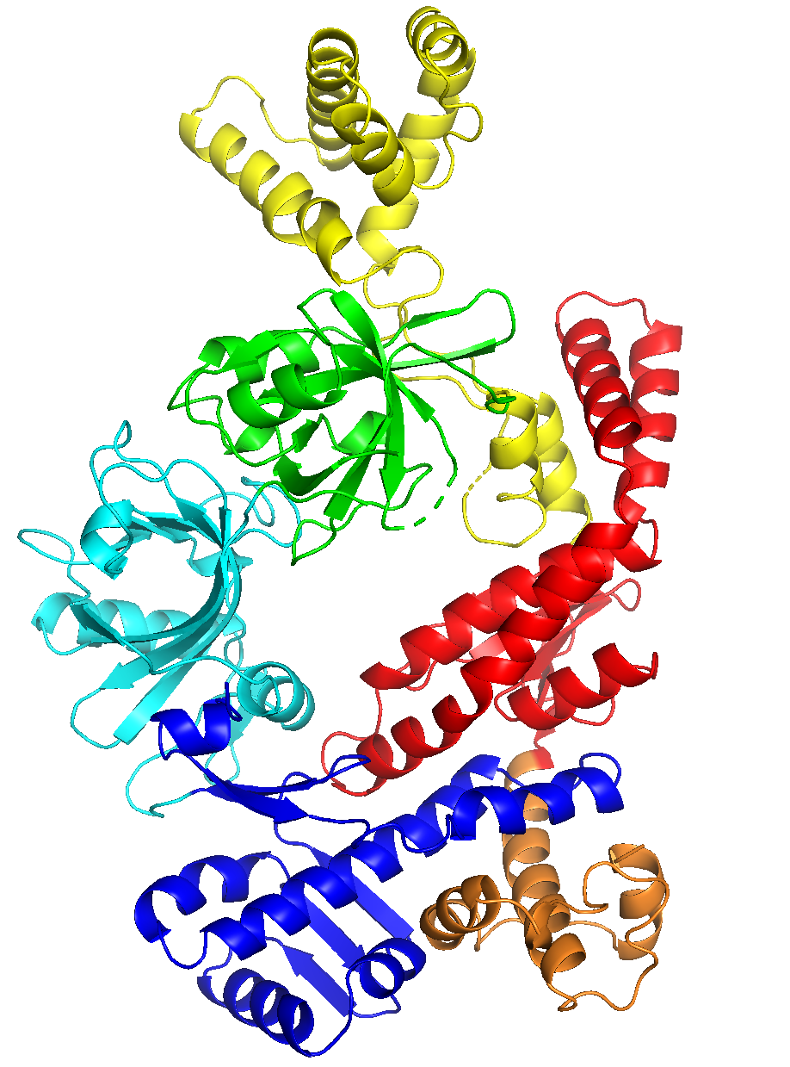
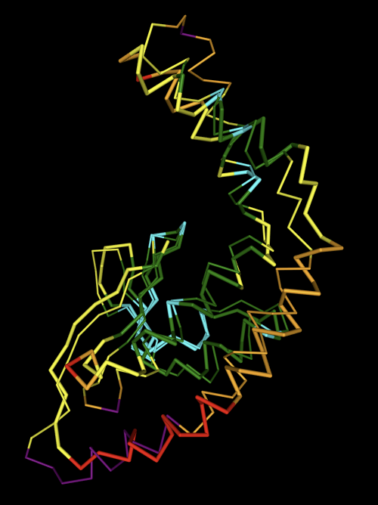
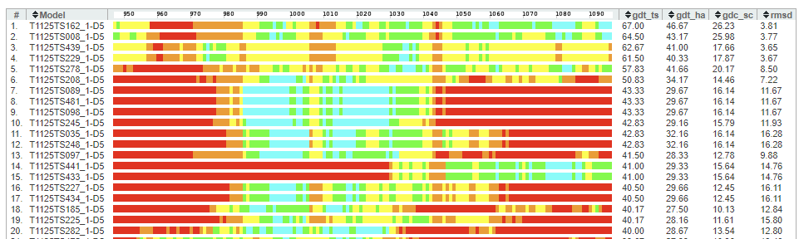
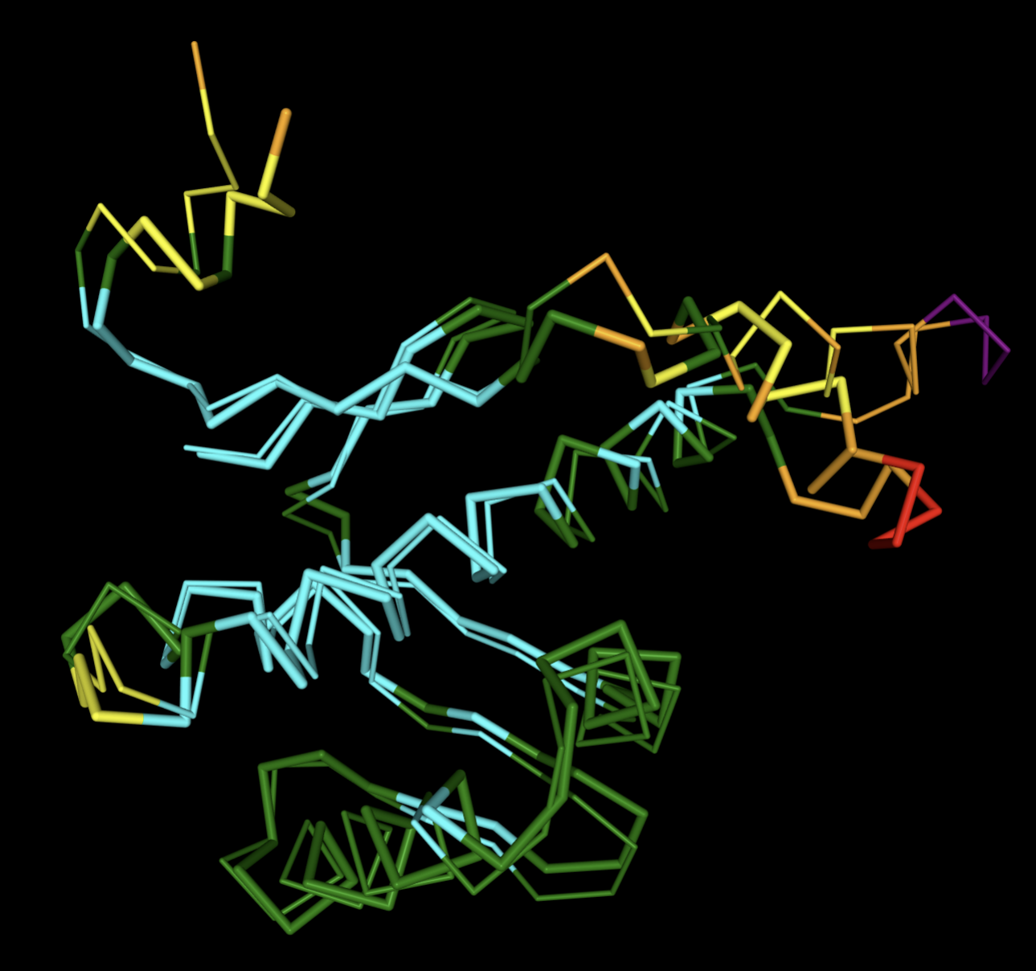
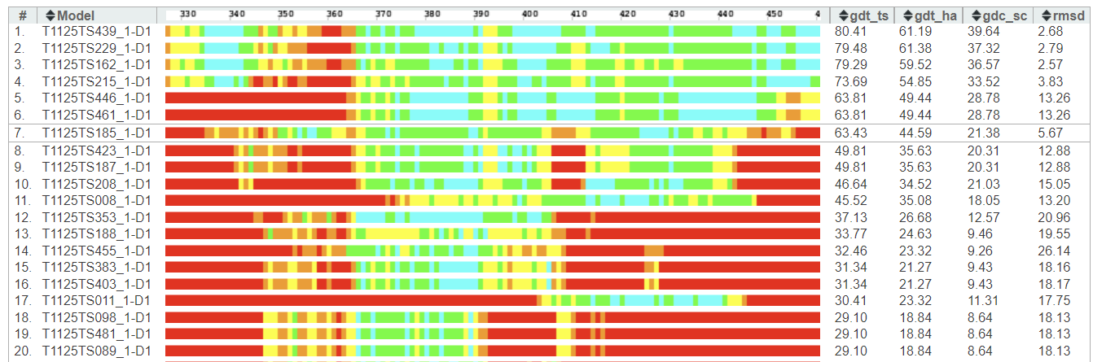
T1125, Thermus thermophilus bacteriophage gp96RNAP, five FM and one TBM-hard
D5
UM-TBM
D1
D1 (FM) and D5 (FM) among hardest targets
Yang

Slide 28
Harder targets may, in addition to lacking templates, be
Smaller
Have low Neff
Be monomeric (?)
Helical rather than β-sheet (?)
Determined by crystallography rather than cryo-EM (??)
Do any of these explain CASP15 vs CASP14?

Slide 29
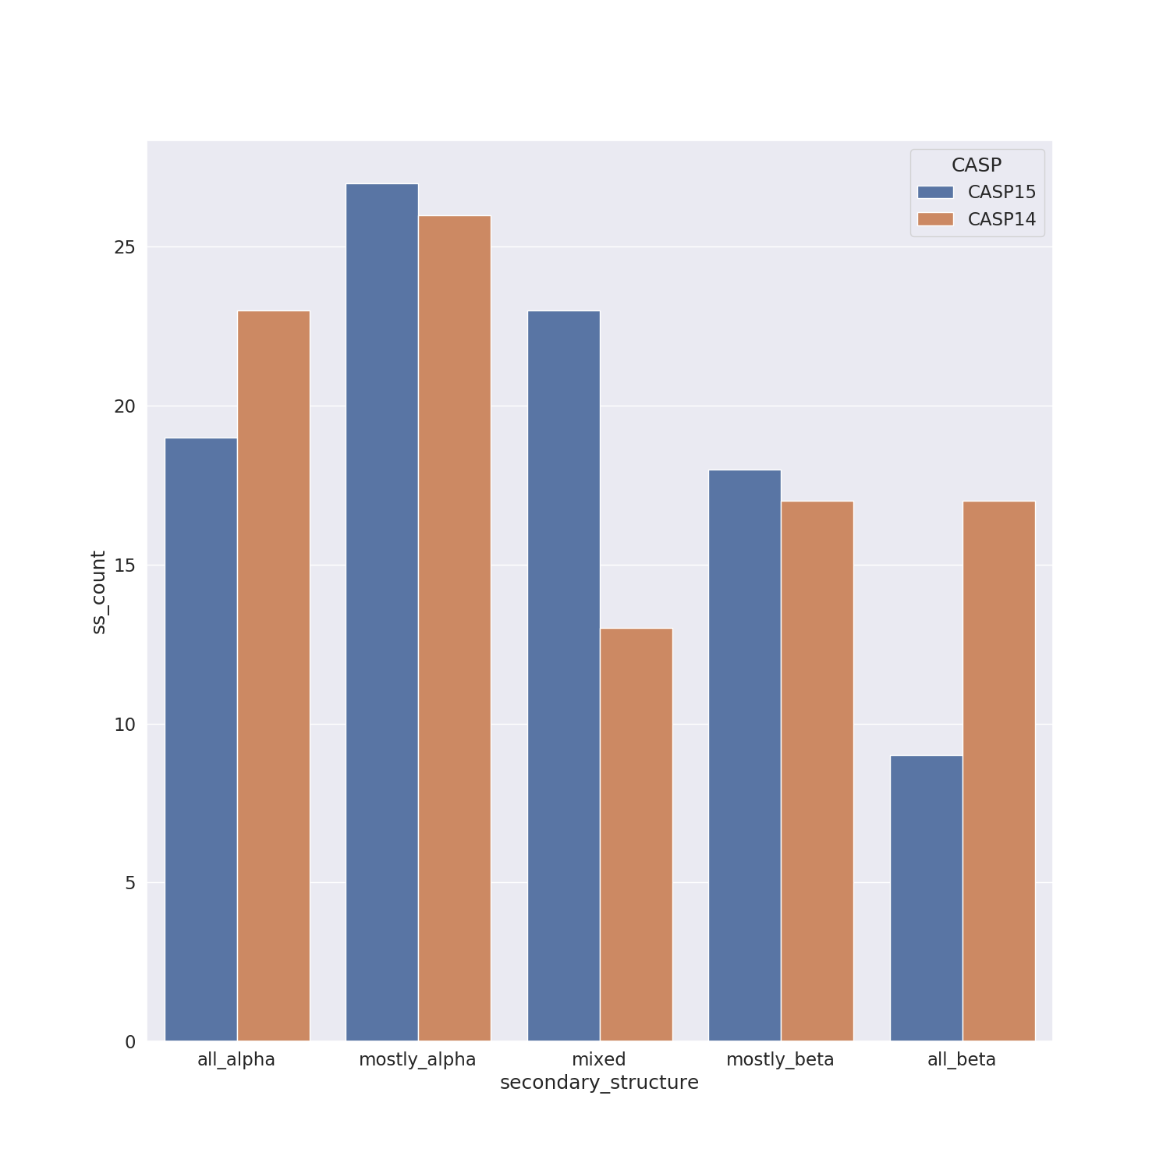
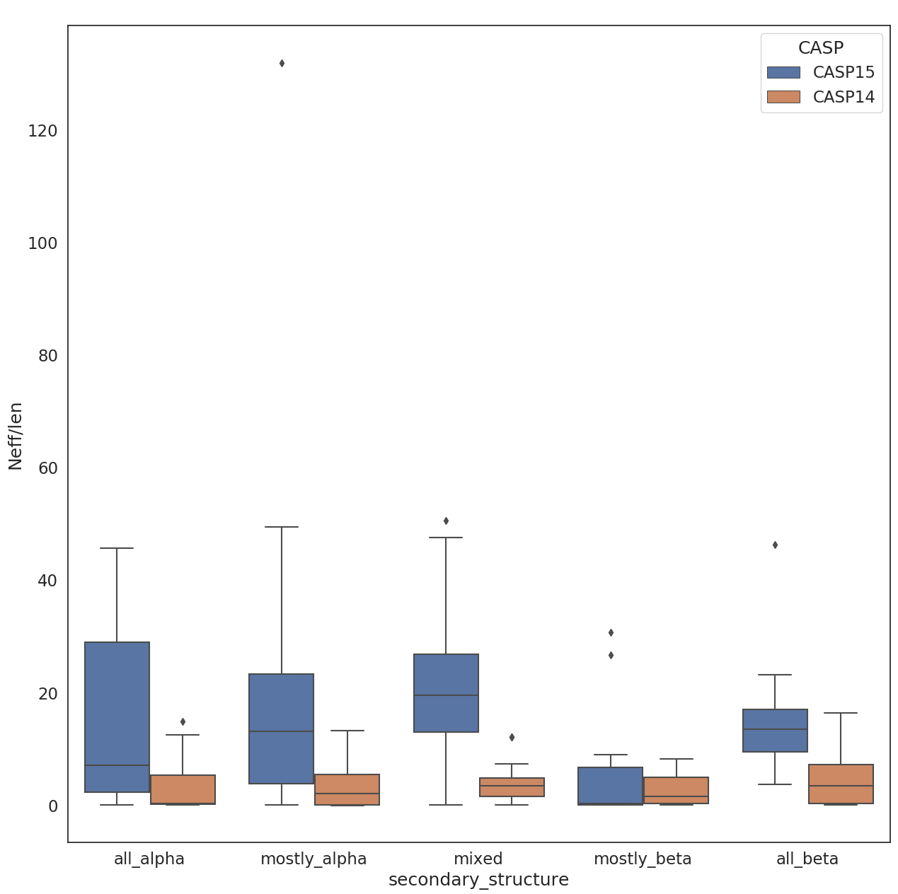
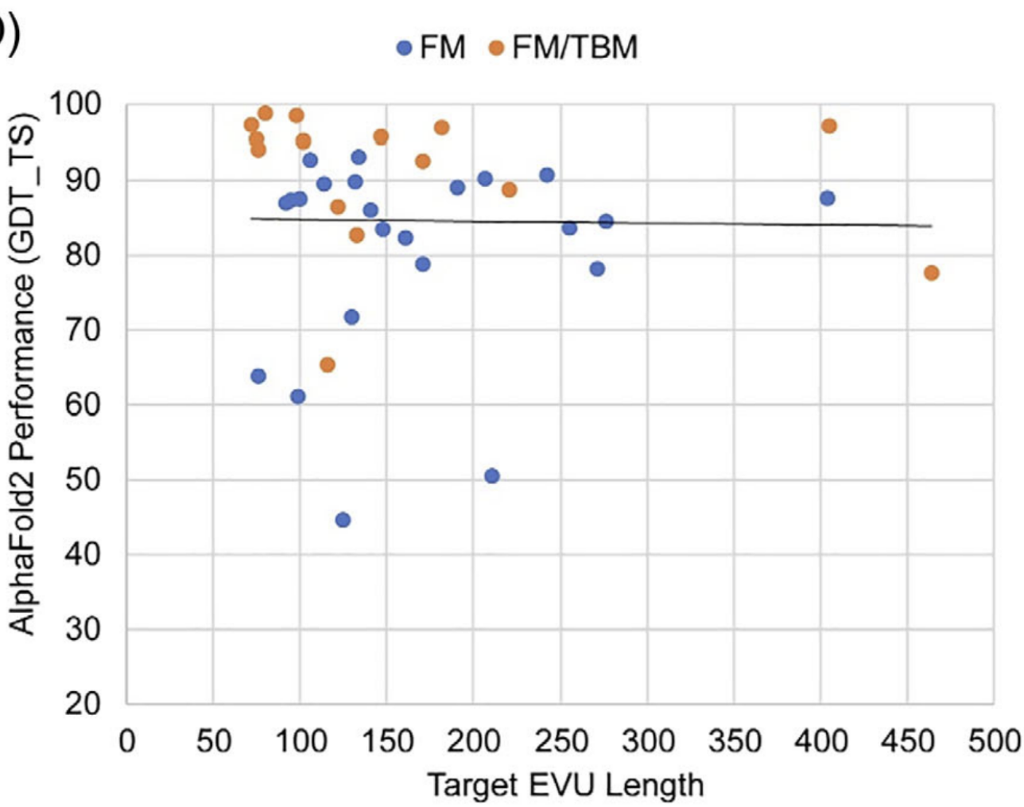

Neff/len has improved, as expected, but singletons remain
Secondary structure mix same. Maybe more hetero-oligomers, otherwise same quaternary structure mix
7rej β
7d2o α
7bglA β
6uf2 α/β
Kinch et al., (2021)
At CASP14, hardest target was small but was mixed alpha/beta and was significantly better predicted than the hardest targets here
Not really: answer may simply be that among the larger proportion of FM targets at CASP15 there are a number that combine these complicating factors

Slide 30
Performance of different kinds of methods and self-assessment

Slide 31


PCA analysis of groups based on the heatmap: top groups cluster
NBIS-af2-multimer
NBIS-af2-standard
colabfold-human
colabfold

Slide 32


Non-AF2 groups in the top cluster
pLM groups outside the top cluster
BAKER
UNRES
ESM-single-sequence
EMBER3D

Slide 33



Which targets do pLM methods perform well on?
ESM-single-sequence top S_{CASP15} models: T1104-D1, T1122-D1, T1155-D1 and T1195-D1
T1104-D1
FM
GDT_TS 97 (best 97)
T1122-D1
FM
GDT_TS 34 (best 39)
T1155-D1
FM/TBM
GDT_TS 70
(best 73)

Slide 34

Do language methods have an advantage with low Neff targets?
pLM wins here but all models poor
There are a few cases where pLM wins, but no clustering on the right
Seems to be a tendency for pLM to follow suit if MSA methods struggle
MSA-pLM gap seems to widen to the right, if anything
High Neff/length Low

Slide 35


How well do predictors assess their own predictions?
PCC (model quality i.e. S_{CASP15} vs model number) for groups trying at least 50% of targets. Very weak correlations and balance only slightly positive
% of times model_1 is the best. Only two thirds of groups marginally above random

Slide 36





*ESMfold often only submitted 1 model

Slide 37


How well to predictors assess their own predictions?
 | CASP15 | Top CASP15 groups in terms of Z_ASE | Z_ASE ranking (* denotes server)
1 | PEZYFoldings | 7 | MUFold*
2 | UM-TBM | 15 | GuijunLab- DEEPDA*
3 | Yang-server | 71 | colabfold*
4 | Yang | 72 | MUFold-H
5 | DFolding | 52 | colabfold-human
6 | McGuffin | 69 | GuijunLab- Threader*
7 | MULTICOM | 48 | PEZYFoldings
8 | MULTICOM_ refine | 35 | GuijunLab-Meta*
9 | MULTICOM_ human | 44 | NBIS-af2-standard*
10 | MULTICOM_ egnn | 30 | hFold_human
zASE still assessed at residue level
Servers dominate

Slide 38
Are interfaces still a problem?

Slide 39

Are local errors still predominantly found at interfaces? Residue analysis
Looked at selected method model_1s with GDT_TS>=80. Residues have at least 3 <10Å Cα-Cα contacts.
Residue count for each category across all groups
Other 48842
Crystal lattice 4394
Chain interface 3549
Domain interface 124
For all methods, crystal lattice residues have much higher LGA values by two sample t-test. In fact most interfaces are significantly different (not PEZY and UNRES Chain), albeit not so obviously.
ESM-single-seq may have a particular issue with chain interfaces

Slide 40

Are local errors still predominantly found at interfaces? ‘Error’ analysis
Totals 39 45 50 55 98 67
“Residues are in contact when their C-alpha are within 10Å. An ‘error’ is defined as a range of at least 3 residues with a rolling LGA of at least 3Å. An error is flagged as being in "contact" when the rolling average number of contacts for the involved residues is 0.5 (average is calculated using all contacts, so symmetry mates, domain and chain contacts).”
Numbers too small to do reliable errors/target comparison of crystal vs cryoEM. Suspect complications of cryo maps (eg local resolution << overall) compensate lattice issue

Slide 41

Examples T1196TS278_1
Experimental structure Prediction
Error region in prediction Symmetry mate

Slide 42

High B-factor regions are also harder, as expected
Residues from selected method model_1s with GDT_TS >80 put in 10 equally sized bins

Slide 43
Side chains

Slide 44


How well are side chains predicted?
Average Absolute Accuracy (AAA) from SCWRL4
In best case only get 80% correct, but some side chains do not have a single conformation
Easier → Harder

Slide 45


Does side chain accuracy correlate with main chain accuracy?

Slide 46


Side chain accuracy vs main chain accuracy for MSA/pLM groups
model_1 to model_5
model_1

Slide 47


Has side chain prediction quality improved since last CASP?

Slide 48
Models for MR

Slide 49
Molecular Replacement
How good are the models for MR?
Can try to predict this with reLLG, that requires only coordinates. Atomic error estimates feed into this calculation. (Not all groups put sensible numbers in B-factor column)
Can assess actual LLG from ideal positioning.
Can do actual MR with models to see if they can be placed i.e. whether packing clashes from inaccurate regions hamper
Can try automatic domain splitting on more complex targets

Slide 50


For many targets, most models are good enough if ideally placed

Slide 51

Similarly by actual MR typically, but….

Slide 52

… sometimes method choice and editing are important
Here, the trimming is essential for a clear solution
These two methods fail with this target while…

Slide 53


T1145 (model 1) - SliceNDice
Notes:
2 copies (P212121, 2.2 Angs)
Different conformation for second copy

Slide 54




Automatic editing with Slice’N’Dice is sometimes essential
ESM-Single-Sequence Prediction
Processing with Slice’N’Dice
Automated X-ray
structure solution
T1145: Prediction (blue) aligned to target structure (white) on largest domain
4-way Birch split of prediction
Truncation to residues with a pLDDT > 70
pLDDT converted to B-factor
Slice’N’Dice places 7 of the 8 domain models (2 copies of target in asymmetric unit of crystal) using Phaser (LLG=755 TFZ=16.1)
Automated model building with Modelcraft brings model close to completion (R/Rfree 0.26/0.3)
(Domains aligned for comparison with target)
2 copies (P212121, 2.2 Angstroms)

Slide 55

Comparison across targets for full MR runs

Slide 56

Simple scoring based on LLG ranking overall for placed model_1 after pLDDT-based trimming
B11L group top. No Abstract

Slide 57
Cryo-EM

Slide 58
How well can models be placed into cryoEM maps
Wanted to assess models’ usefulness for placing into cryoEM maps
Placed whole model_1 and CASP-defined AUs into available maps (11). Ranking on AUs only.
Calculated rmsds using supplied reference structures, but subtracted rmsd error of the model for scoring
Mapped score against various parameters, and used machine learning to objectively select the most informative about usefulness
Ranked groups by usefulness of their models

Slide 59


T1157s1-D1
Group | Raw RMSD | Fitting Score
140 | 29.97 | 17.91
Group | Raw RMSD | Fitting Score
447 | 28.77 | 2.039

Slide 60


RMSD example distributions
T1165 AUs into full map
T1169 AUs into segmented map
2Å rms threshold for success comes from balanced specificity/sensitivity in logistic regression model

Slide 61

Familiar groups at top end. BAKER top

Slide 62



Automatic editing with Slice’N’Dice using EM-Maps
Single-Sequence Prediction
Processing with Slice’N’Dice
Automated Rigid Body Map fitting
T1154: Prediction (blue) aligned to map (white)
4-way Birch split of prediction
Slice’N’Dice places 3 of the 4 domain models using Molrep

Slide 63
Conclusions
No single stand-out this time
Many groups do very well, with AF2-based methods predominating
Servers clearly better represented at top end. Human groups in ‘pairs’ have no consistent advantage
pLM methods not yet as good in prediction accuracy, but this area is younger and the extreme speed of some will open up new possibilities
Many methods, including pLM, solve most crystal structures and are useful for cryoEM fitting. Established methods for processing models sometimes required and usually helpful

