Slide 1
Special Interest Group Discussion: Multiple Conformational Modeling in CASP
G.T. Montelione
CASP15
Antalya, Turkey
Dec 11, 2022

Slide 2
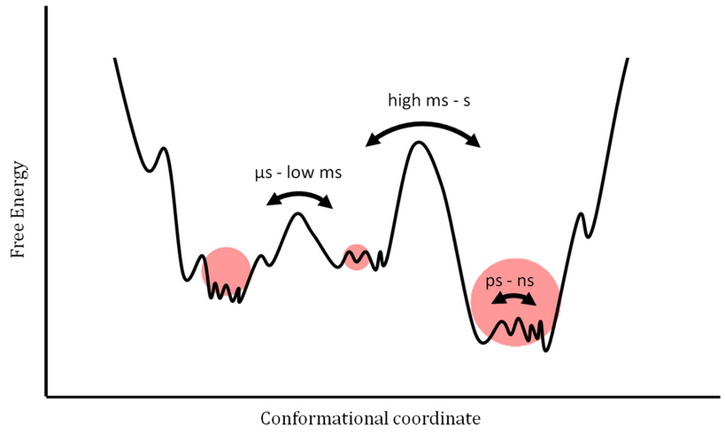
Protein Dynamics
Protein Structures Sample a Conformational Landscape
www.mdpi.com

Slide 3
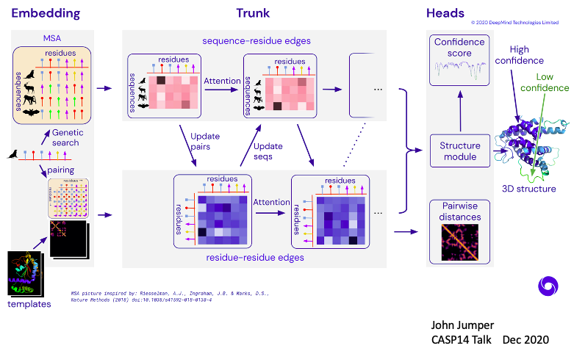
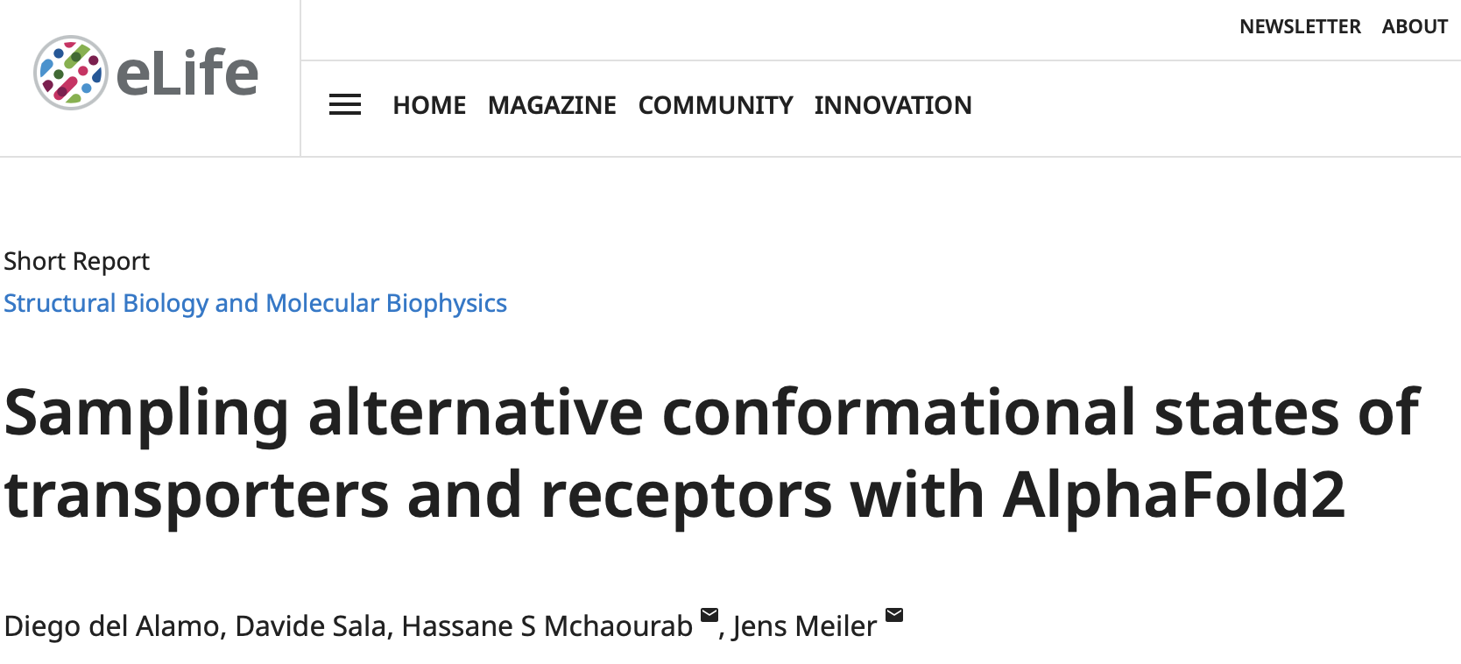
Exploring AlphaFold to Predict
Multiple Conformational States
attention-based machine learning
Use shallow MSAs to provide subsets of ECs
Jumper et al 2021
BioRxiv 2022

Slide 4
Ground Truth Data
X-ray Crystallography
Can see alternative conformations in different crystal forms
Multiple conformations in asymmetric unit
Can sometimes fit density to multiple conformations
Do crystal lattice interactions shift conformational distributions; e.g. stabilize low populated states
CryoEM
Can generate multiple models from cryoEM data
Need a lot of data
Effects of freezing?
NMR
Chemical shift, NOEs, RDCs, Paramagnetic effects
Particularly sensitive to motions
Limited in size (< 50 kDa)
Exchange broadening can make peaks “disappear”
Fluorescence Energy Transfer, Chemical Cross Linking; Small Angle X-ray scattering

Slide 5
Assessment
How do we get data for Ensembles / Alternative Conformations?
Is it better to assess against models, or against data?
Poster #2: Comparative Recall (CR) Analysis for Assessment of Protein Structure Models Against Experimental NMR Data: Characterizing Multiple Conformational States. YP Huang, TA Ramelot, L Spaman, R. Tejero, GT Montelione
Relative Populations

Slide 6
Ideas for Combined Disorder / Ensemble CASP SIG
Monthly zoom meeting integrating advances in modeling alternative conformational states (ML, MD) with discussions of experimental methods for generating ground truth data
Subgroup to explore generation of Ground Truth Data and Methods for Assessing disorder predictions and multiple conformational modeling
White paper on Disorder and Ensembles in CASP
Initial 1-page draft to share with broader community
Connect with other efforts: ML⁴NMG, Int Soc for HDX-MS, others
Develop into more complete White Paper -> Publication

