Slide 1

Advancing solutions to the Potein Folding Problem
Advancing solutions to the Protein Folding Problem
Rigor
Transparency
Communication
Collaboration
CASP15
Critical Assessment of Structure Prediction
Notes:
Schematic from Fabio Pietrucci (online

Slide 2
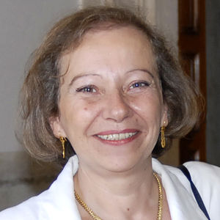
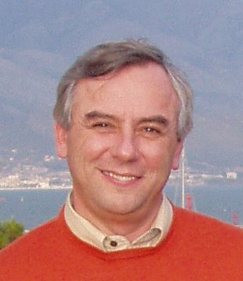
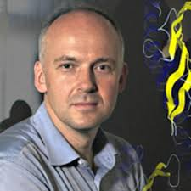

Founders and Organizers
Anna Tramontano
Krzysztof Fidelis
Andriy Kryshtafovych
Torsten Schwede
Maya Topf
Jan Pedersen
Tim Hubbard
Steve Bryant
Burkhard Rost

Slide 3
PAST CASP ASSESSORS
Mike James, Shoshana Wodak, Fred Cohen, Janet Thornton, Michael Levitt, Alwyn Jones, Alexey Murzin, Christine Orengo, Arthur Lesk, Anna Tramontano, Manfred Sippl,, Nick Grishin, Rob Russell, Alfonso Valencia, Roland Dunbrack, BK Lee, Neil Clark, Torsten Schwede, Randy Read, Mike Tress, Jane Richardson, Joel Sussman, Ken Dill, Justin MacCallum, Guy Montellone, David Jones, Alexandre Bonvin, Matteo Dal Peraro, Francesco Gervasio, Aleix Lafita, Russ Altman, Jose Duarte, Andras Fiser, Susan Tsutakawa, Chaok Seok, Ezgi Karaca, Andrei Lupas, Daniel Rigden, Sandor Vajda.

Slide 4
CASP14 categories
Protein Topology
High accuracy modeling
Protein assemblies
Refinement
Contact prediction
Data assisted modeling
Accuracy estimation
Function – what is the model good for?
Threading
Secondary structure
Disorder

Slide 5
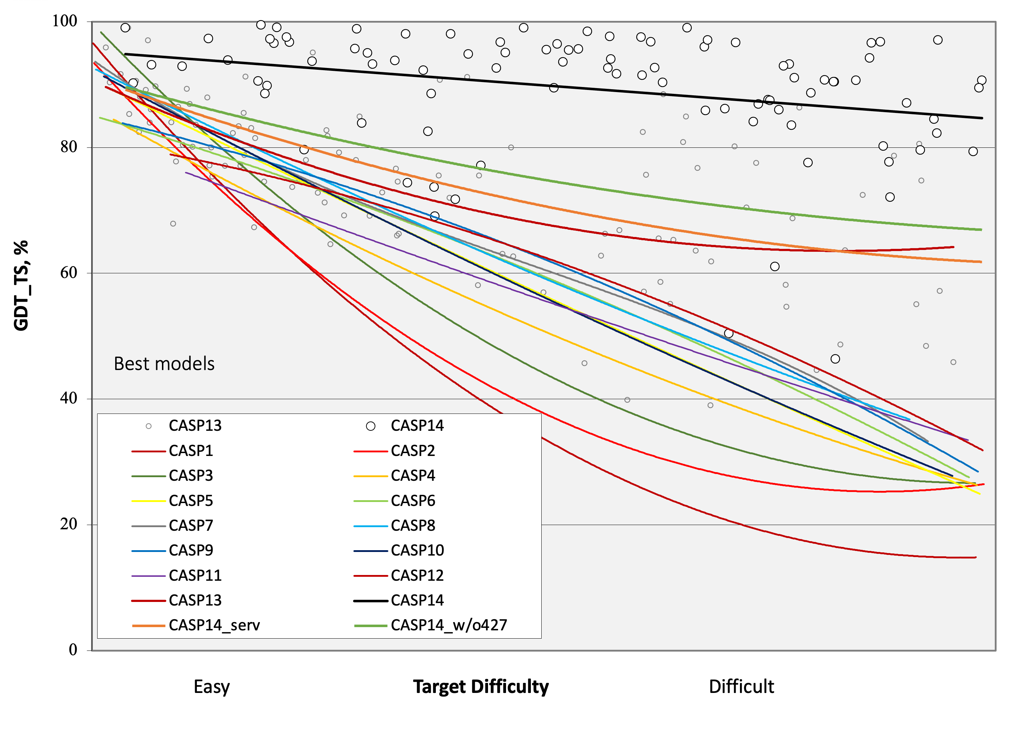

Slide 6
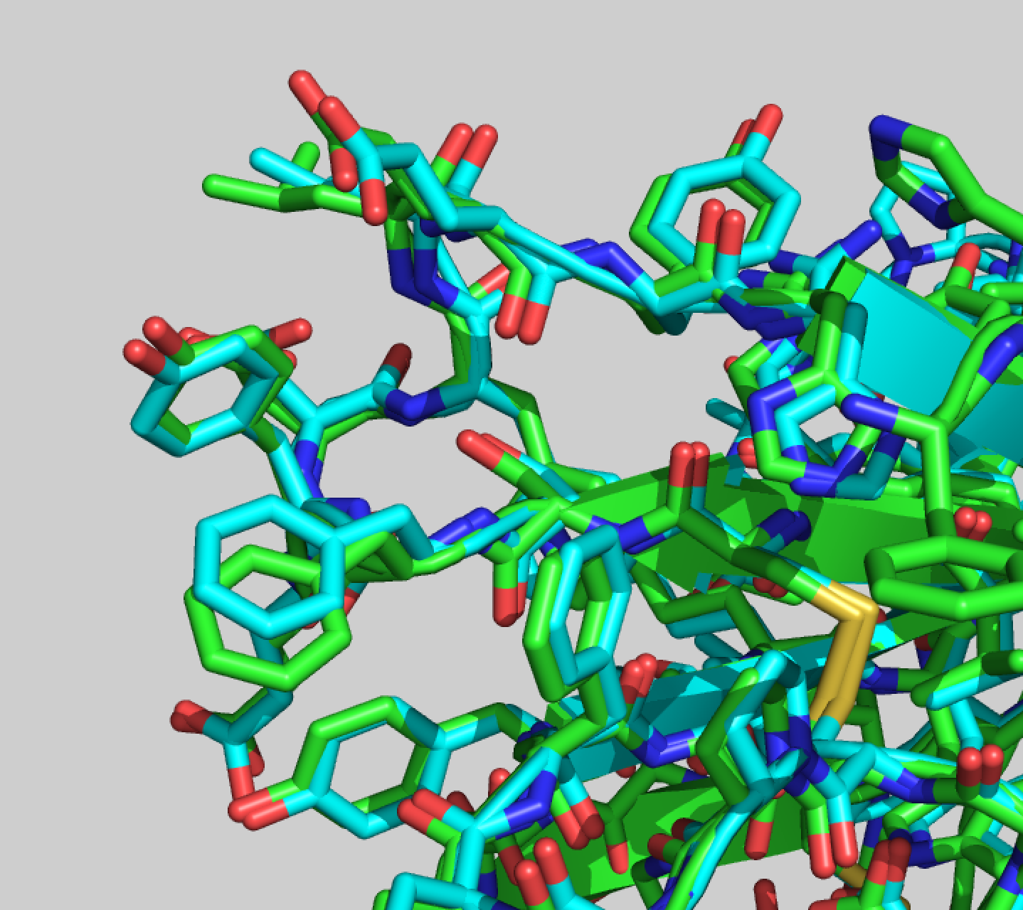
Notes:
Orf8 side chains

Slide 7
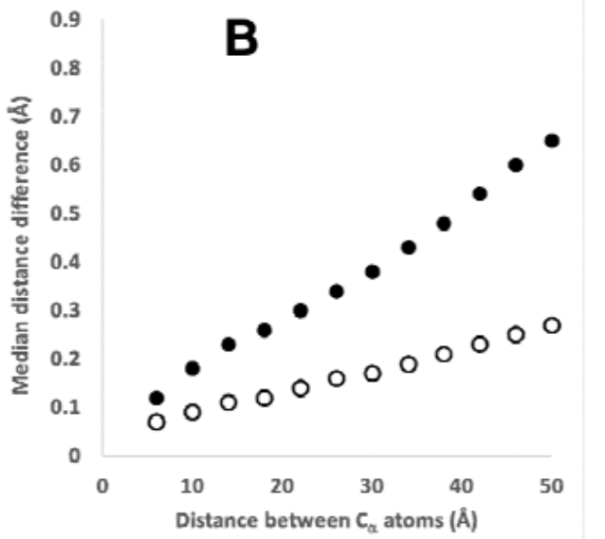
AlphaFold predictions: great hypotheses but no match for experiment Terwilliger et al

Slide 8
CASP14 categories
Protein Topology
High accuracy modeling
Protein assemblies
Refinement
Contact prediction
Data assisted modeling
Accuracy estimation
Function – what is the model good for?
Threading
Secondary structure
Disorder

Slide 9
CASP15 categories
Protein Tertiary structure
Protein assemblies (with CAPRI)
RNA structure (with RNA Puzzles)
Protein/Ligand complexes
Ensembles
Accuracy estimation

Slide 10
Advancing solutions to the Potein Folding Problem
Advancing solutions to the Protein Folding Problem
Rigor
Transparency
Communication
Collaboration
Advancing solutions in Computational Structural Biology
CASP15
Critical Assessment of Structure Prediction
Notes:
Schematic from Fabio Pietrucci (online

Slide 11
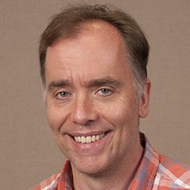
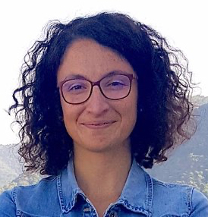
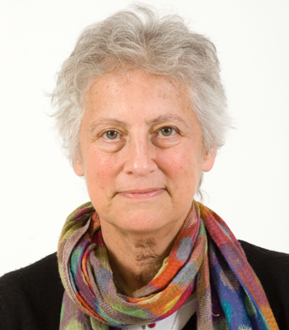
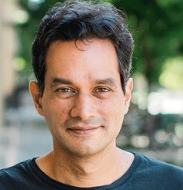
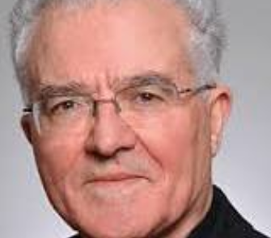
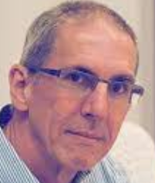
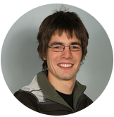
CASP15 ASSESSORS
Protein tertiary structure Dan Rigden
Protein complexes (CASP) Ezgi Karaca
Protein complexes (CAPRI) Marc Lesink, Shoshana Wodak
RNA structure (CASP) Rhiju Das
RNA structure (RNA puzzles) Eric Westhof
Protein/Ligand complexes Pat Walters
Accuracy estimation Gabriel Studer

Slide 12
CASP15 CONFERENCE COMPONENTS
Assessment talks
Participant talks
Followup discussions
Poster sessions
SIG sessions
Participants meeting
Deep learning and structural biology
Antalya

Slide 13
Advancing solutions to the Potein Folding Problem
Advancing solutions in Computational Structural Biology
Rigor
Transparency
Communication
Collaboration
CASP15
Critical Assessment of Structure Prediction
Notes:
Schematic from Fabio Pietrucci (online

Slide 14
CASP15 SIGs
Disorder and ensembles
Protein Interactions
Ligand/protein complexes
RNA structure
AI methods

