Slide 1


Modeling ligand interactions in CASP
  Dima Kozakov
  Laufer Center for Physical and Quantitative Biology
  Stony Brook University

Slide 2
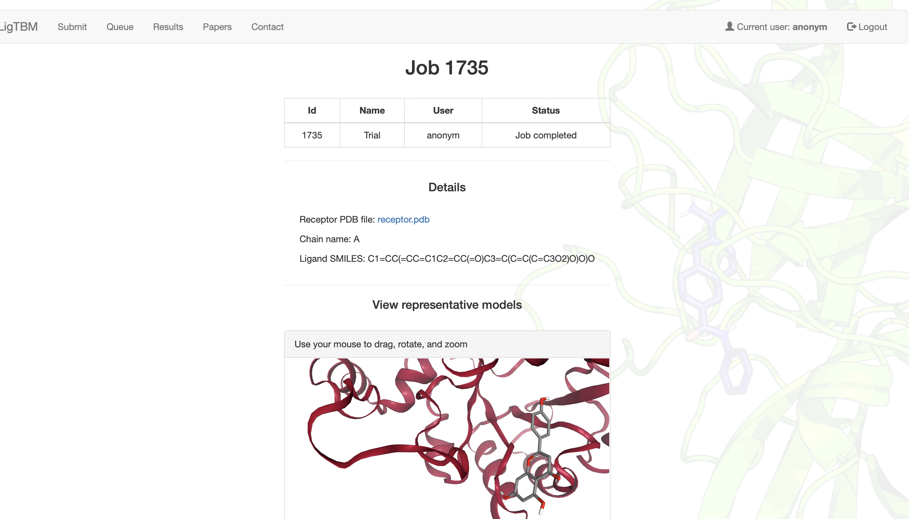
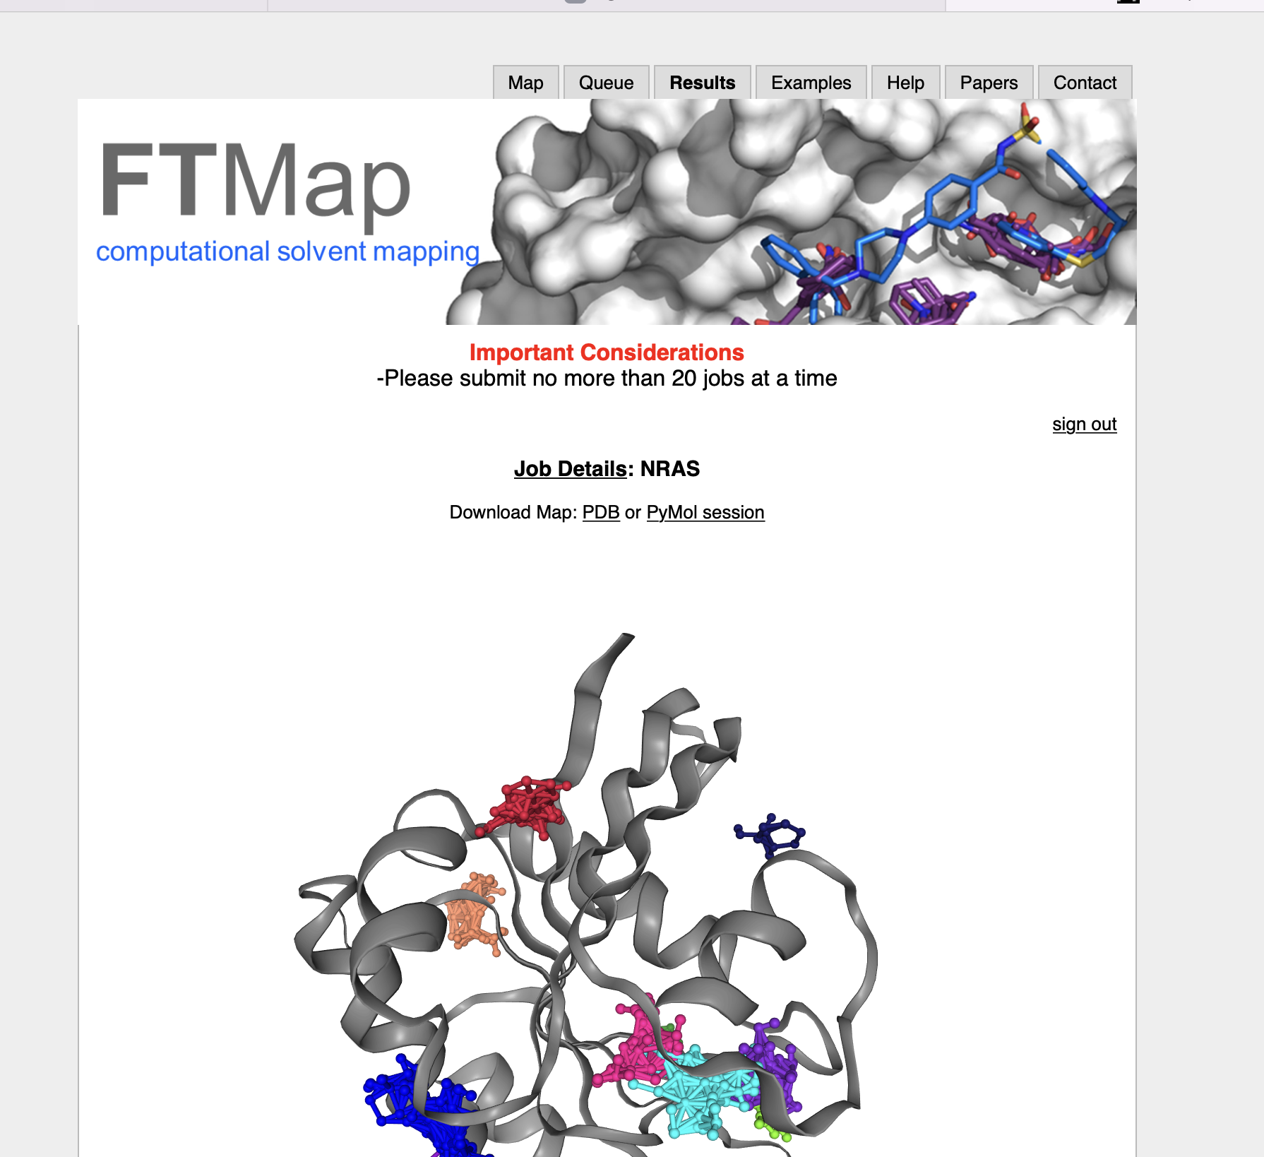
CASP ligand pipeline overview
ClusPro LigTBM
Docking
FTMap box
detection ->Glide> Density+Energy Filtering

Slide 3
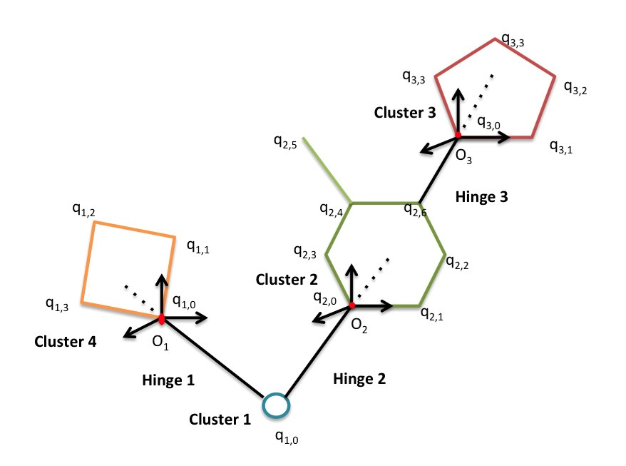
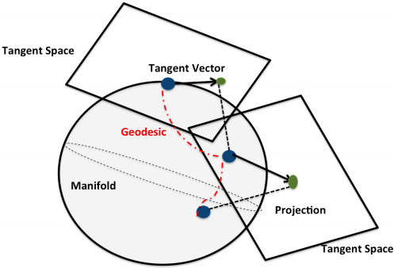
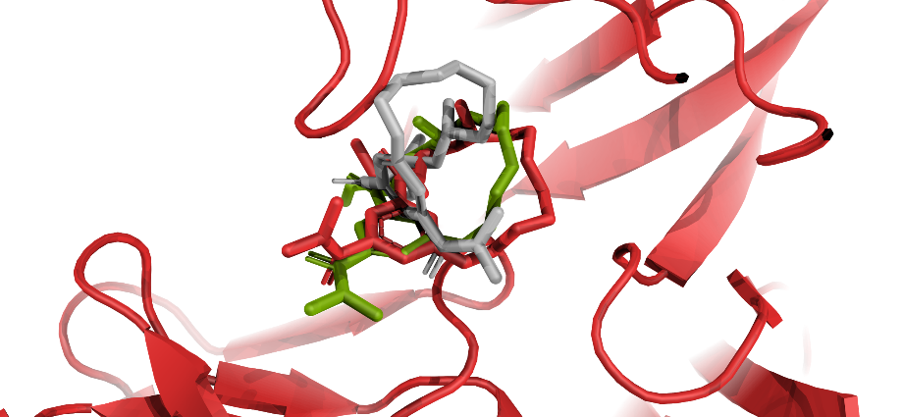
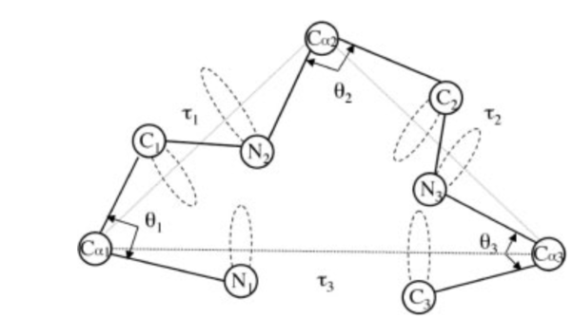
LigTBM- Steps
Exhaustive Conformational sampling ETKDG (RDKIT) and Brikard (Macrocycles)
Identify best multiple common substructure (MCS) for all templates.
Align conformers based on matched pairs, multiple ways
Perform restraint minimization using matched pairs , in presence of protein
Score based on combination of template similarity and energy (AMBER force-field
+ vina)
Coutsias et. al, Nature Methods, 2009; Coutsias et. al, JCTC, 2016;
Kotelnikov et.al 2019 JCIM; Alekseenko et. al 2020 JMB; Kotelnikov et. al in preparation
Notes:
The Maximum Common Substructure (MCS) was calculated between the target ligand and each of the remaining template ligands. For each target, two MCS were calculated using RDKit with different tolerance criteria: “weak” MCS (atoms and valences should be the same; allow chiral centers to be different; single and aromatic bonds should match each other) and “strict” MCS (allowances mentioned before are prohibited

Slide 4
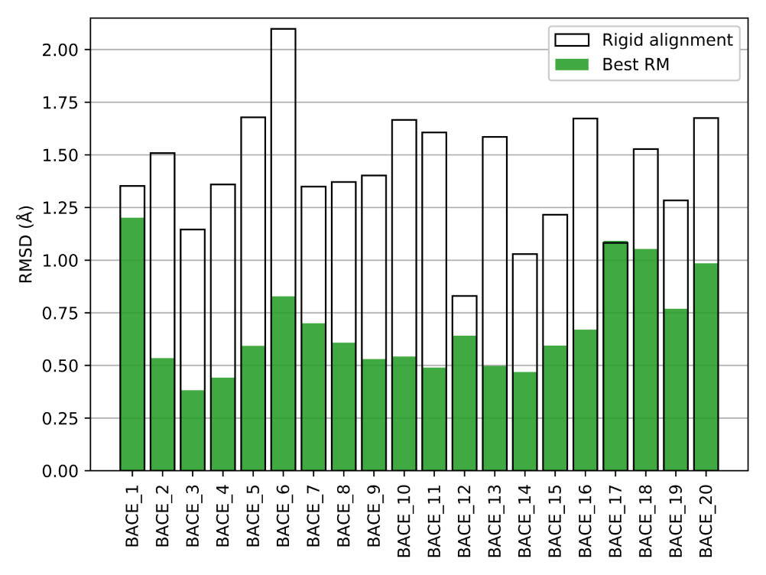
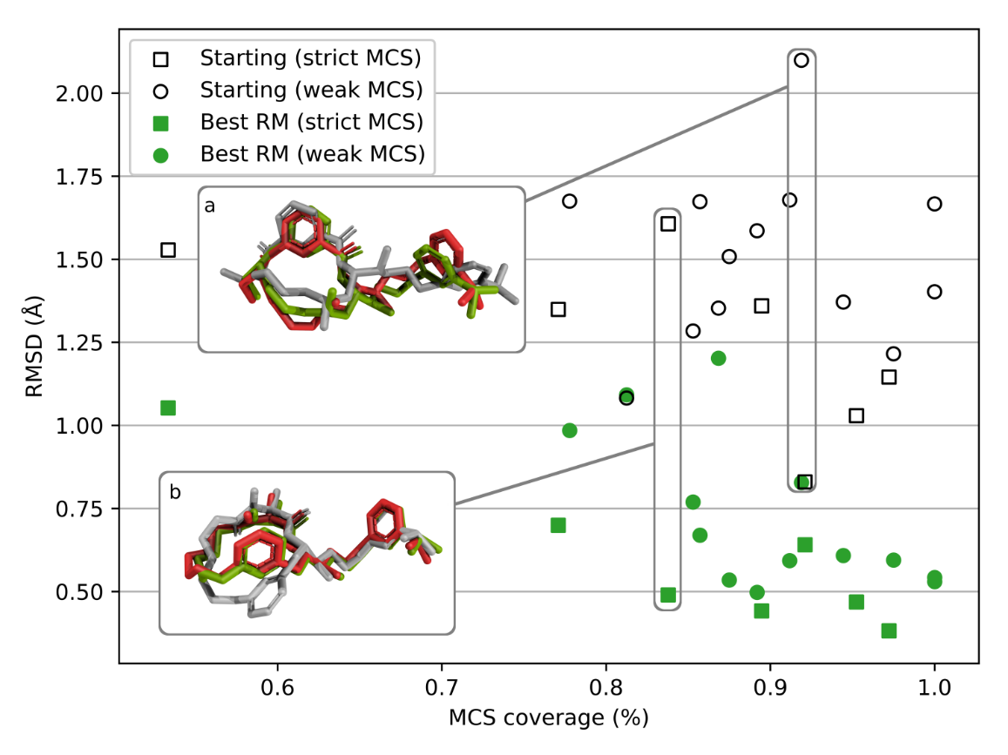
Effect of the steps of the protocol

Slide 5
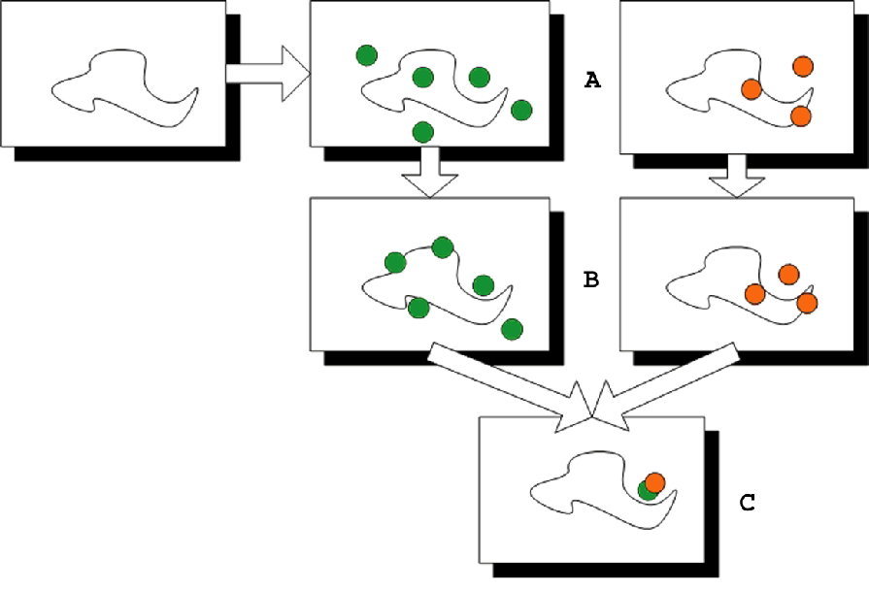
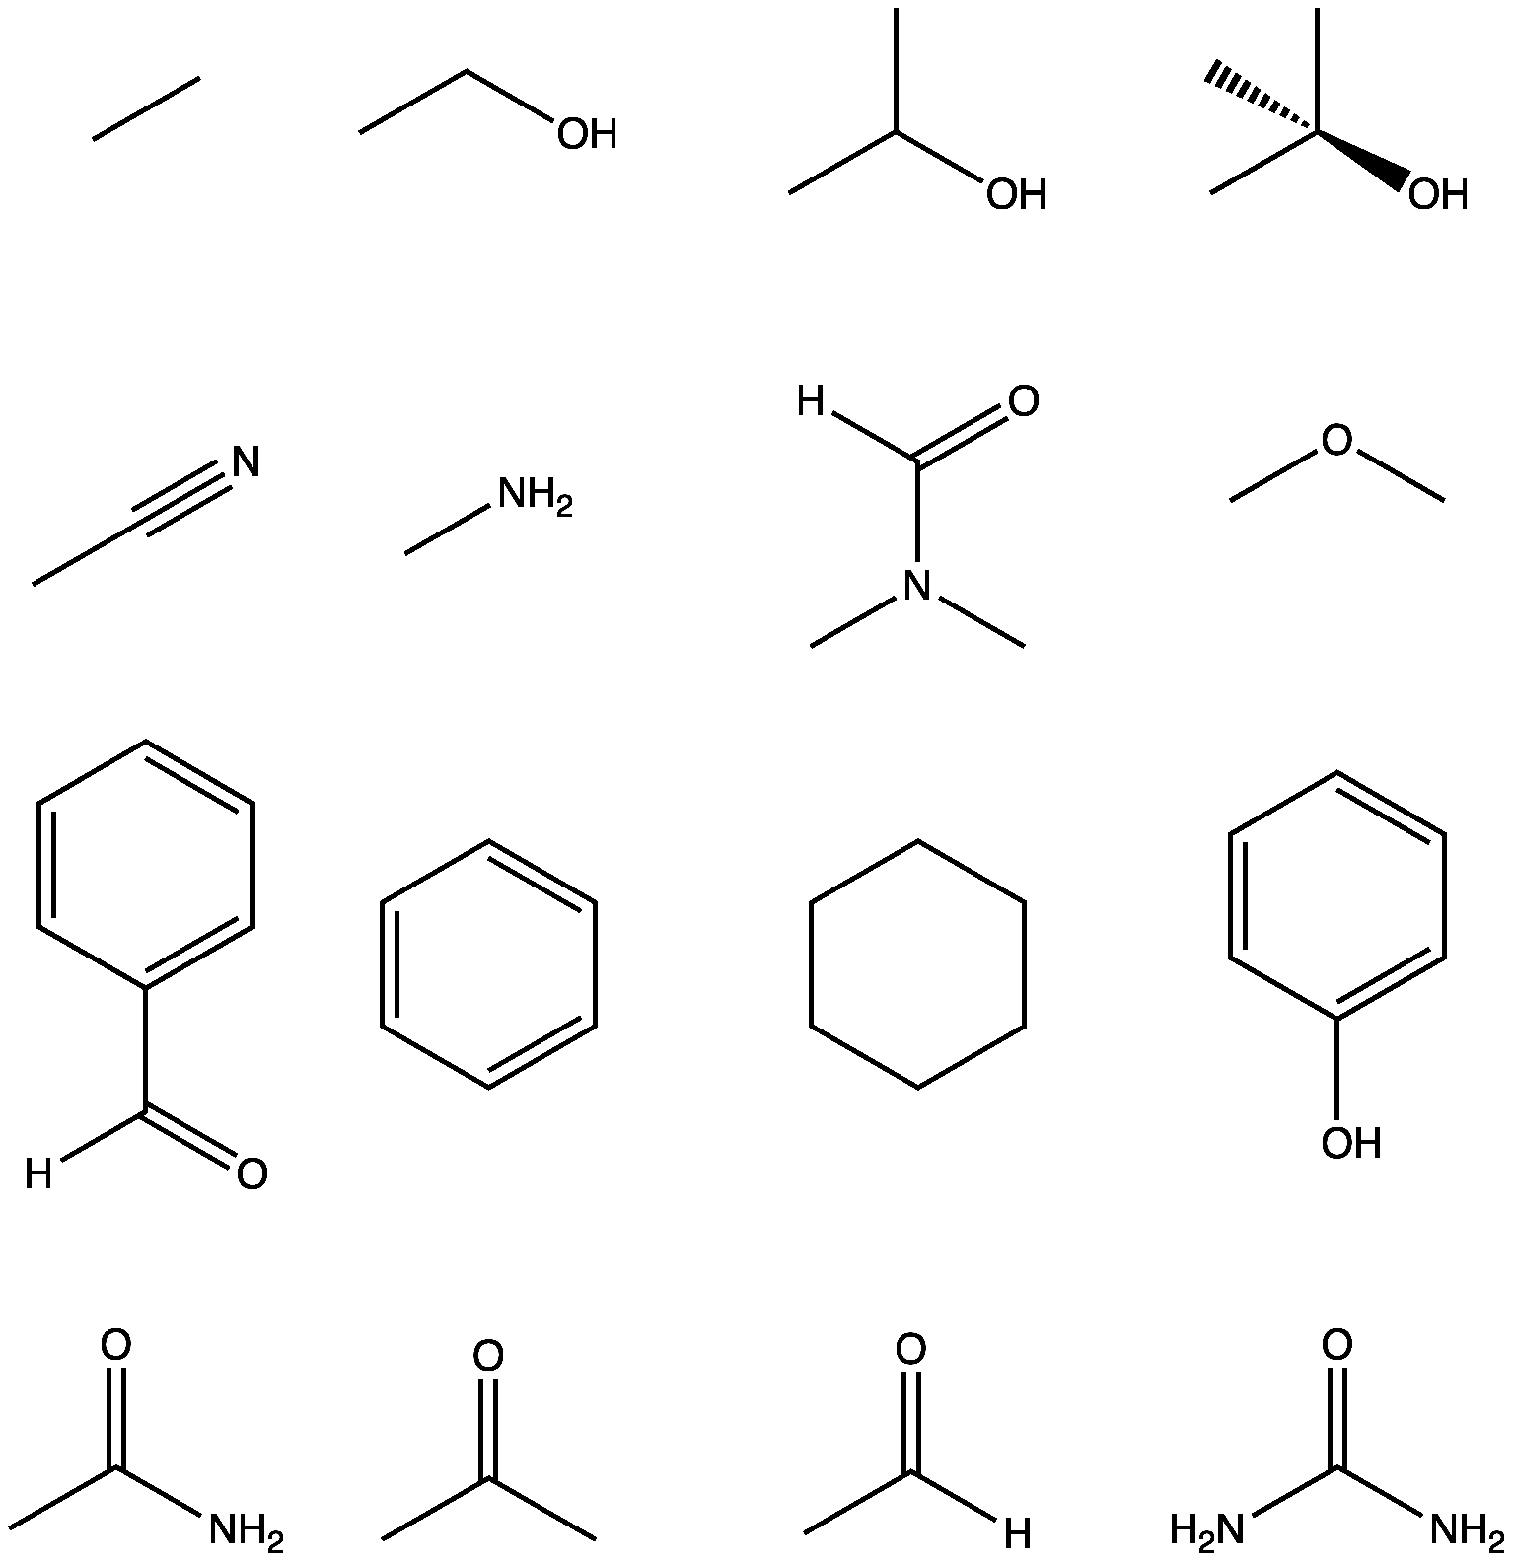
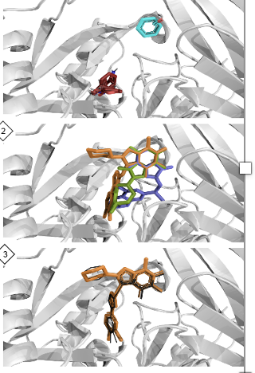
FTMap-> Docking-> Density+ Energy Filtering
Finding hot spots by computational mapping using FFT-based sampling
16 probe molecules
Poisson–Boltzmann potential precalculation
Global docking - FFT correlation approach
Minimization of best-scoring probe poses
Clustering of
Consensus cross-clustering
Find consensus sites:
regions with several probes binding
Kozakov, Dima, et al. "The FTMap family of web servers for determining and characterizing ligand-binding hot spots of proteins." Nature protocols 10.5 (2015): 733-755.

Slide 6
CASP experience
Proteins used: For ligand experiment we mostly used AF2 protein models.
For docking we used several most diverse ones from AlphaFold database

Slide 7
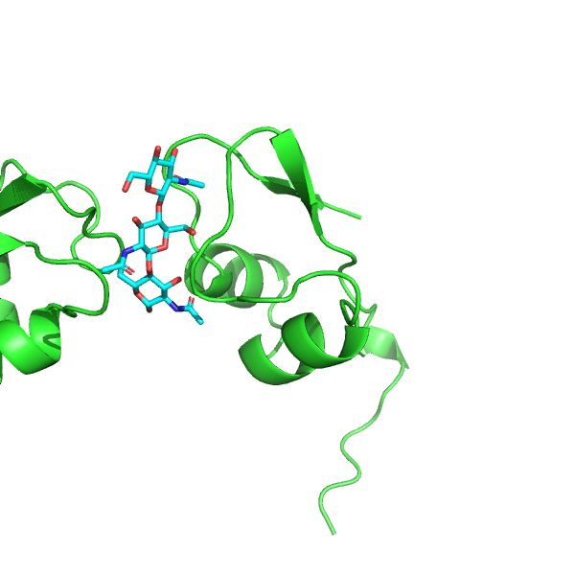
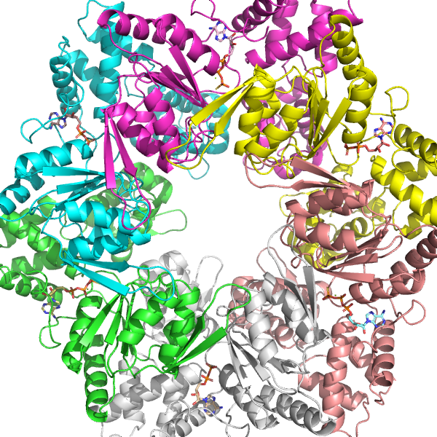
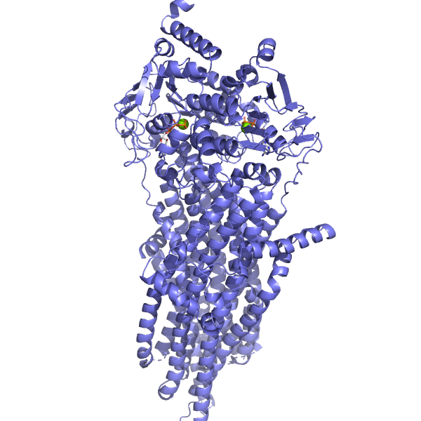
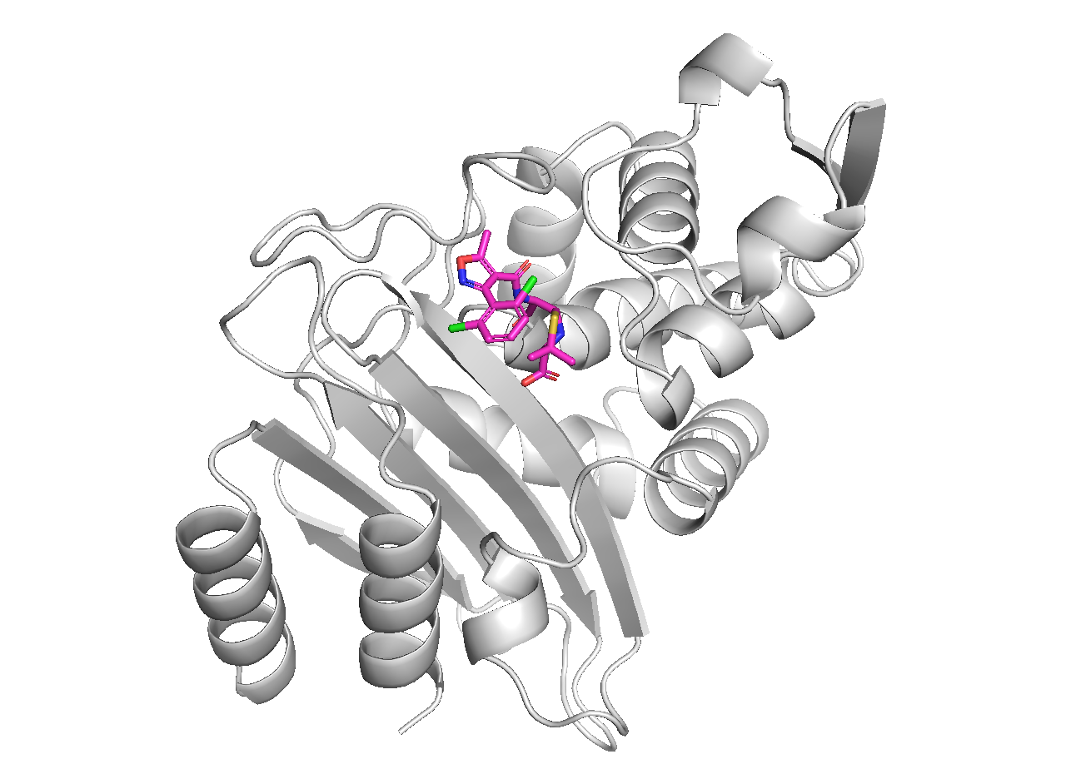
LigTBM – Things which went well
T1152 – was described as monomer
But ligand had to be modelled in presence
of another unit
T1170
T1168 – dicloxacillin
T1158 – closed state of the channel
Used AF model based on template structure

Slide 8
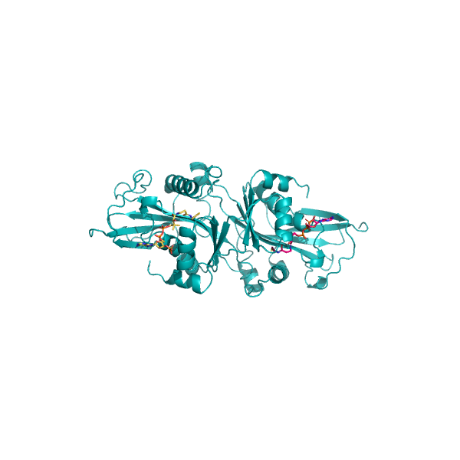
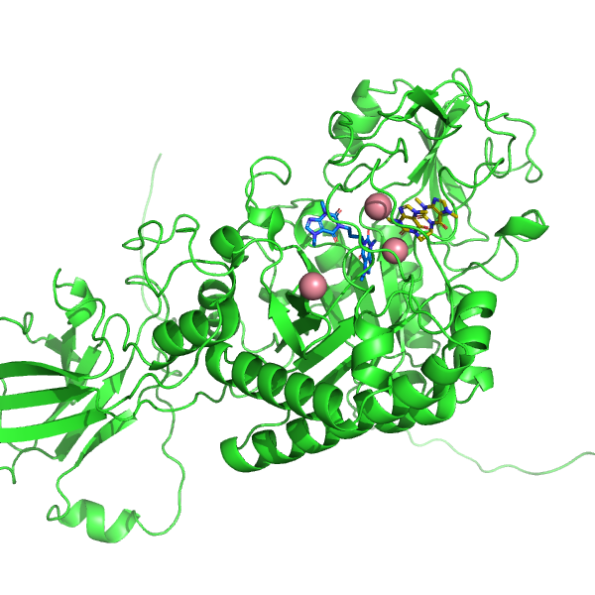
LigTBM – Things which weren’t so good
T1127 – tail of cofactor is off
wrong template
T1188 – protein conformation issue

Slide 9
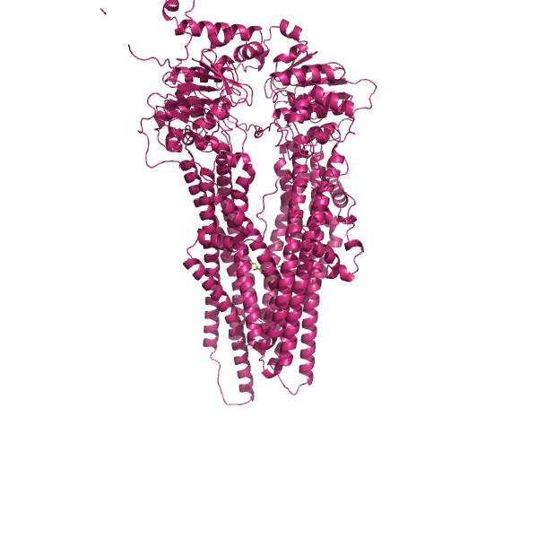
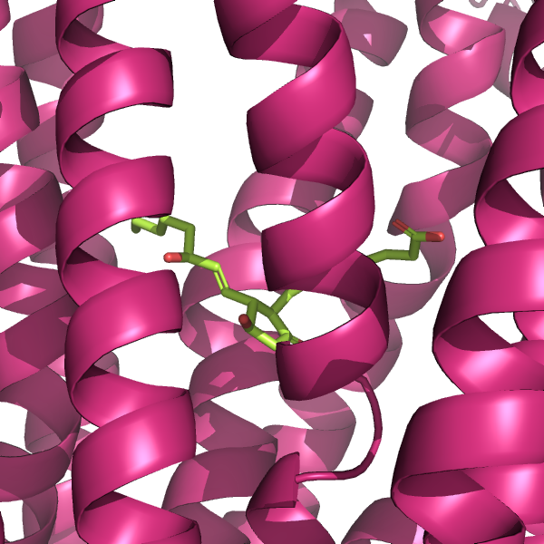
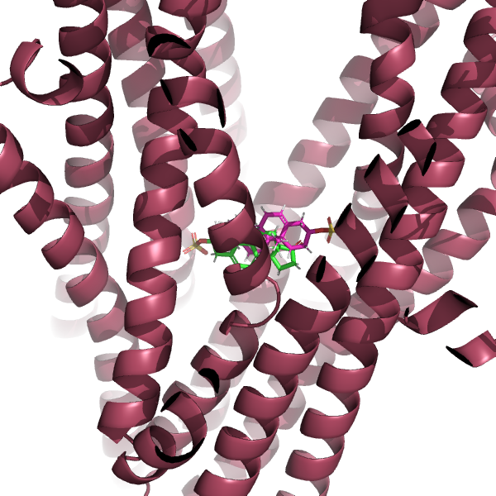
Docking – T1158
V1, V2 reasonably close
~2.3 RMSD and 2.9 RMSD
V3 symmetry flipped or shifted
~4A RMSD
Used combination of
most diverse default AF
Structures (1 and 5)

Slide 10
Summary
Most targets had good template, although some where challenging
AF structures can be used for docking

Slide 11

Credits
Collaborators
Dr. Vageli Coutsias
Dr.Alex. Tropsha (UNC)
Dr. Konstantin Popov (UNC)
Sergey Kotelnikov Dr. Andrey Alekseenko
Ignatov Mikhail
Dzmitry Padhorny
NIH, NSF

