Slide 1

AIchemy_LIG/LIG2
Transformer-based deep learning model for ligand pose prediction
Liangzhen ZHENG
Zelixir Biotech, Shanghai, China
yishan@zelixir.com

Slide 2
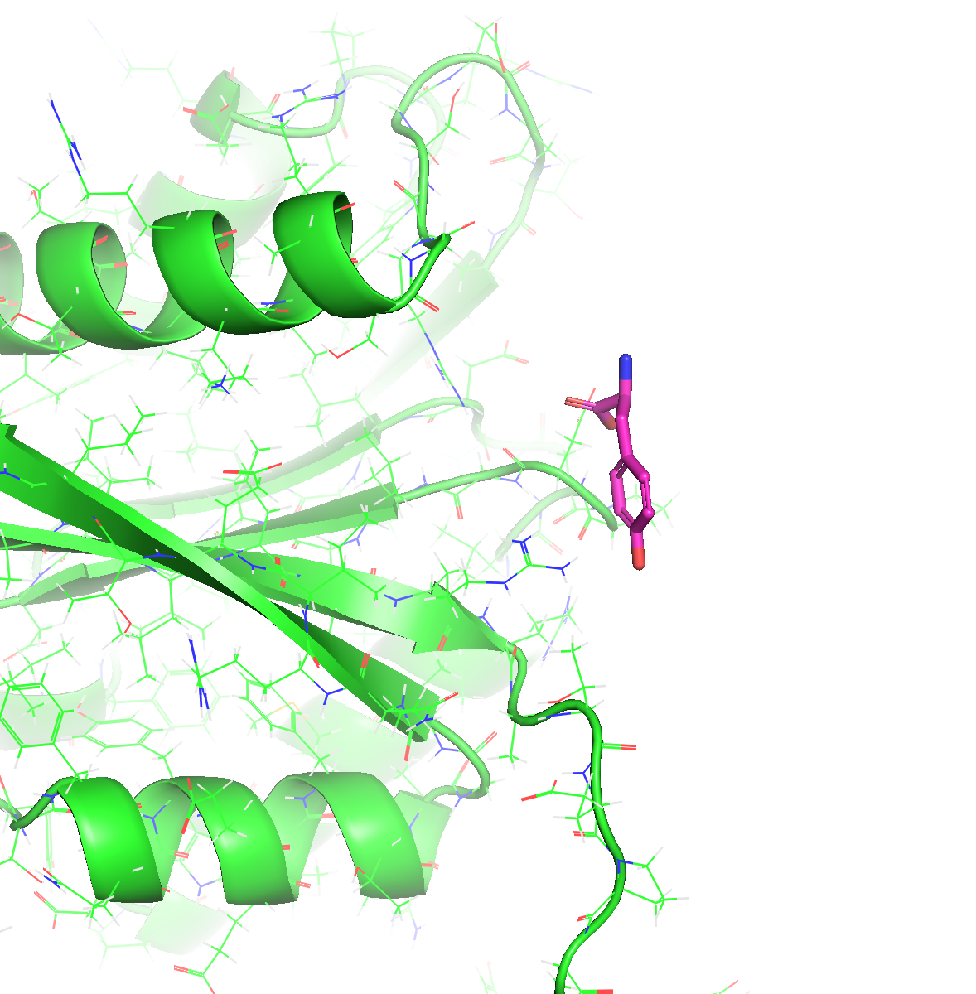
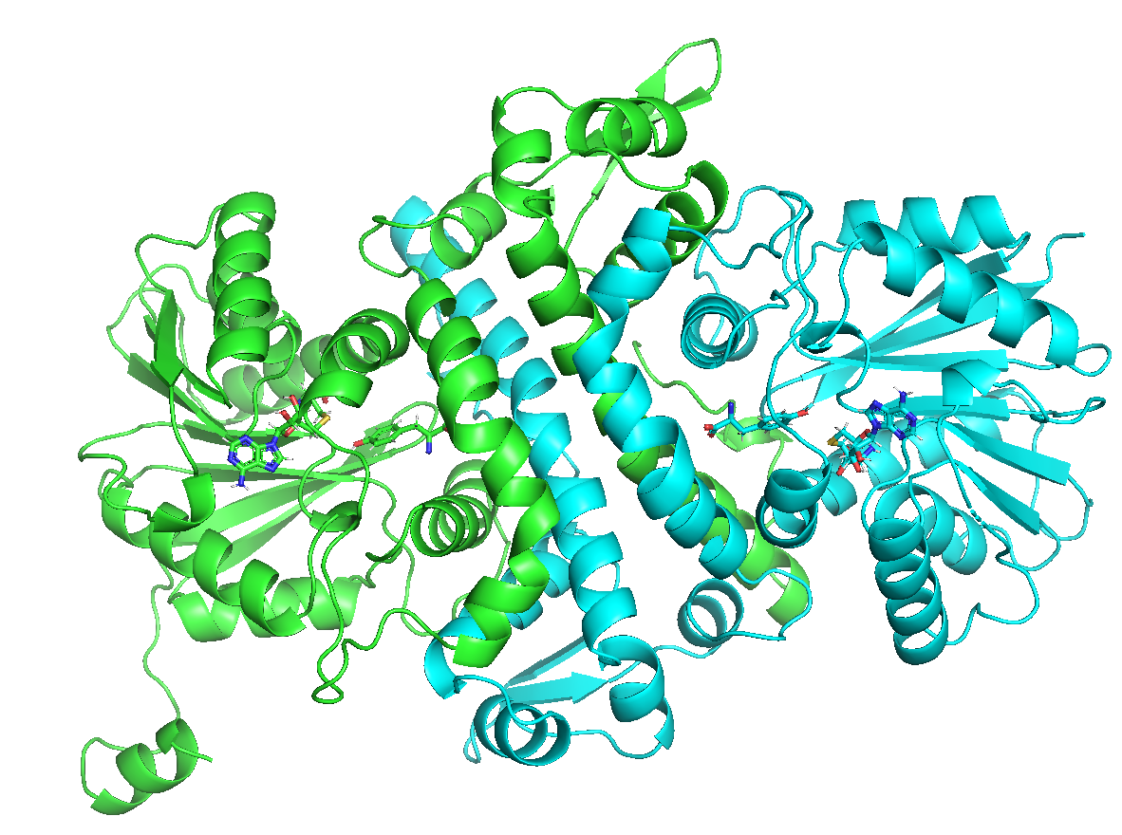
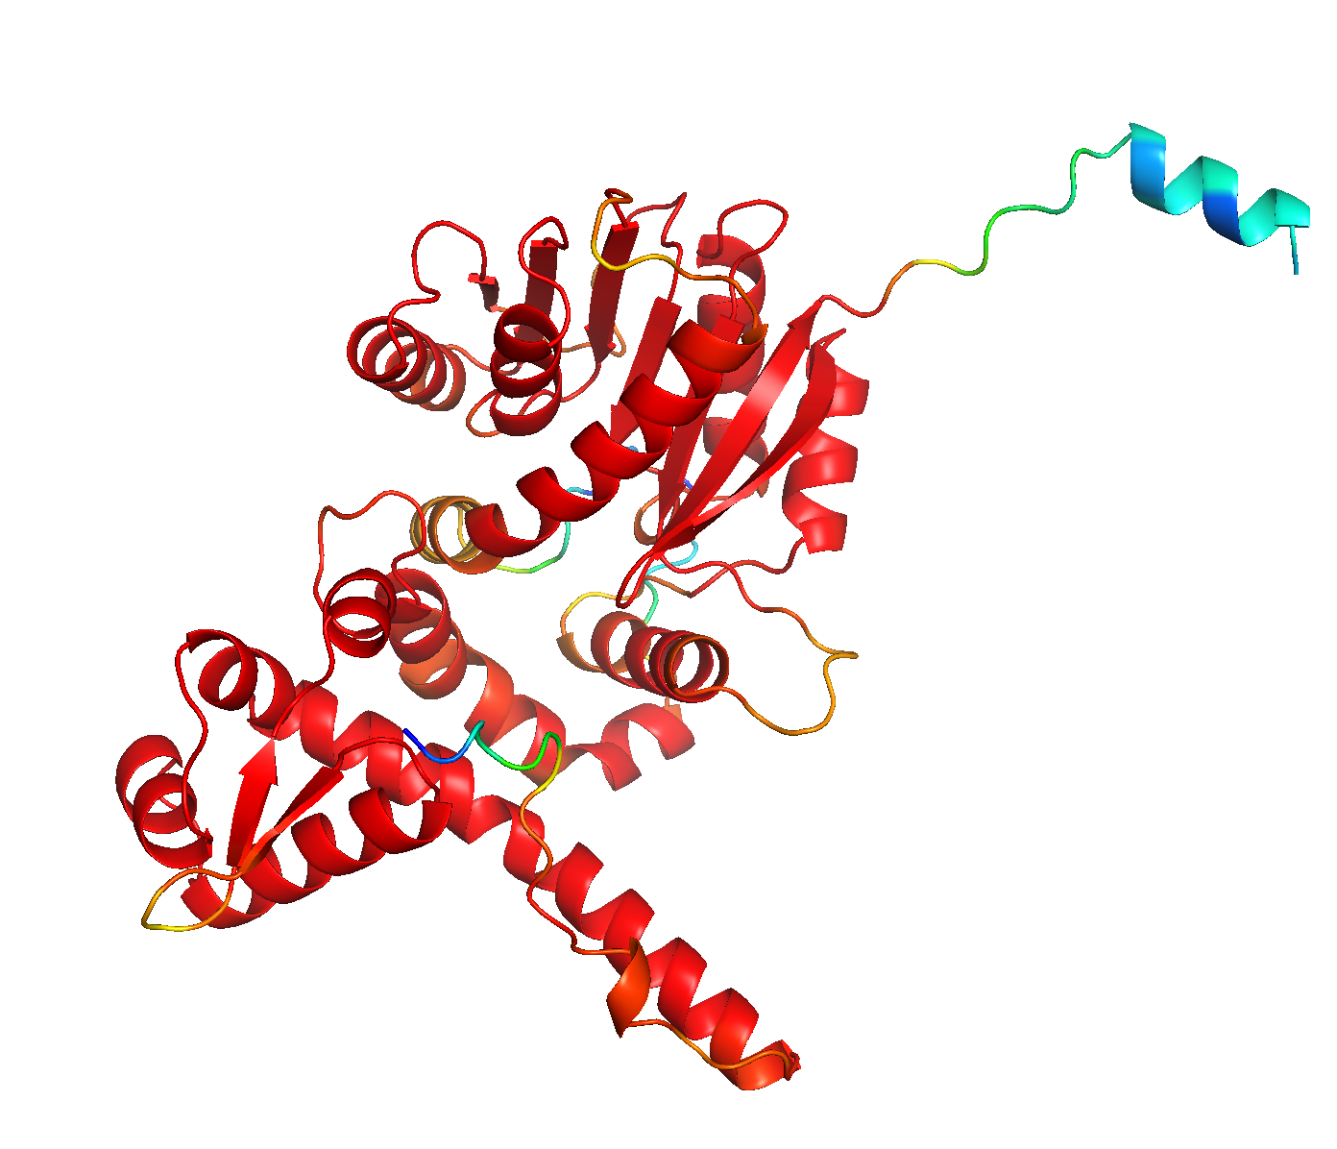

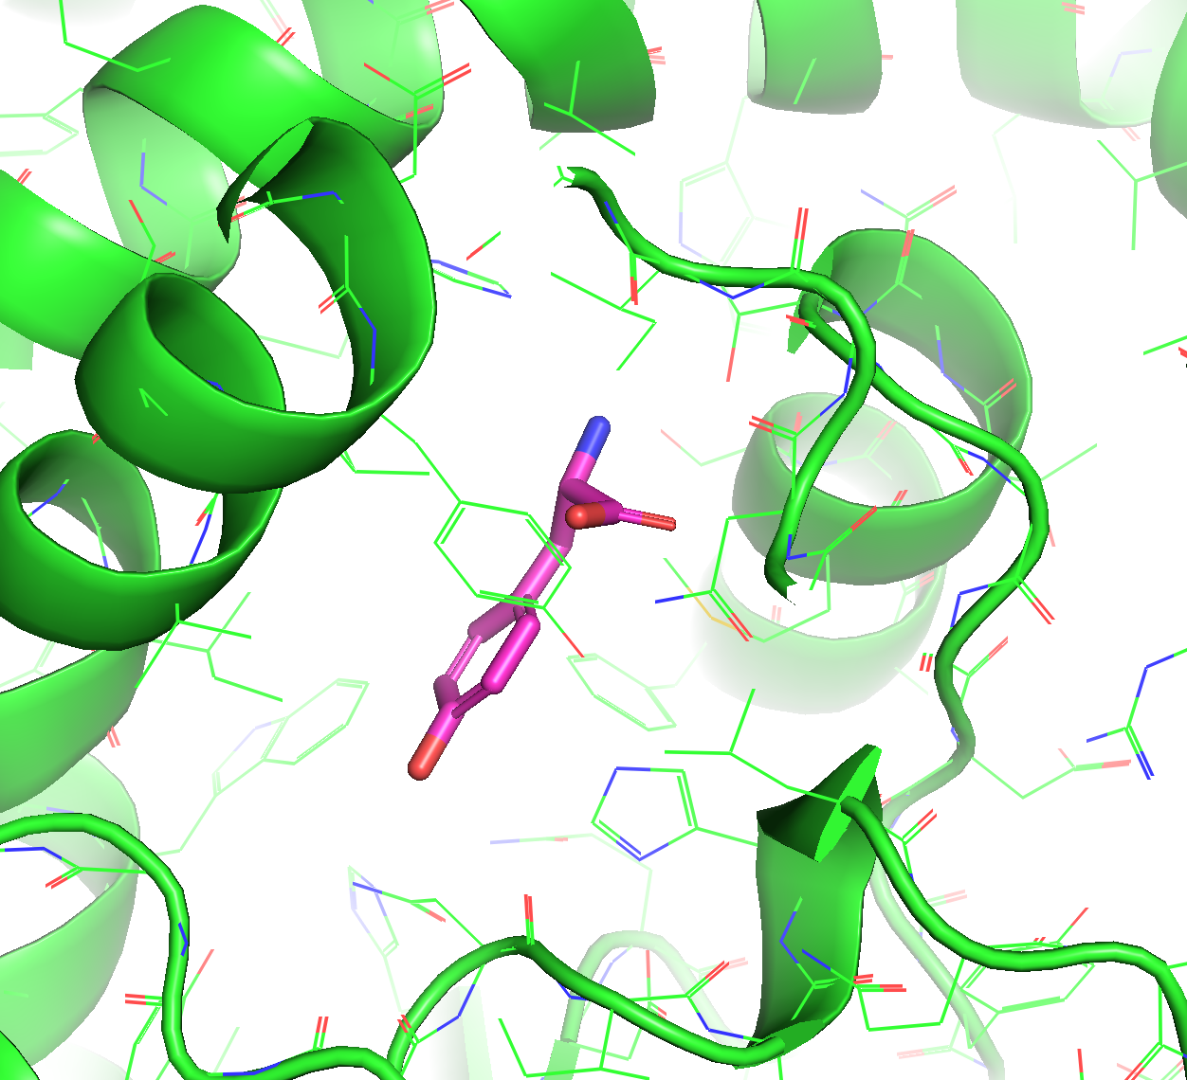
Training and Testing Dataset Preparation
Protein Sequence
fastAF2
Blind Docking
Filters
PDBParse
Pocket
Prediction
Local Docking
All PDB Data
Protein-Ligand Pairs
Ligand 3D Generation
Decoys
Collect all PDB structures and split into chains
Generate predicted receptor structure
Dock ligand into predicted structure
Predict docking pose per-atom deviation
Protein-similarity based train-test split
New PDB records as independent test

Slide 3
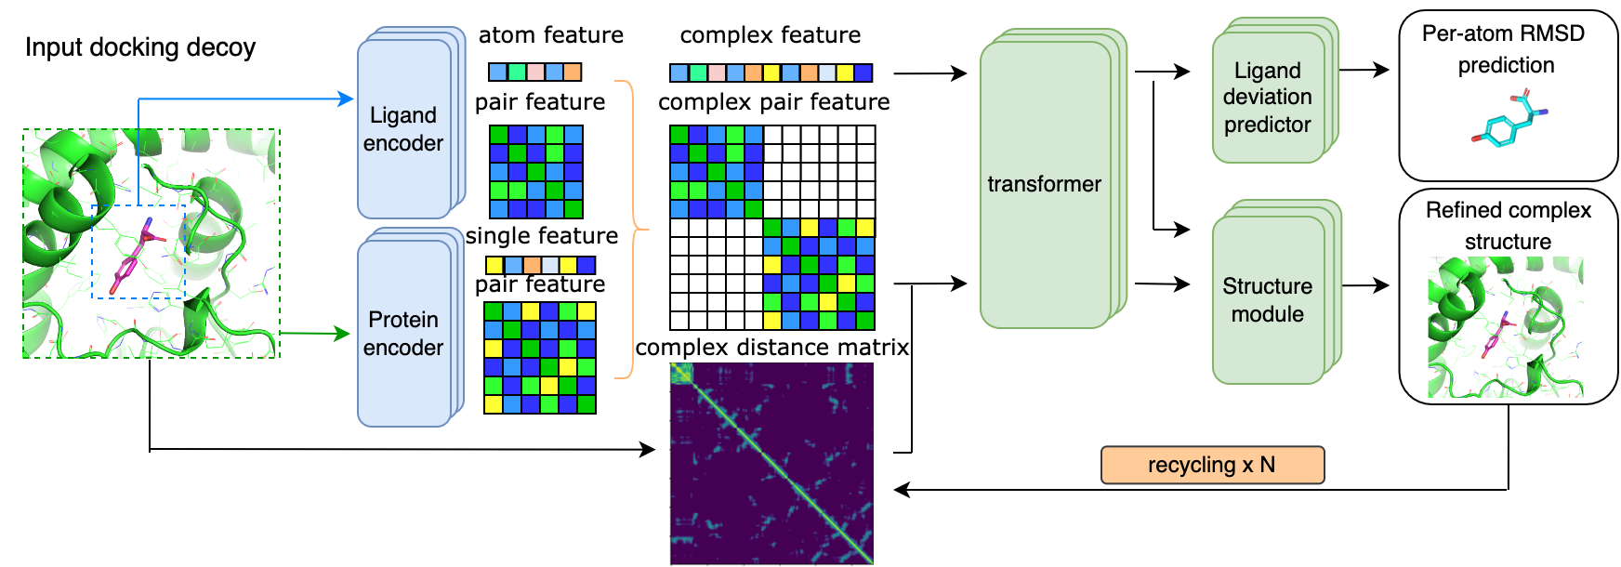
AIchemy_LIG/LIG2 core scoring module
zPoseScore - A transformer-based model
  Takes protein-ligand complex as input
  A novel structure module iteratively outputs refined complex structure
  The model is optimized to predict per-atom deviation of the input decoy

Slide 4
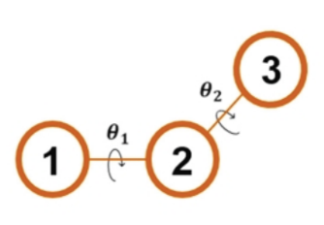
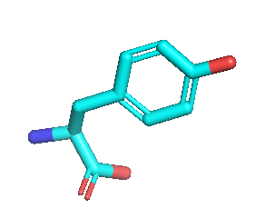
Ligand Pose Prediction Protocol
Protein Sequence
AF2
NN Scoring
Clustering
Vis. Inspection
Hybrid
Docking
Pocket
Prediction
DeepRMSD
Final models
Final models
N[C@@H](Cc1ccc(O)cc1)C(=O)O
Rdkit
Decoys
AIChemy_LIG1
AIChemy_LIG2
Hybrid docking protocol combines global docking, template-based docking (for metal ions or other metal-related ligands) and local docking
DL Scoring is the most important component for correct pose selection
Clustering is used after NN scoring to maintain the pose diversity
Visual inspection is required to ensure reasonable interaction patterns

Slide 5
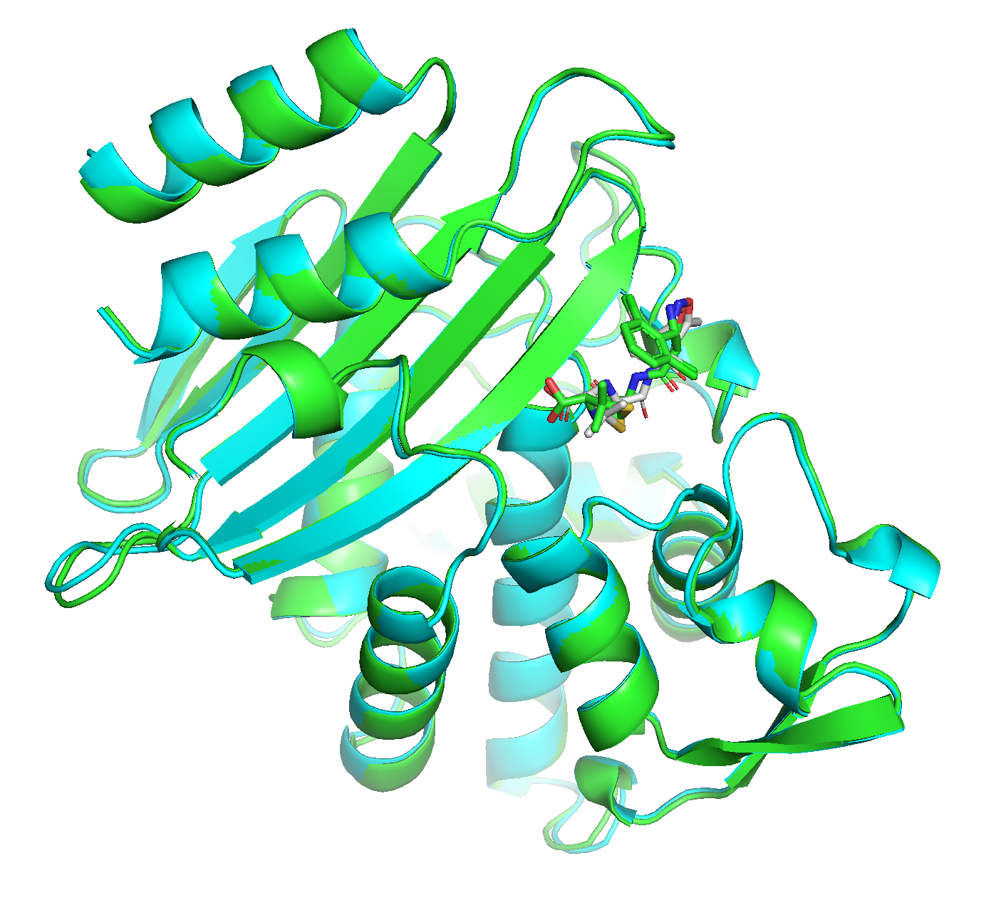
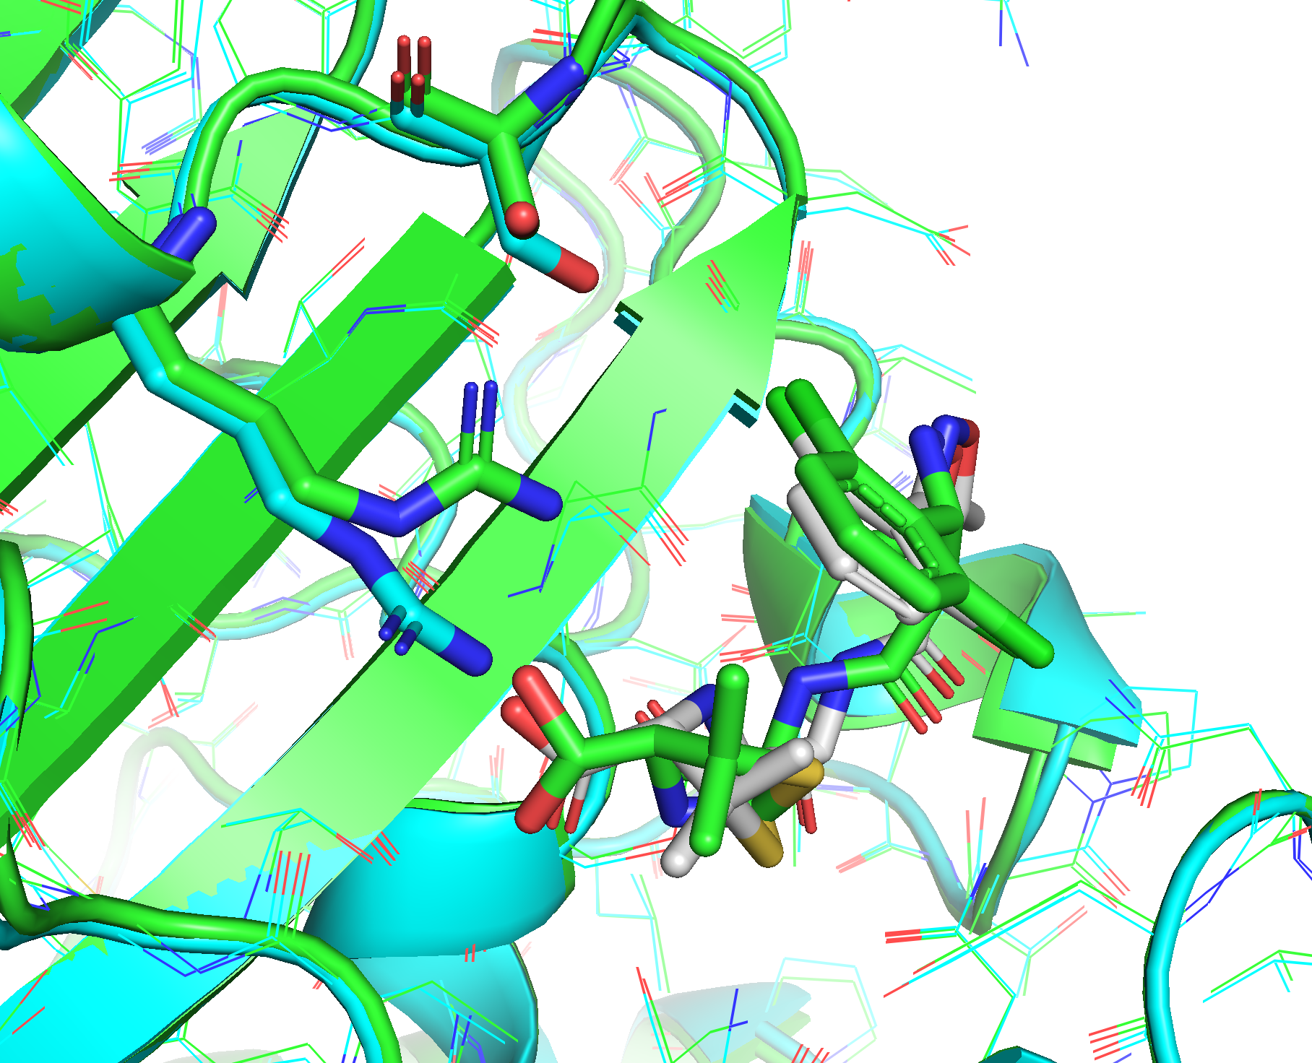
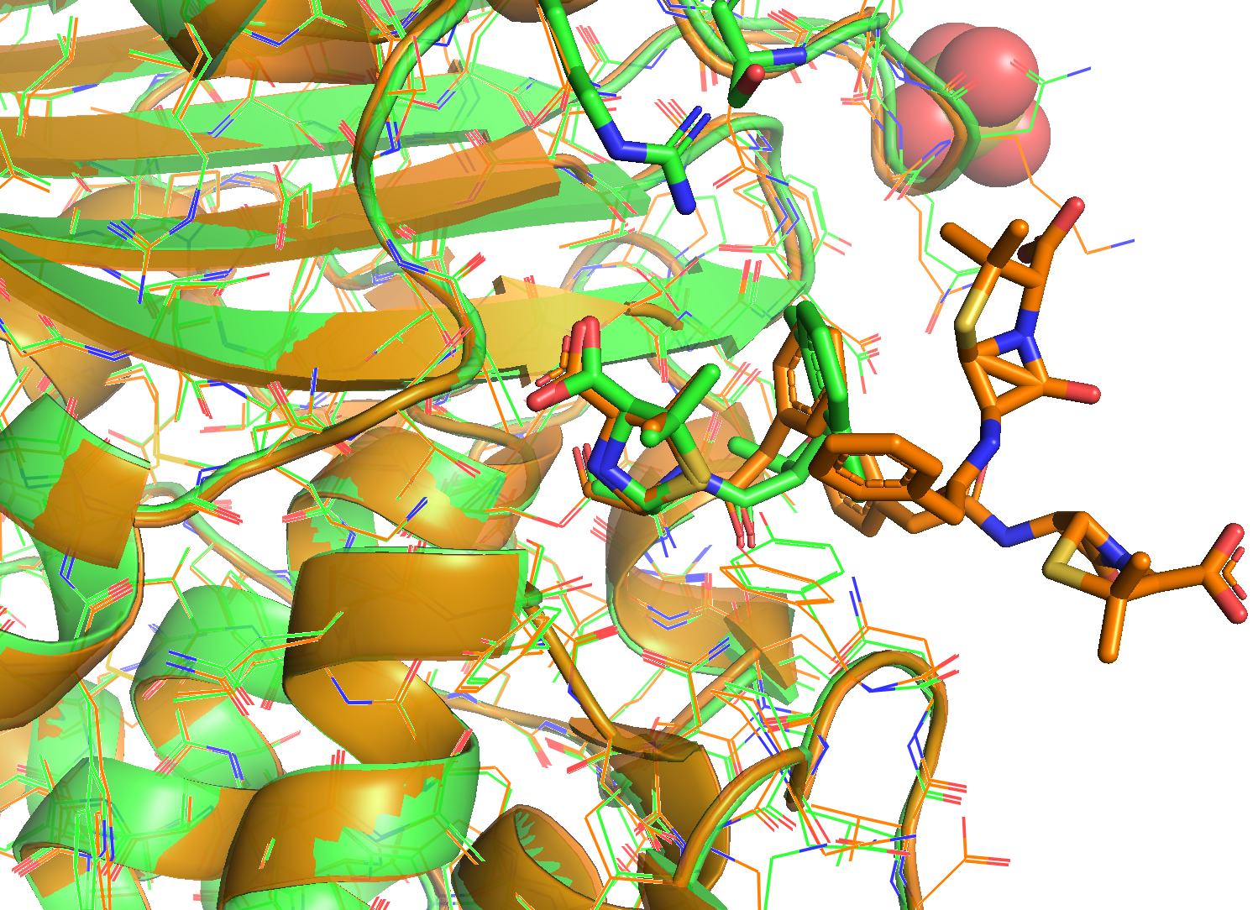
What went right: T1186
Template 5kmwA (Orange)
T1186 Native (Green)
RMSD: 0.31A
Native Receptor (Green)
AF2 Predicted (Cyan, RMSD=0.3A)
Native Ligand Pose (Green)
Predicted Ligand Pose (Gray, RMSD=1.189A)
Docking generates decoys, DL module ranks the decoys
Template information is used to guide visual inspection

Slide 6
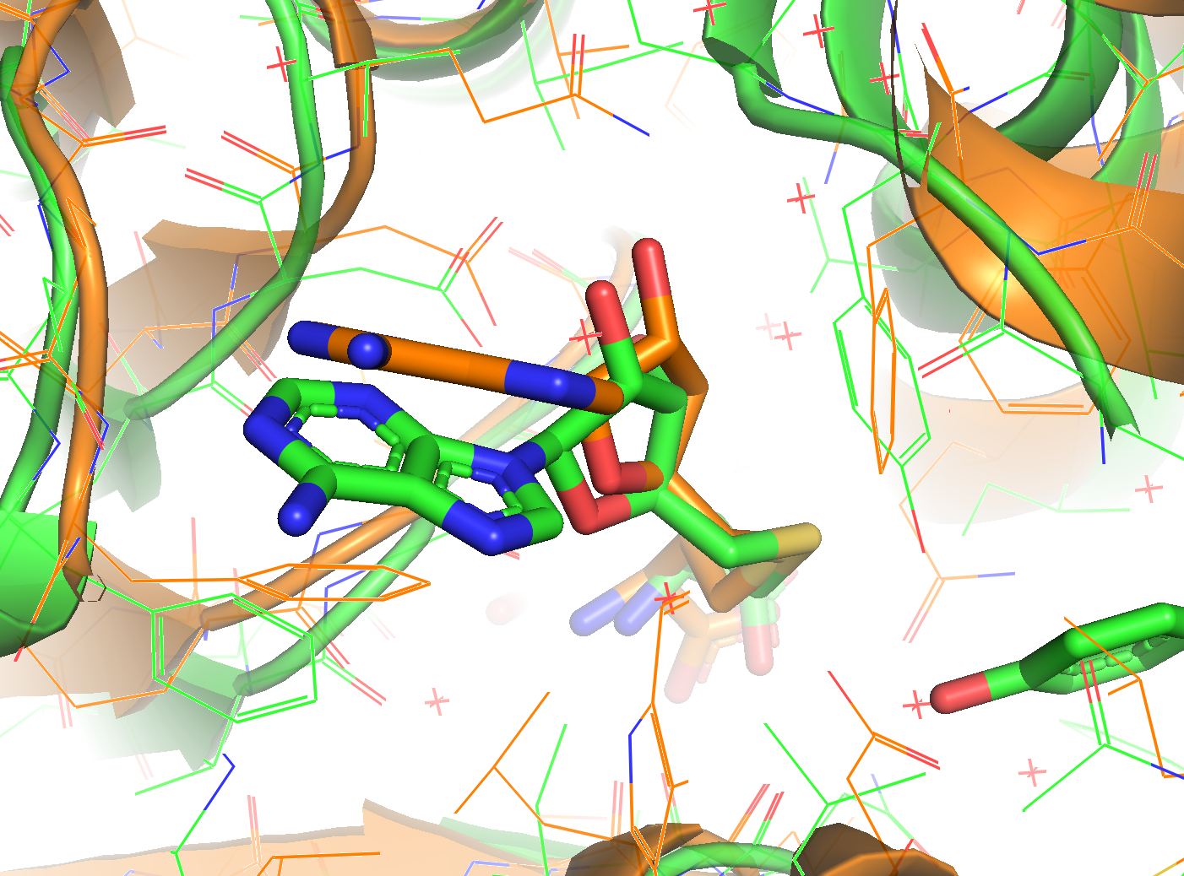
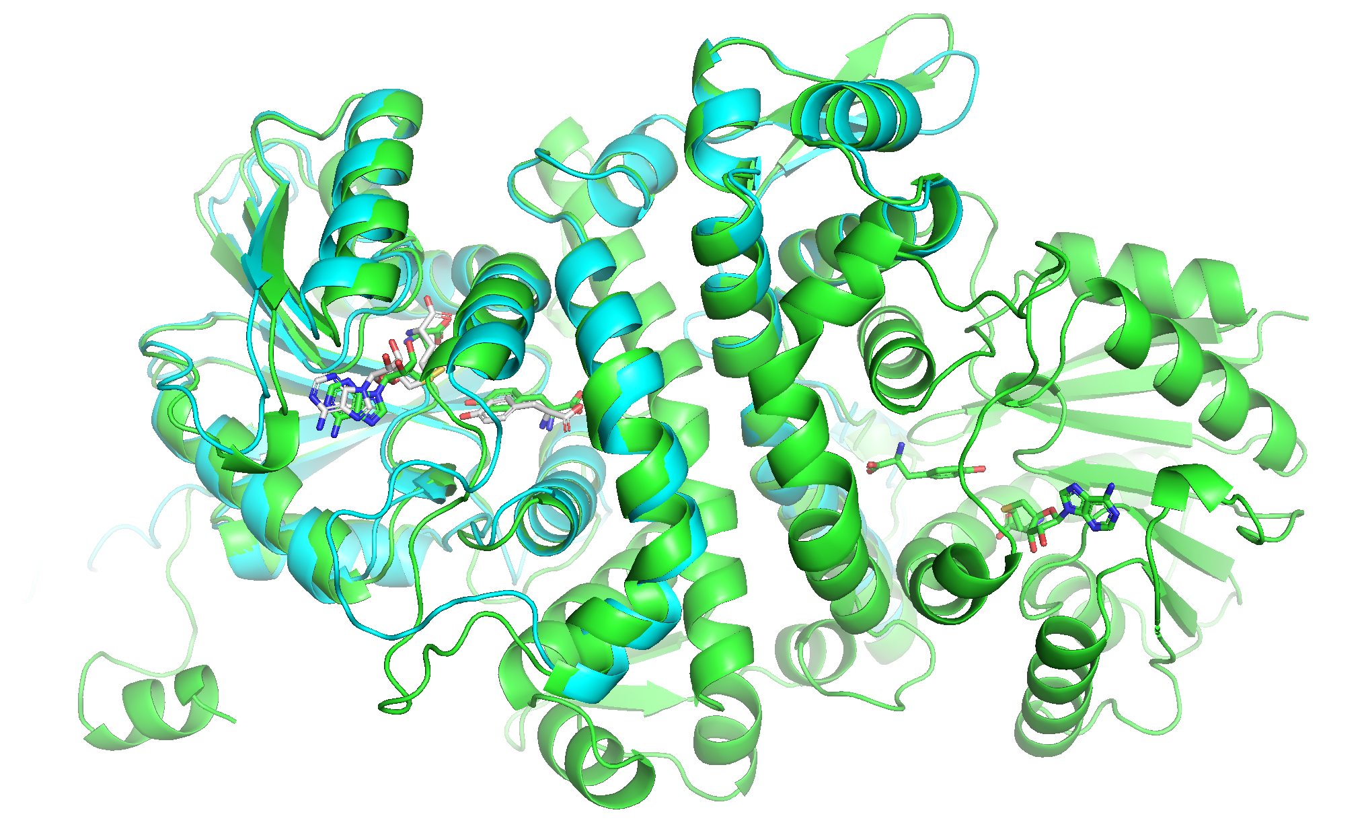
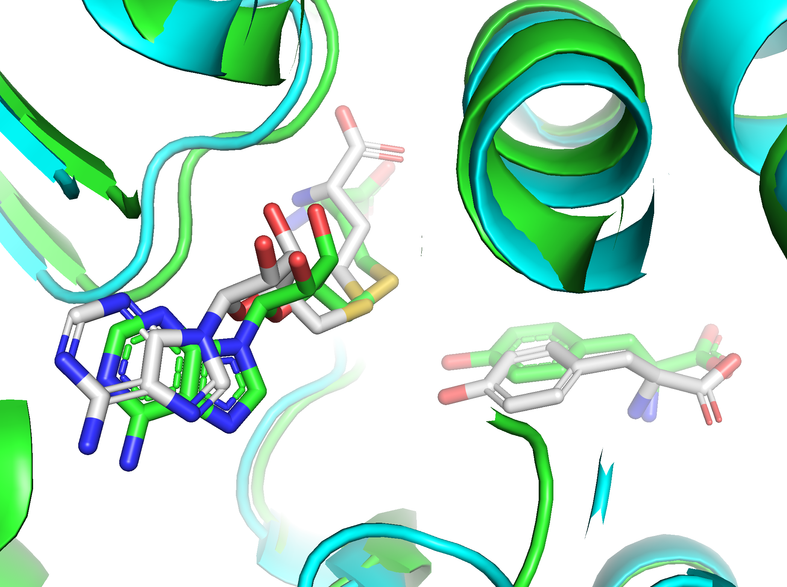
What Went Right: T1124
Template 6c5bB (Orange)
T1124 Native (Green)
Native (Green)
AF2 Predicted (Cyan, RMSD=1.3A)
Native Ligand Pose (Green)
Predicted SAH Pose (Gray, RMSD=1.4A)
Docking generates decoys, DL module ranks the decoys
Pocket Sidechains should be adjusted to enable accurate docking

Slide 7
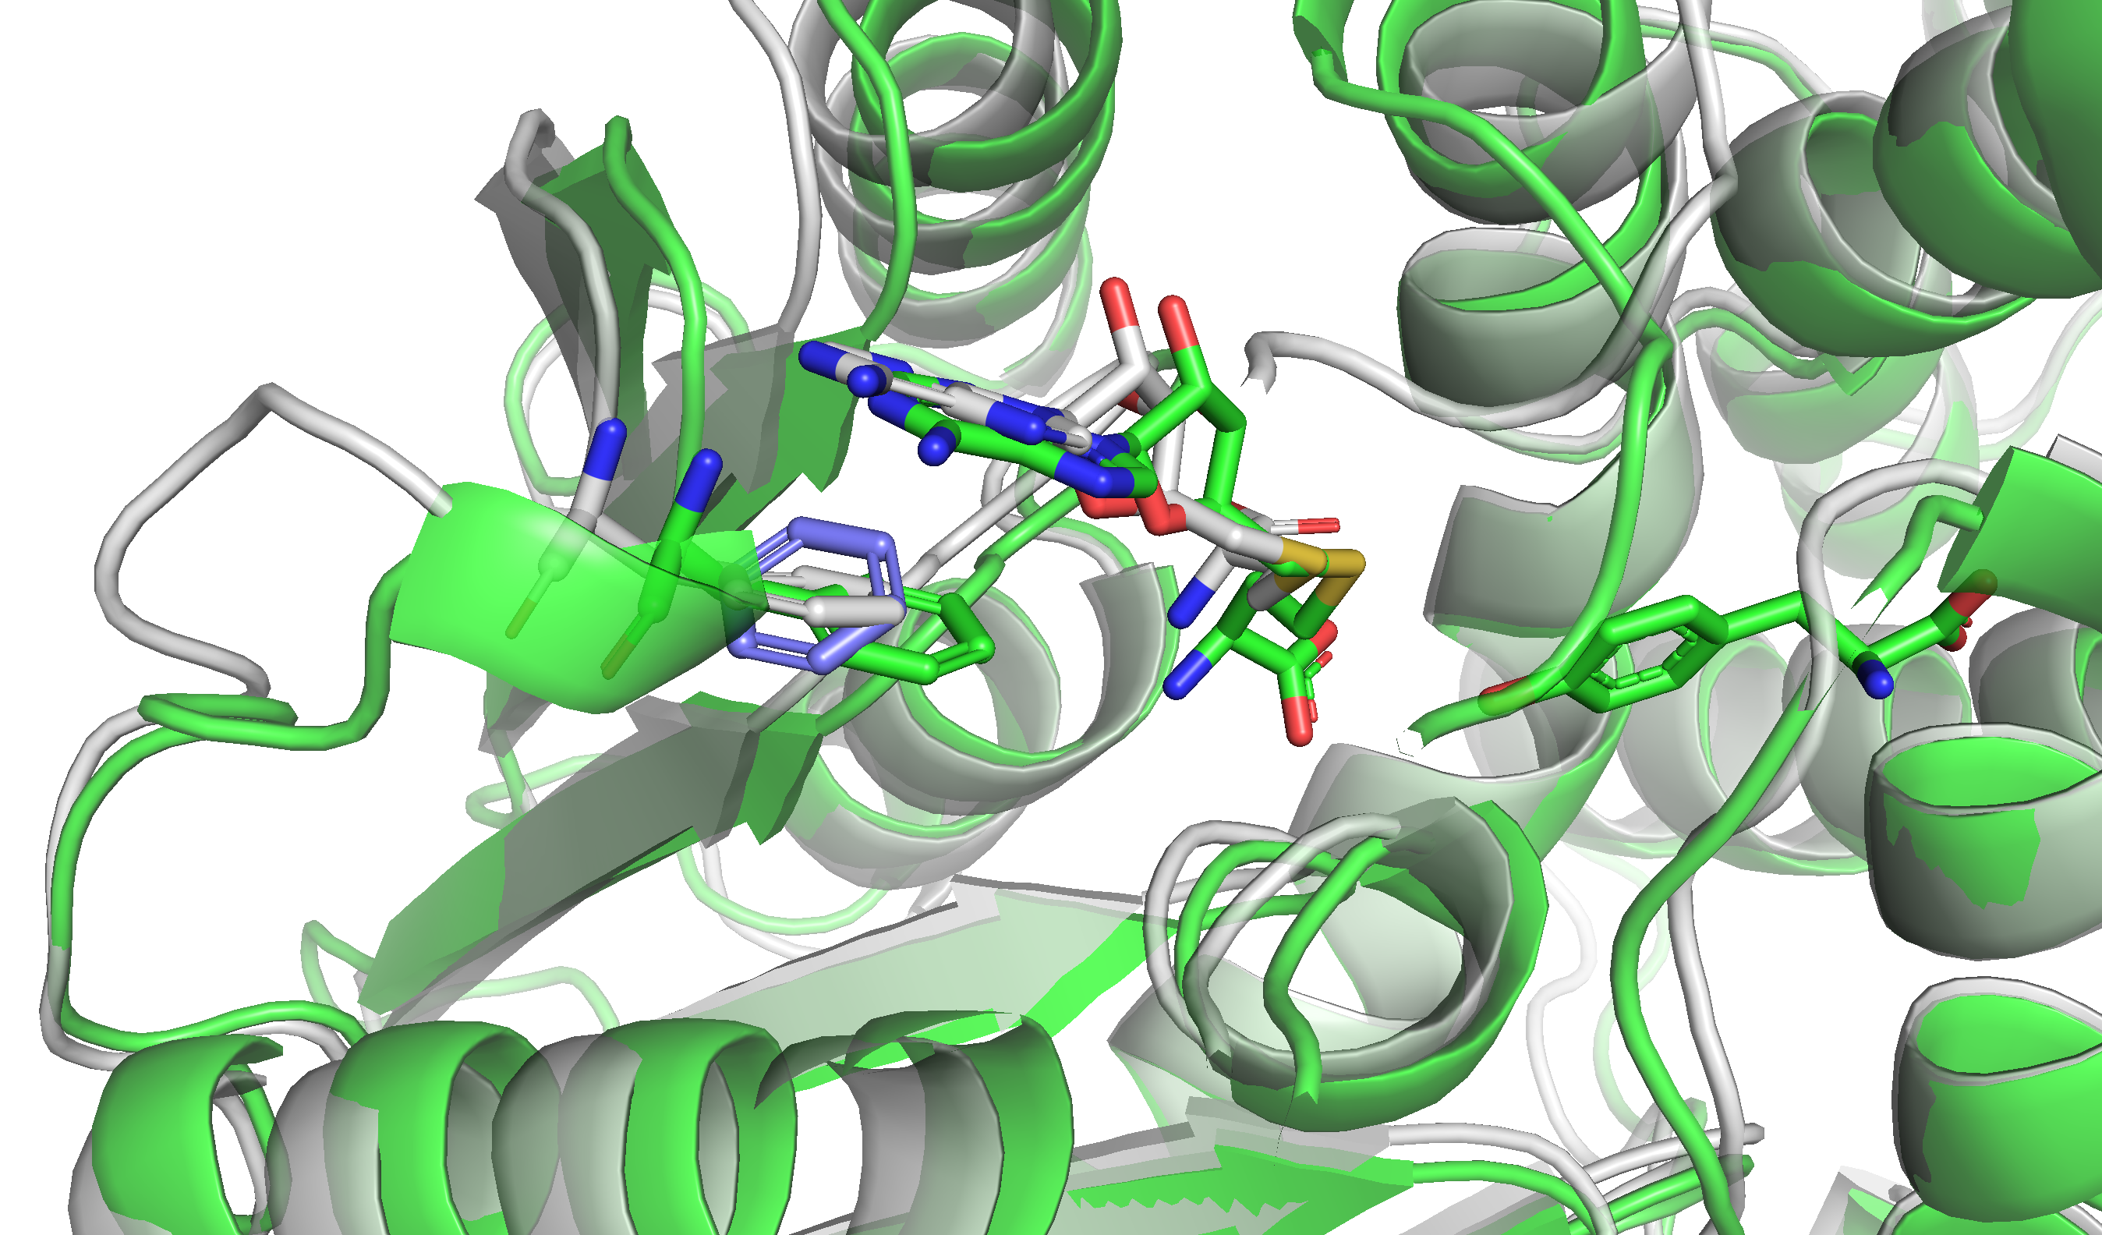
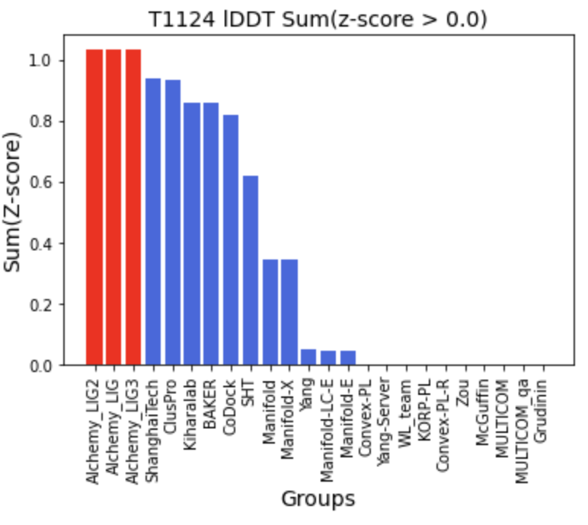
What Went Right: T1124
Sidechain orientation affects ligand accuracies
Native Receptor (Green)
AF2 Predicted (Gray)
Native Phe253 (Green)
AF2 Phe253 (Purple)
AF2 adjusted Phe253 (Gray)
T1124-SAH binding pattern

Slide 8
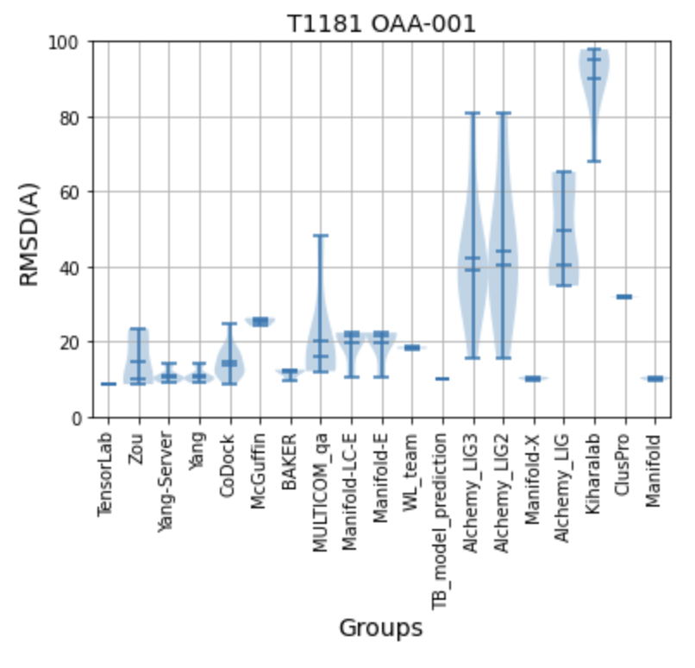
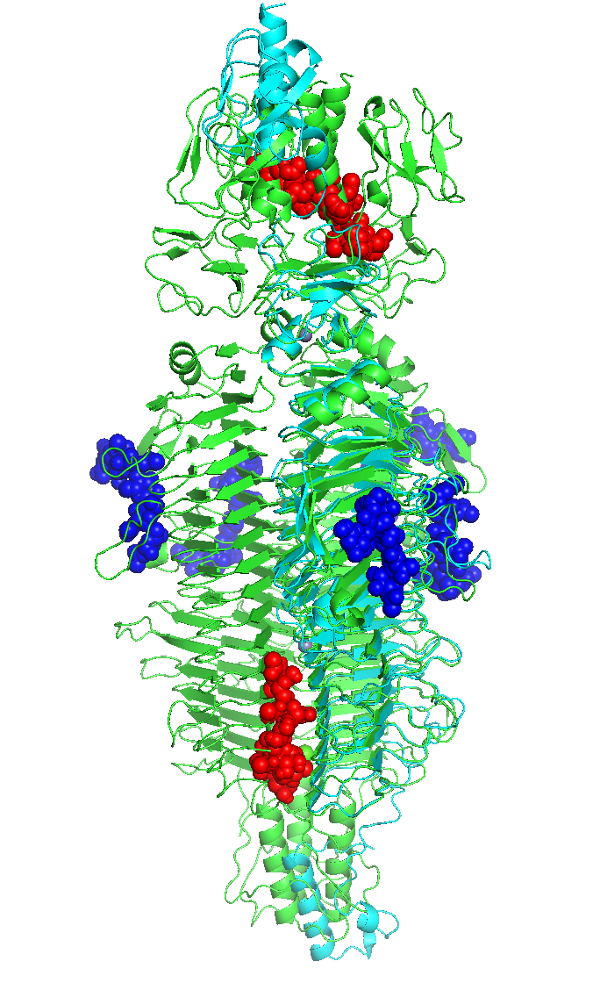
What Went Wrong: T1181
AF2 predicted chainA
T1124 Native
RMSD=1.1A
Native OAA poses
Predicted OAA poses
Ligand binding sites are hard to locate!!!

Slide 9
Conclusions
The protein structure and ligand are modelled seperately
Pocket sidechain orientations are important for accurate ligand prediction
Ligand binding site prediction remains a challenge
DL-based model could enrich the template-like decoys
Template information is useful for pose selection and visual inspection
Template-based modelling is accurate for metal ion modelling

Slide 10
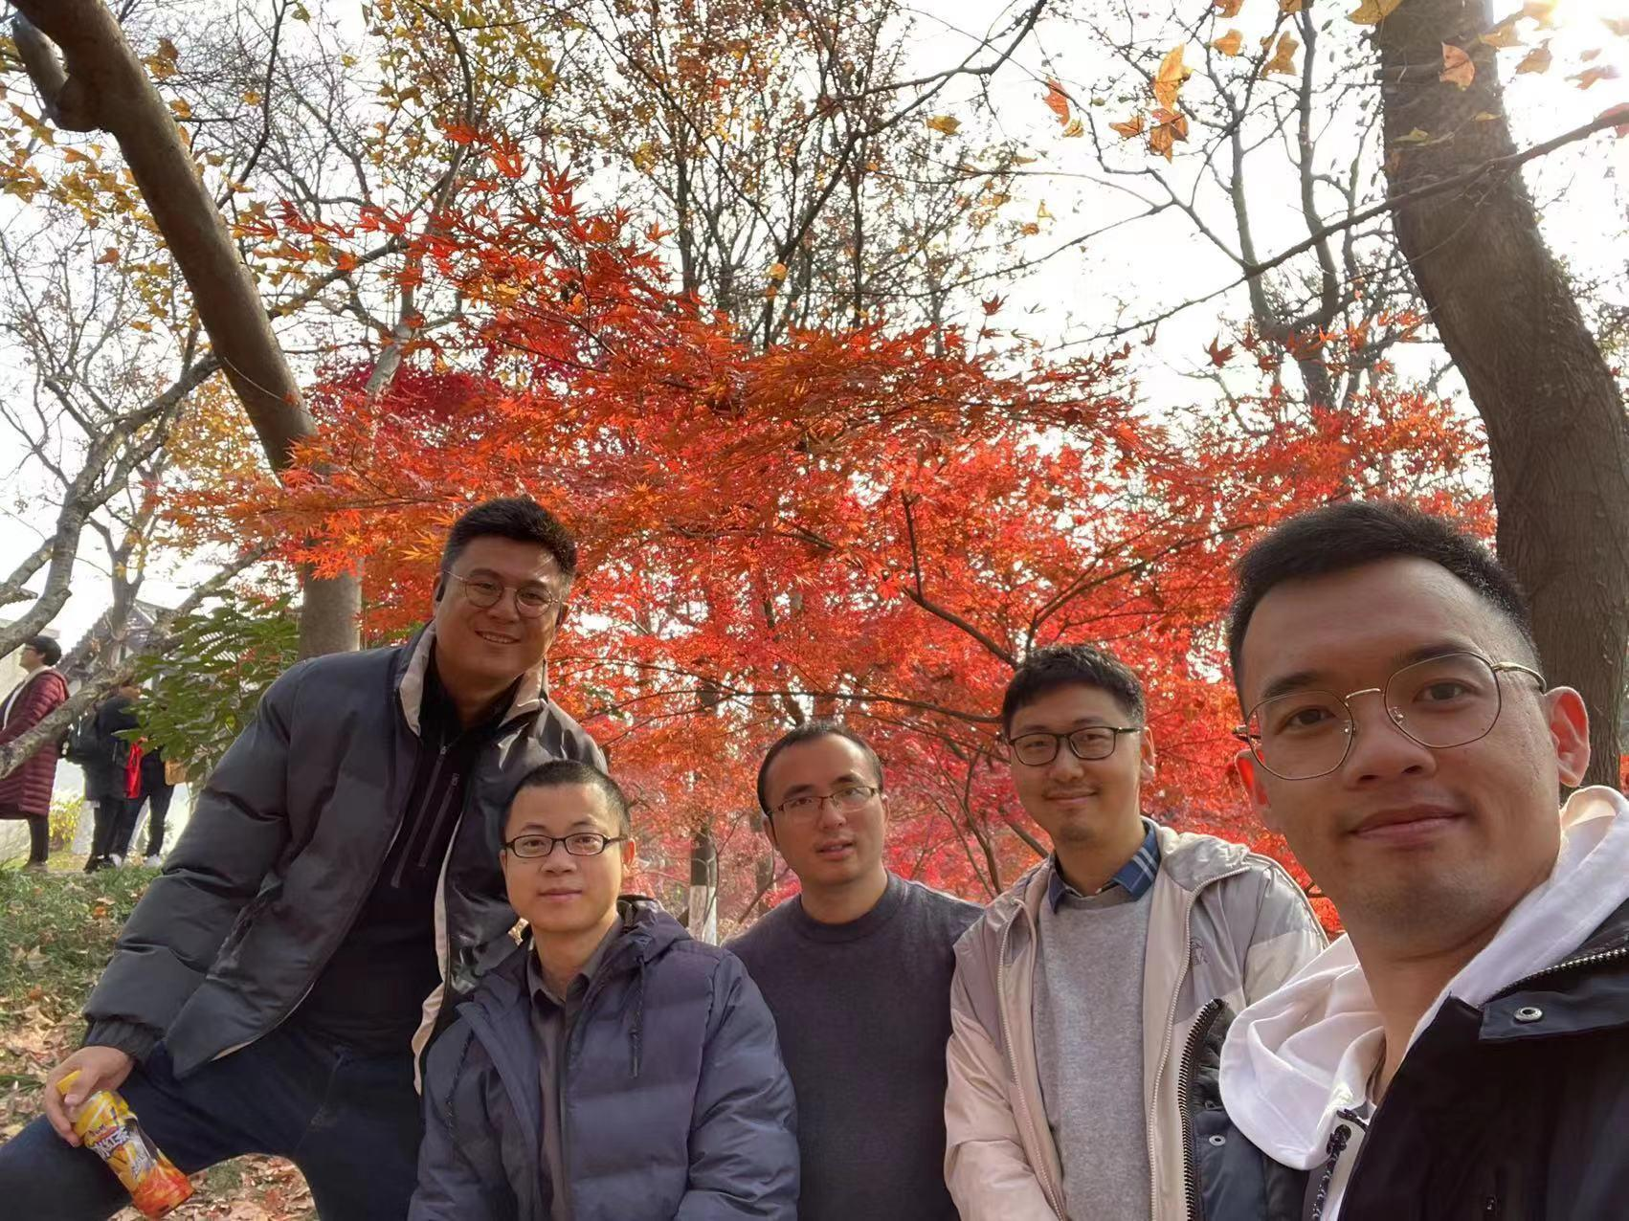


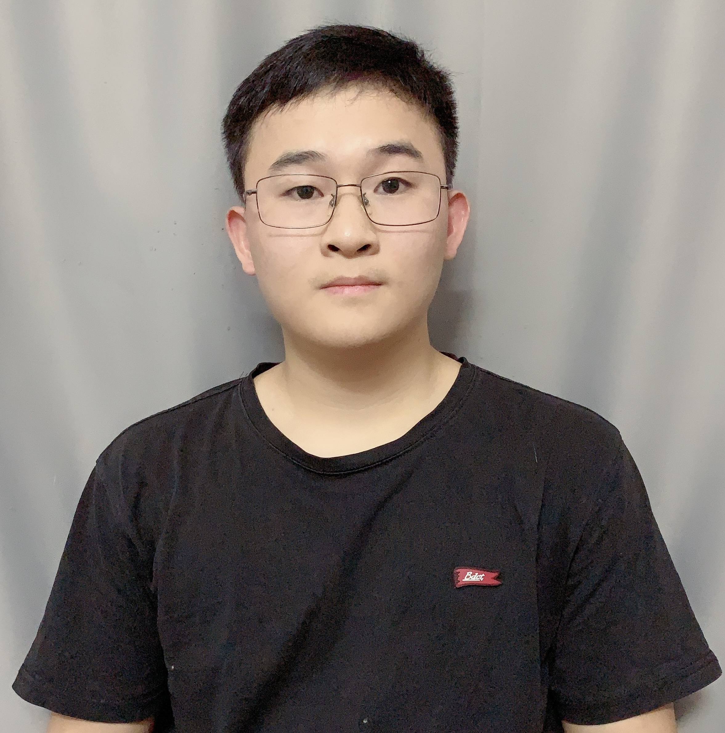








Acknowledgement
zPoseScore deep learning model
Tao Shen (Zelixir)
Fuxu Liu (Zelixir)
Zelixir cofounder team
Visual Inspection
RNA-Lignad (R1117)
DeepRMSD Optimization
Jinyuan Sun
(Institute of Microbiology, CAS)
Yifan Bu (Zelixir)
Peng Xiong (Zelixir)
Zechen Wang (Shandong U)
Weifeng Li (Shandong U)
Yanjie Wei
(SIAT, CAS)

Slide 11
Thanks!

