Slide 1
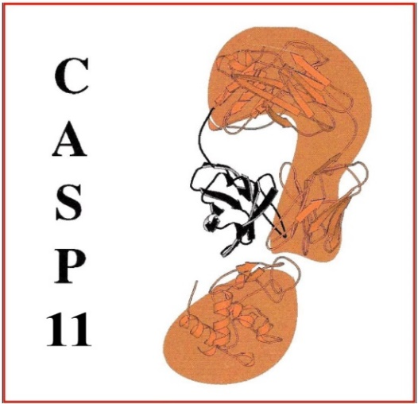
15
EMA discussion

Slide 2
What we did right and wrong with the EMA category in CASP15?
DL in EMA
Self-assessment: is it all about the AF2 error estimates or other conceptually different methods exist /deliver?
Monomers -> complexes /interfaces -> ?

