Slide 1
ModFOLDdock, ModFOLDdockR
& ModFOLDdockS
McGuffin Group, University of Reading
l.j.mcguffn@reading.ac.uk

Slide 2
Methods: Overview
3 variants:
ModFOLDdock - global scores optimised for positive linear correlations with the observed scores.
ModFOLDdockR - global scores optimised for Ranking, i.e. the top-ranked models (top 1) should have higher observed overall accuracy
ModFOLDdockS - a Single model approach to score models. Reference multimer models were generated using our MultiFOLD method. Each model was compared individually against the reference model set.
Target functions (assessors’ formulae for CASP14 multimers):
Local (Interface) - ICS (F1), IPS (Jaccard.Coeff.)
Global (“Fold”) - Oligo-lDDT, TMscore

Slide 3
Methods: Components
Consensus model scoring:
DockQJury, QSscoreJury, QSscoreOfficialJury, lDDTOfficialJury, ModFOLDIA
Single-model scoring:
Voronota-js-voromqa, CDA (Contact Distance Agreement)
Quasi-single model scoring:
MultiFOLD (single models compared with 30 reference models)

Slide 4
Methods: Fold, interface & residue quality scores
3 variants, 3 sets of scores each:
ModFOLDdock
Fold: DockQJury, lDDTOfficialJury
Interface: DockQJury, QSscoreOfficialJury
Residue: ModFOLDIA
ModFOLDdockR
Fold: QSscoreJury, lDDTOfficialJury, voromqa
Interface: DockQJury, QSscoreOfficialJury, voromqa
Residue: ModFOLDIA, voromqa
ModFOLDdockS
Fold: DockQJury, lDDTOfficialJury
Interface: DockQJury, QSscoreOfficialJury
Residue: ModFOLDIA, voromqa, CDA
(B) QMODE2. Residue-based Interface Assessment
PFRMAT QA
TARGET T0999
AUTHOR 1234-5678-9000
REMARK Reliability of residues being in Interfaces
METHOD Description of methods used
MODEL 1
QMODE 2
T1031TS000_1o 0.8 0.4 A1:0.9 A3:0.9 A17:0.7 A19:0.7 B45:0.7 B49:0.4
B50:0.4 B53:0.8
T1031TS999_1o 0.7 X A15:0.5 A17:0.9 A44:0.7 A46:0.7 B4:0.3 B9:0.4
END
“Fold”
score
Interface score
Residue scores

Slide 5
Methods: ModFOLDdock
ModFOLDdock variant -
scores optimised for global correlations
DockQJury
QSscoreJury
All Models
Interface score
lDDTOfficialJury
Fold score
QSscoreOfficialJury
Global score
ModFOLDIA
Local scores
Residue scores
Global score
Single Models
voronota-js-voromqa
Local scores
CDA
Global score
Sequences
Local scores

Slide 6
Methods: ModFOLDdockR
ModFOLDdockR variant -
scores optimised for global ranking
DockQJury
QSscoreJury
All Models
Interface score
lDDTOfficialJury
Fold score
QSscoreOfficialJury
Global score
ModFOLDIA
Local scores
Residue scores
Global score
Single Models
voronota-js-voromqa
Local scores
CDA
Global score
Sequences
Local scores

Slide 7
Methods: ModFOLDdockS
ModFOLDdockS variant-
a quasi-single model approach
Sequences
DockQJury
MultiFOLD
QSscoreJury
30 models
Interface score
lDDTOfficialJury
Fold score
QSscoreOfficialJury
Global score
ModFOLDIA
Local scores
Residue scores
Global score
Single Models
voronota-js-voromqa
Local scores
CDA
Global score
Sequences
Local scores

Slide 8
Methods: MultiFOLD
Sequences
LocalColabFold 1.0.0
LocalColabFold 1.3.0
20 models
ModFOLDdockR
Top 5 models
30 reference models
Sequences
LocalColabFold 1.3.0
10 models

Slide 9
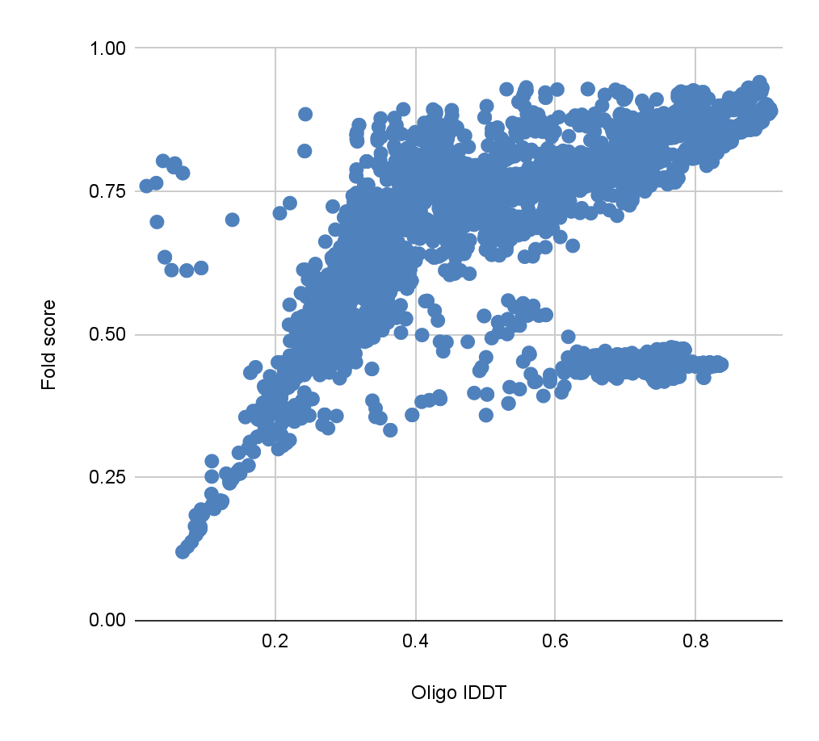
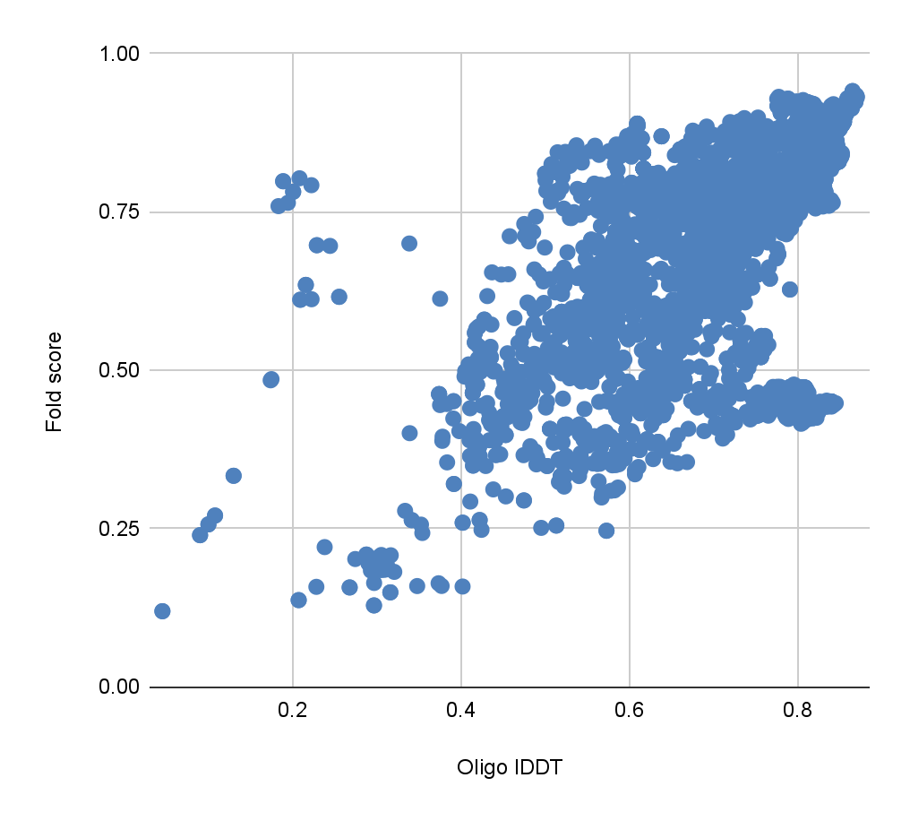
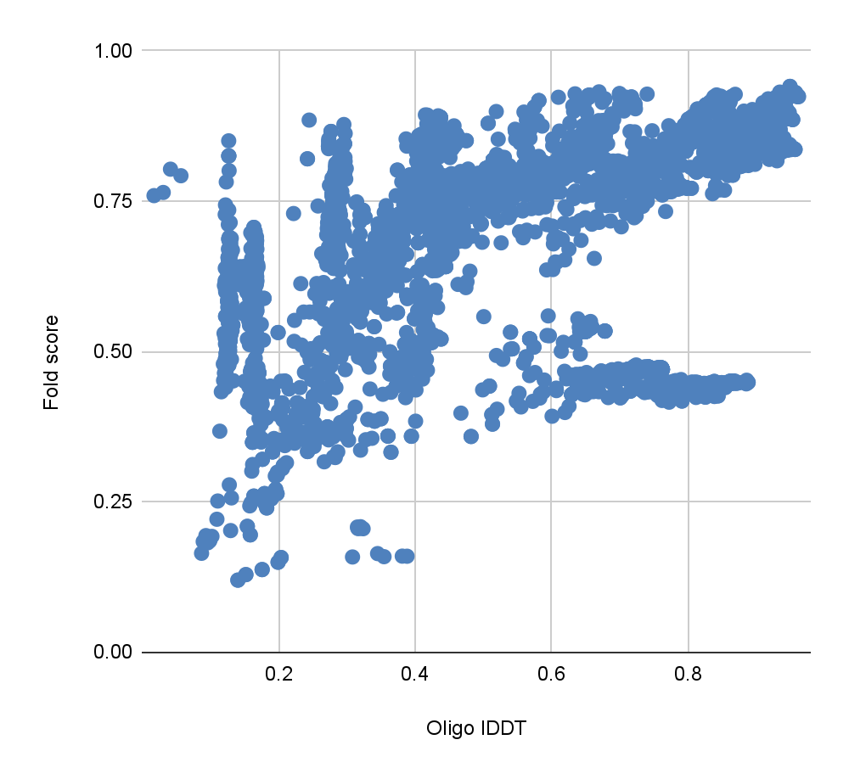
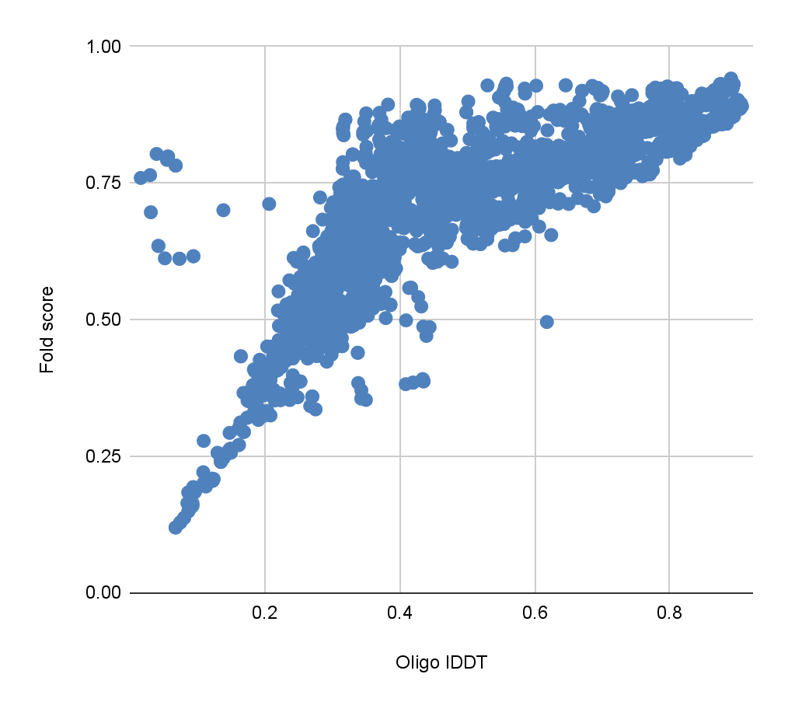
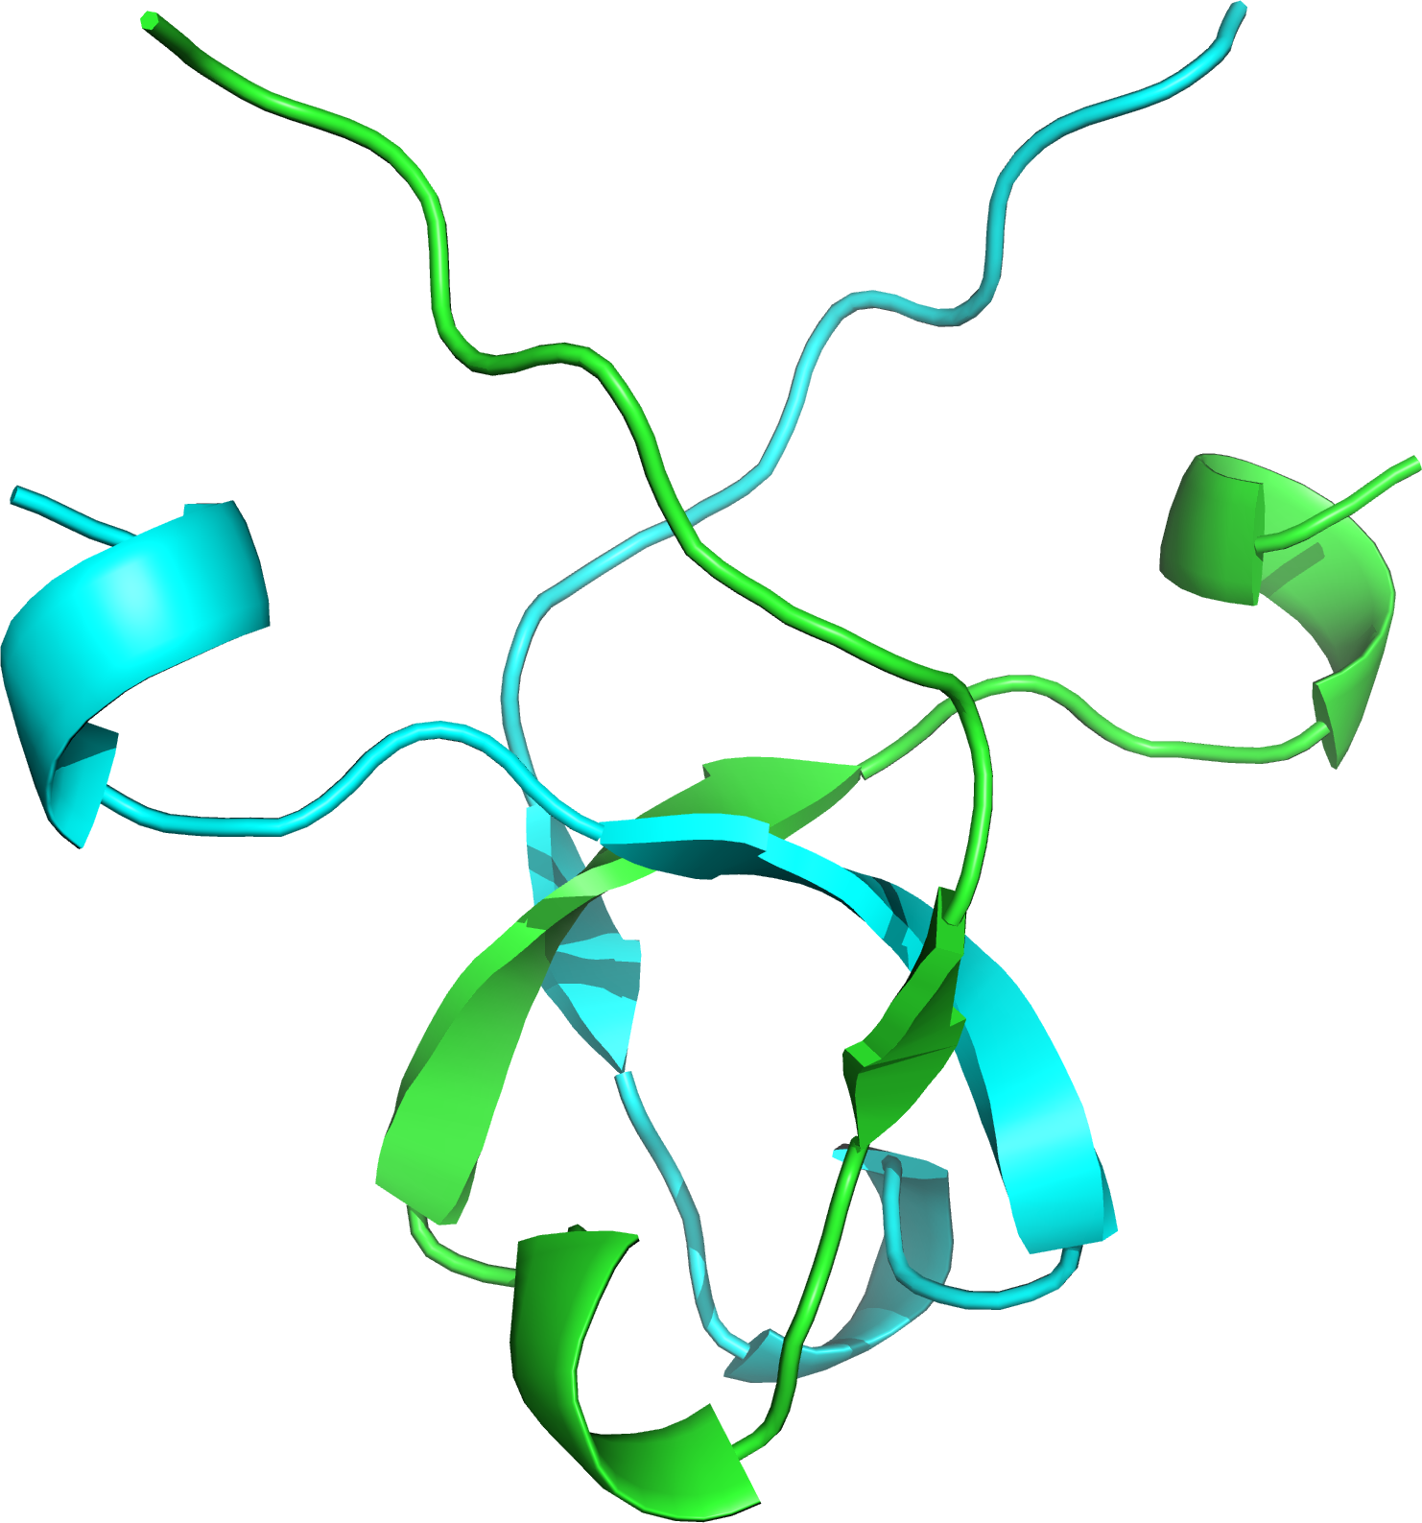
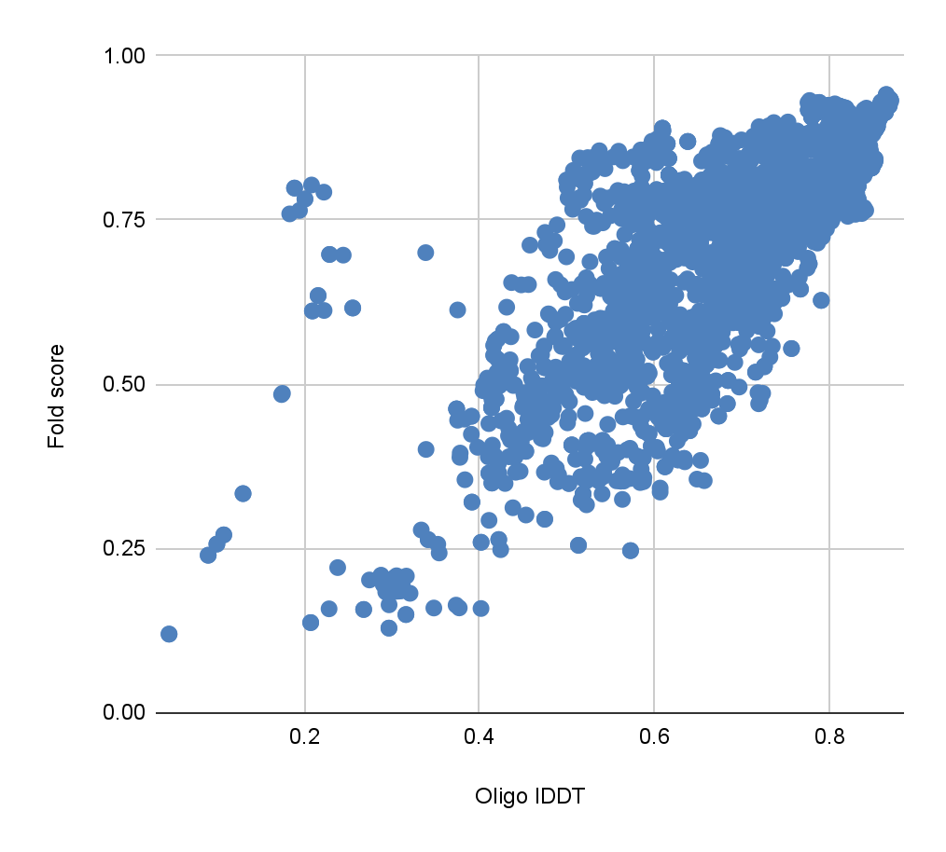
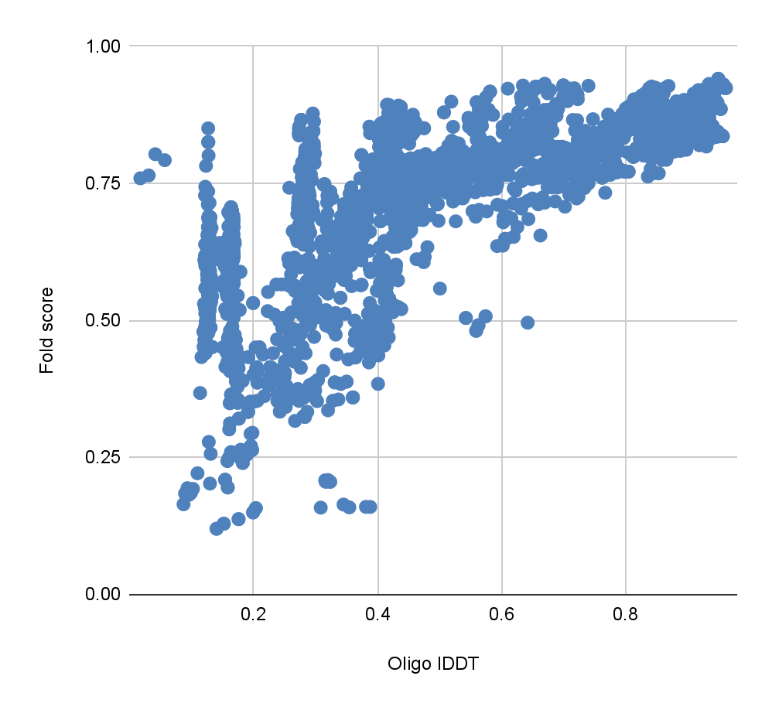
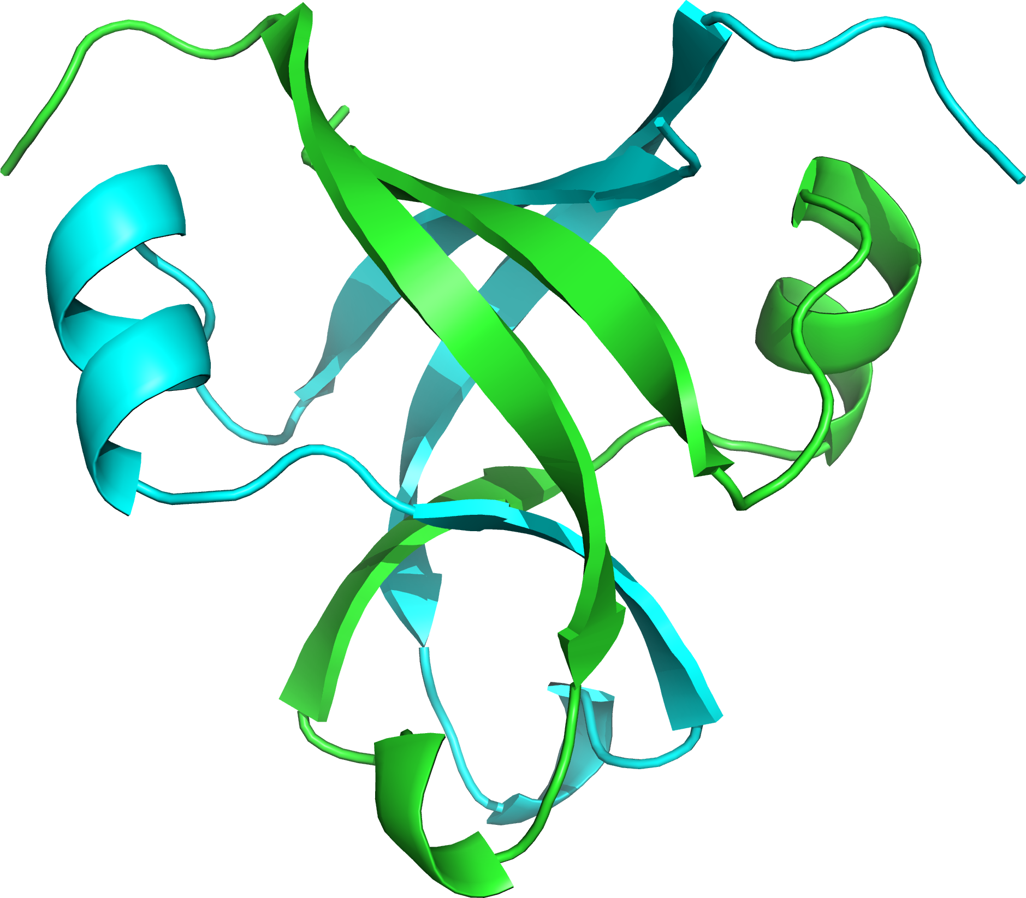
Question: Where do you think are you particularly good?
Predicted fold score versus oligo-lDDT scores for all homomeric targets
ModFOLDdock
ModFOLDdockR
ModFOLDdockS
T1160 & T1161
T1160 & T1161
T1160 & T1161
r=0.55
r=0.55
r=0.51
“T1160 and T1161 have similar sequences but different conformations due to the crystallization conditions.”
r=0.82
r=0.78
r=0.76

Slide 10
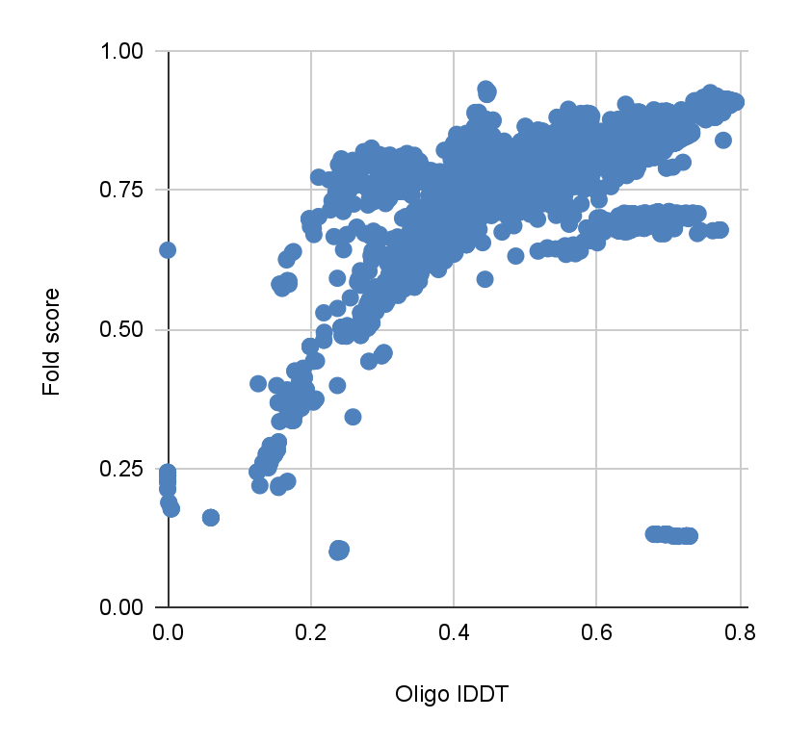
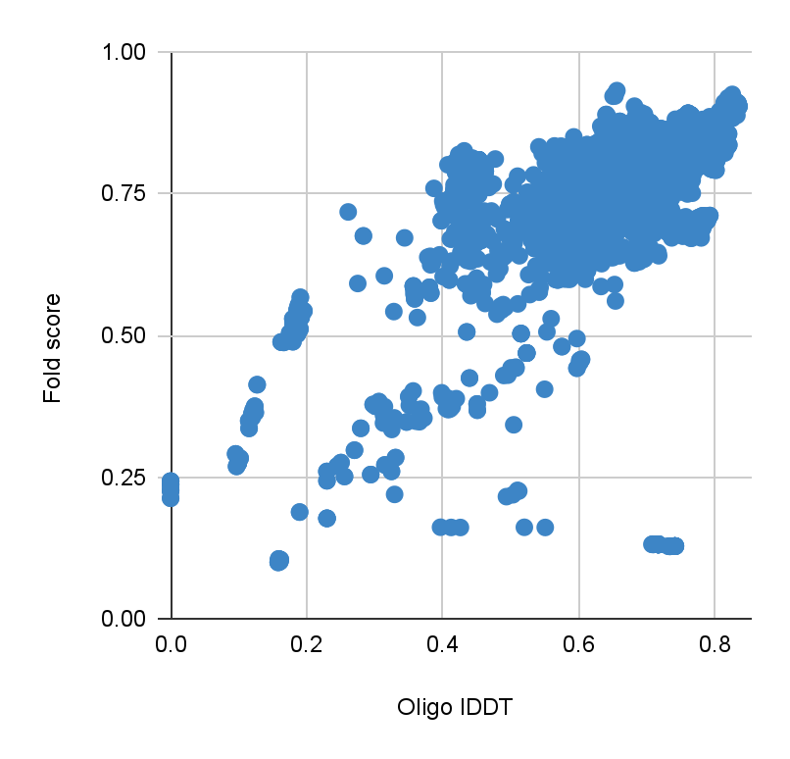
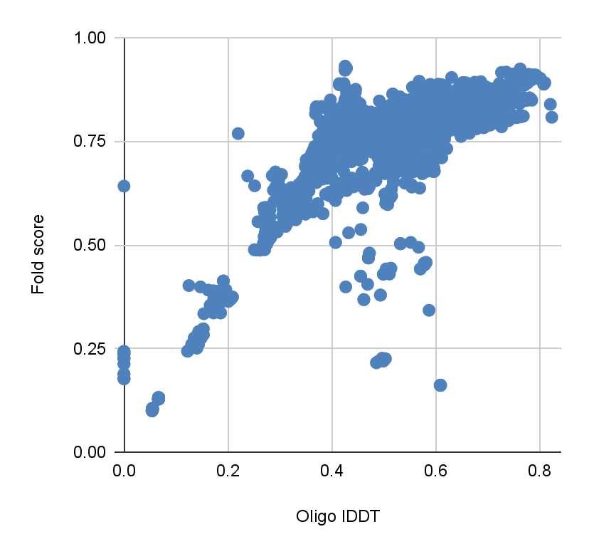
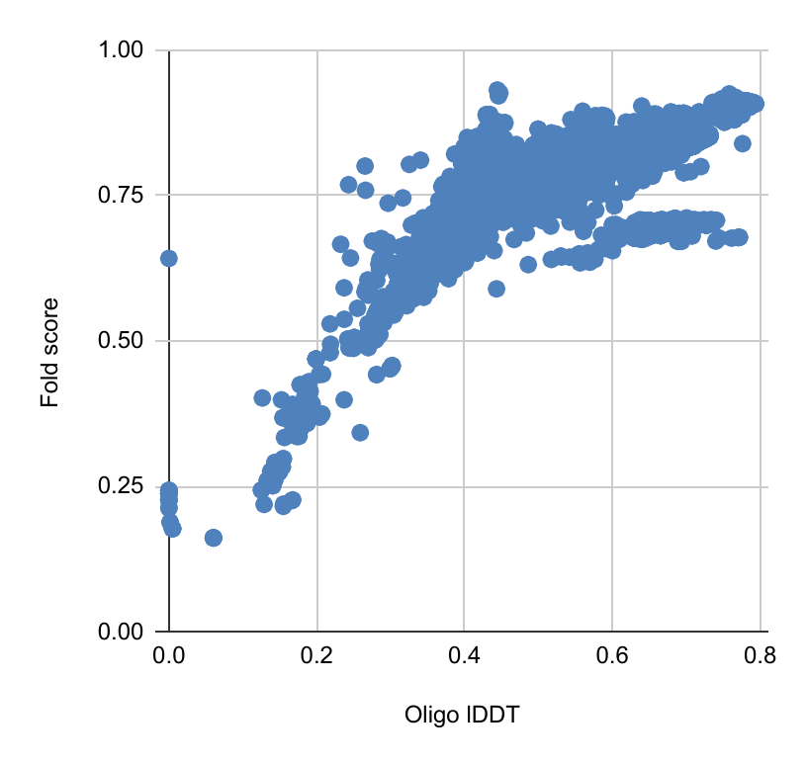
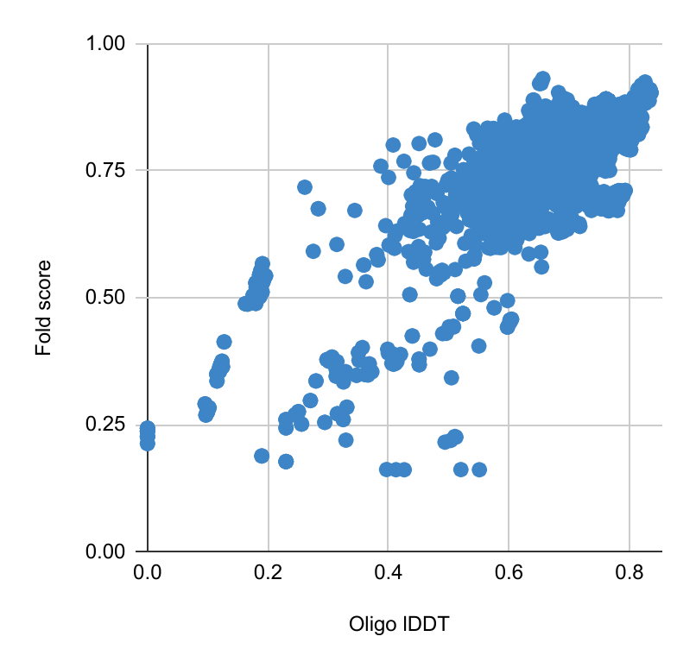
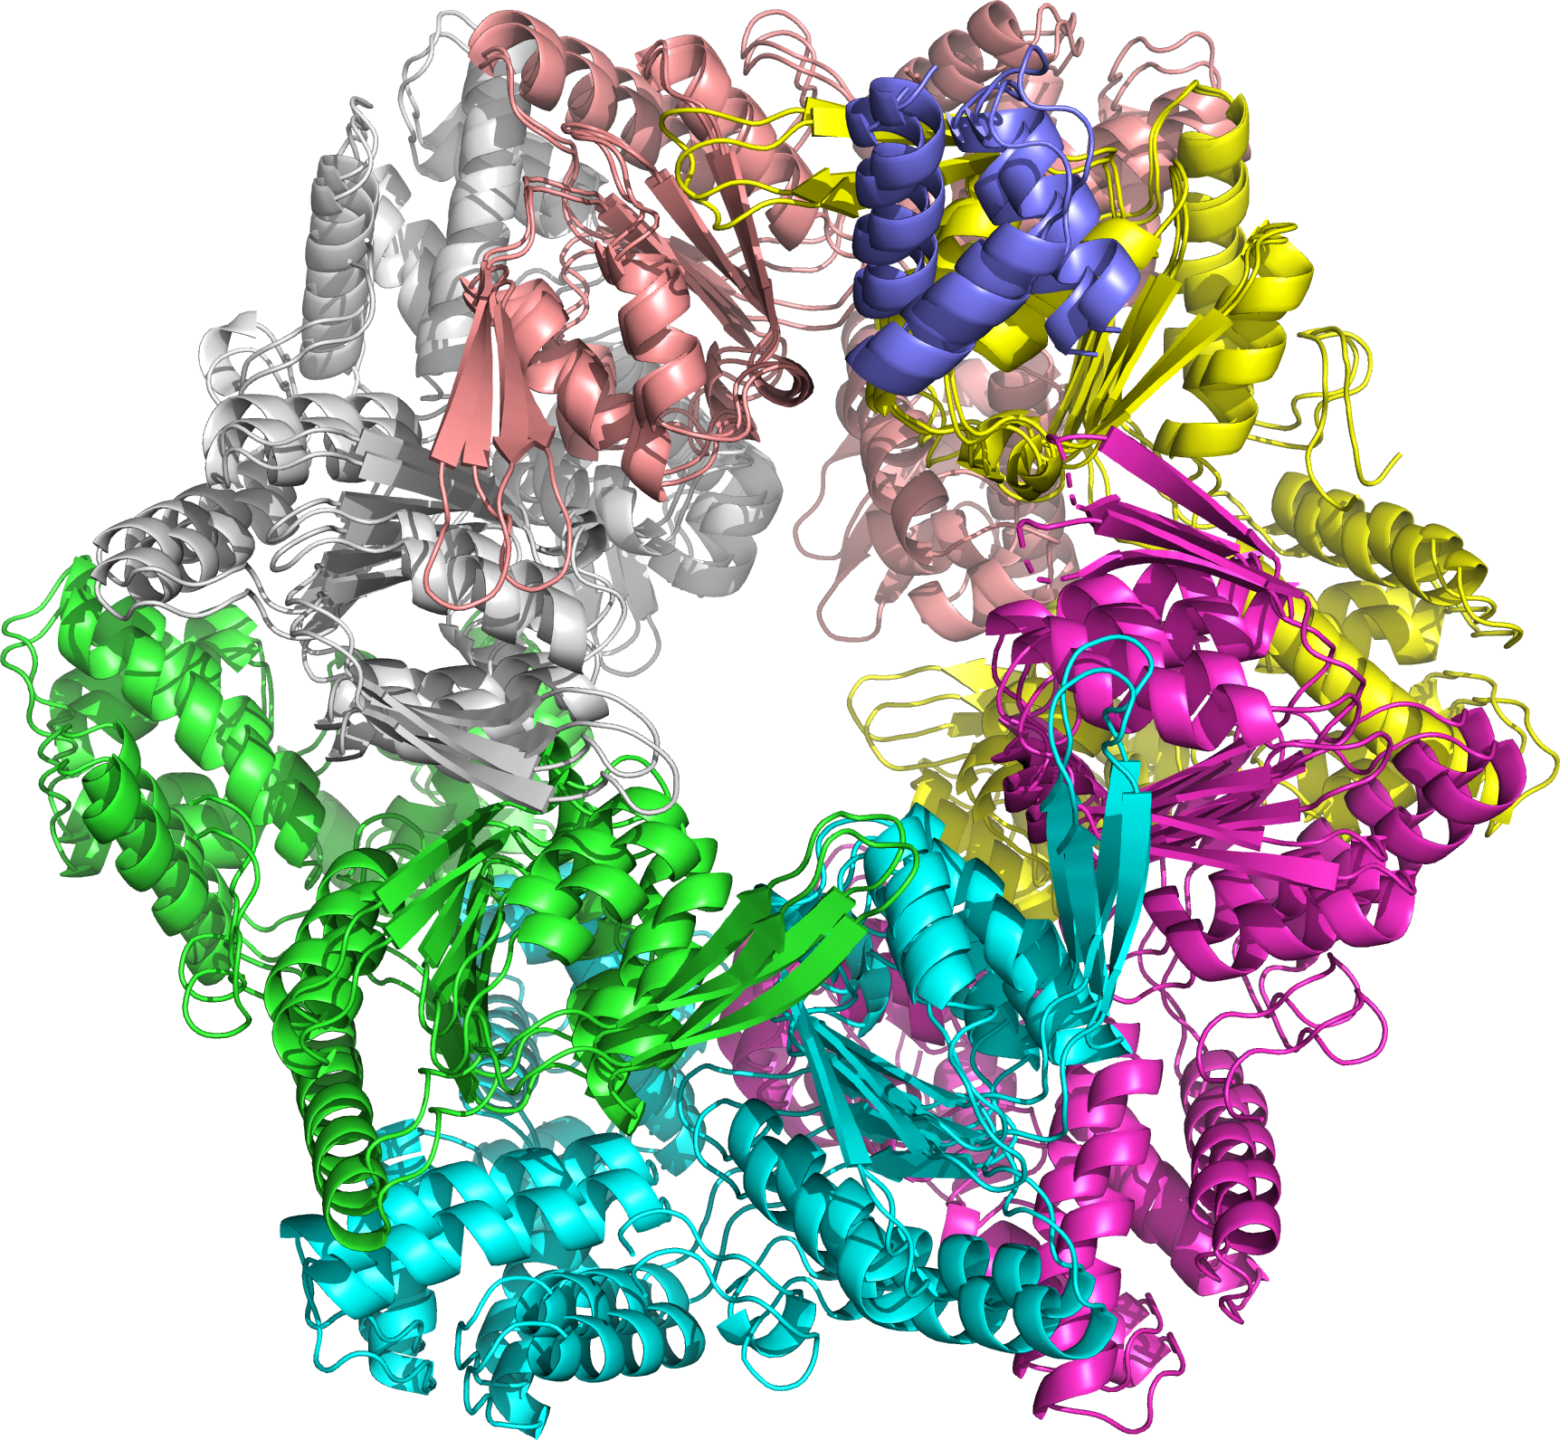
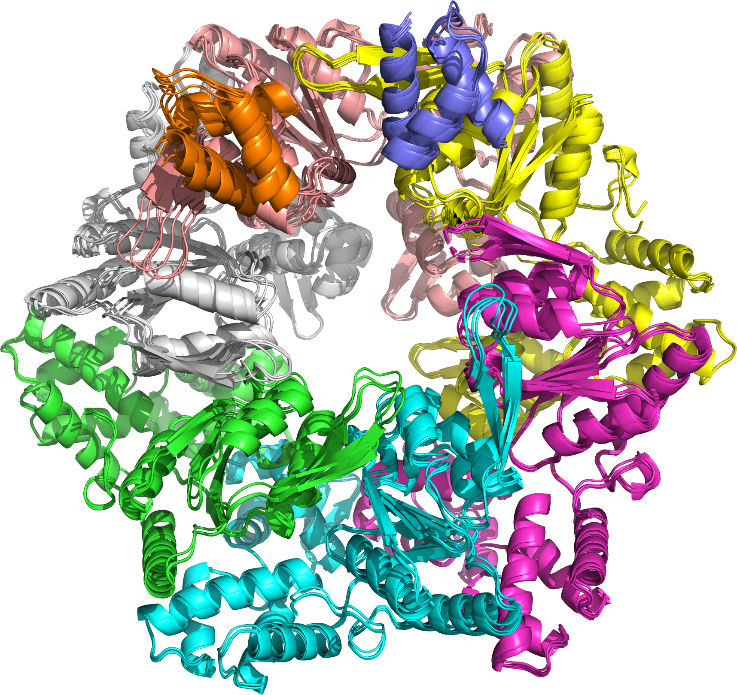
Question: Where do you think are you particularly good?
Predicted fold score versus oligo-lDDT scores for all heteromeric targets
ModFOLDdock
ModFOLDdockR
ModFOLDdockS
H1171 & H1172
H1171 & H1172
r=0.52
r=0.58
H1171 & H1172
r=0.77
“Target H1171 can come in two conformations… Target H1172 can come in three (actually 4+!) conformations...”
r=0.74
r=0.78
r=0.73

Slide 11
Question: Where do you think are you particularly good?
Correlations between predicted and observed QS and oligo-lDDT scores for all* targets
Method | Pearson r |  | Spearman rho
 | QSscore | Oligo-lDDT | QSscore | Oligo-lDDT
ModFOLDIA | 0.69 | 0.48 | 0.7 | 0.52
DockQJury | 0.79 | 0.56 | 0.81 | 0.68
QSscoreJury | 0.77 | 0.42 | 0.77 | 0.49
QSscoreOfficialJury | 0.83 | 0.55 | 0.81 | 0.62
lDDTOfficialJury | 0.36 | 0.88 | 0.39 | 0.77
VoroMQA | 0.26 | 0.56 | 0.21 | 0.52
CDAscore | 0.04 | 0.34 | 0.26 | 0.56
ModFOLDdock Interface | 0.83 | 0.57 | 0.82 | 0.65
ModFOLDdock Fold | 0.71 | 0.77 | 0.71 | 0.8
ModFOLDdockR Interface | 0.82 | 0.62 | 0.81 | 0.68
ModFOLDdockR Fold | 0.67 | 0.75 | 0.72 | 0.72
ModFOLDdockS Interface | 0.74 | 0.56 | 0.76 | 0.7
ModFOLDdockS Fold | 0.64 | 0.73 | 0.67 | 0.81
*Excludes T1160, T1161, H1171 & H1172 with alternative conformations and 2 targets that failed in OST due to this error: chainost.mol.alg.qsscoring.QSscoreError: Too many possible mappings

Slide 12
Questions: What are the added challenges of assessing assemblies versus single chains? Where do you see problems? Lessons learned?
The size of some structures (H1111, H1114, T1115, H1137) & 48h deadline - resource available for time allocated - a real challenge to balance loads on servers.
General parsing problems and unforeseen issues with scoring multiple chains, e.g., chain mapping, missing chain IDs, out-of-sync chain IDs… all needed to be handled and fixed before we could even start scoring.
Unknown target functions - what should we be optimising? We guessed based on CASP14 assessors’ formulae for global scores. Standards for interface residues?
3 different scores to optimise - fold (global), interface (global), interface residues (local).
In future, we will combine quasi and pure single model approaches (similar to our ModFOLD9 method for monomers).

Slide 13
Questions: How does your method differ from other state-of-the-art methods in the field? Would you gain anything from detailed knowledge of the modelling process?
Other top methods (based on abstracts):
086 MULTICOM_qa - a consensus method that uses all versus all pairwise MMalign comparisons.
121 VoroIF - a single model method, VoroIF-GNN: a graph attention network (GAT) that accepts a Voronoi tessellation-derived graph of inter-chain interface contacts.
089 GuijunLab-RocketX - a single model method, DeepUMQA: Ultrafast Shape Recognition-based Protein Model Quality Assessment using Deep Learning.
Our ModFOLDdock approach overlaps with different aspects of each of these; consensus (but different scores), single mode (voromqa), deep learning (CDA, MultiFOLD quasi-single).
Knowledge of the modelling process and self assessment should not influence independent quality scores.

Slide 14
McGuffin Group Members
Nick Edmunds - PhD student
Ahmet Genc - PhD student
Shoaa Alharbi - PhD student
Dr Recep Adiyaman - Postdoc
Dr Bajuna Salehe - Postdoc
Prof. Liam McGuffin - PI
MultiFOLD and ModFOLDdock web servers will be available soon:
https://www.reading.ac.uk/bioinf/ModFOLDdock/ModFOLDdock_form.html
https://www.reading.ac.uk/bioinf/MultiFOLD/MultiFOLD_form.html
https://hub.docker.com/r/mcguffin/multifold
biorXiv preprint out now: Improvement of protein tertiary and quaternary structure predictions using the ReFOLD4 refinement method and the AlphaFold2 recycling process
Recep Adiyaman, Nicholas S. Edmunds, Ahmet G. Genc, Shuaa M. A. Alharbi, Liam J. McGuffin, https://doi.org/10.1101/2022.12.06.519289

