Slide 1
Poster Flash Talks
Day 2

Slide 7
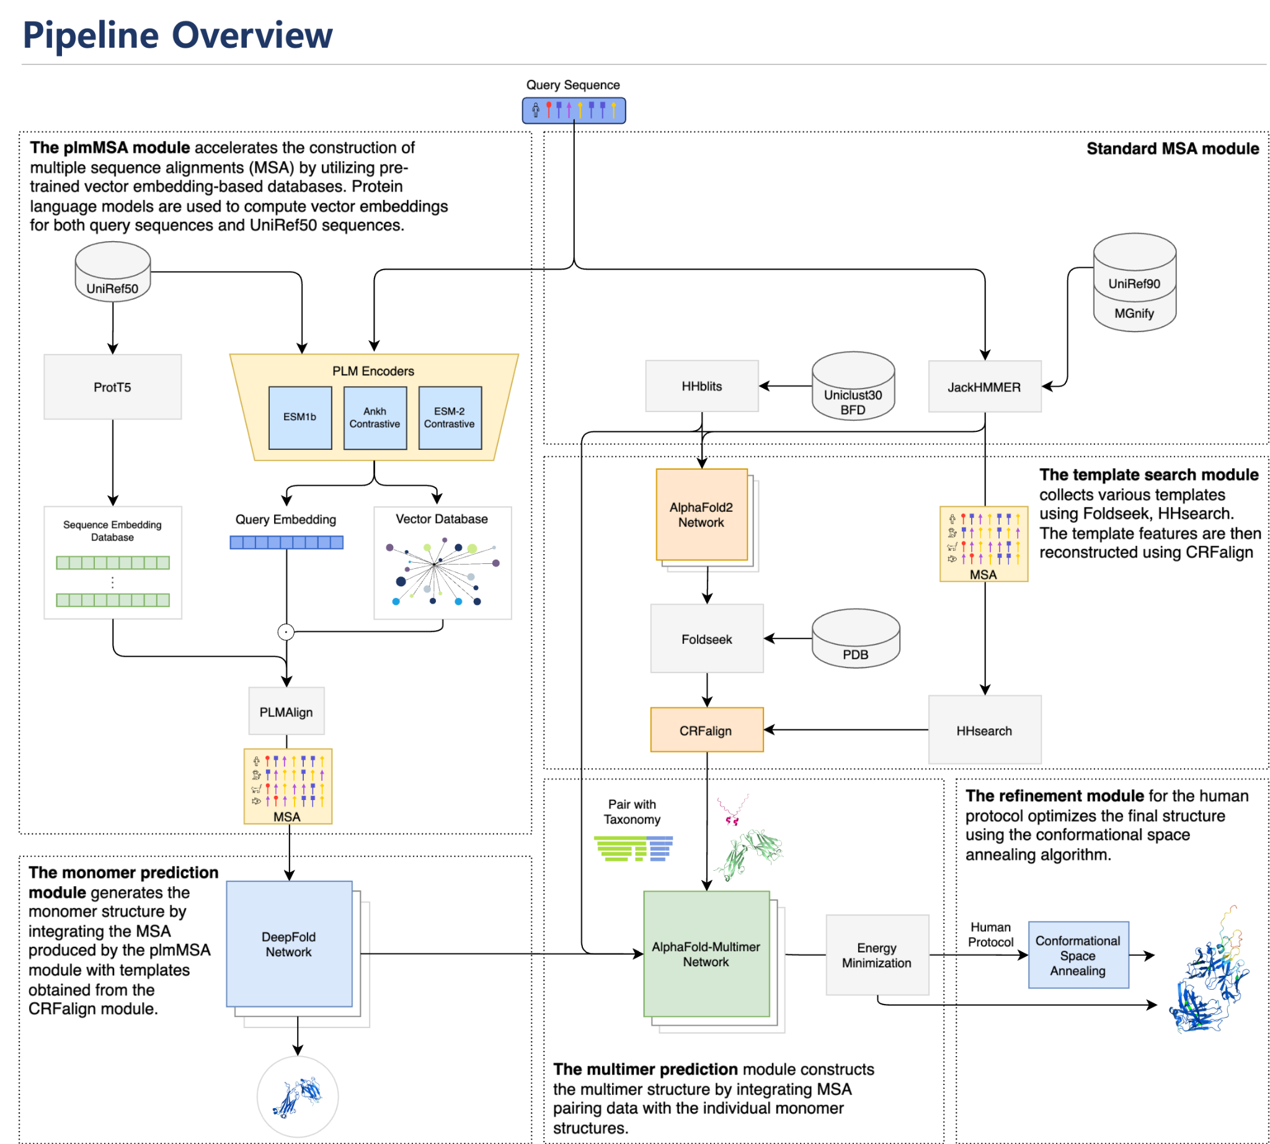
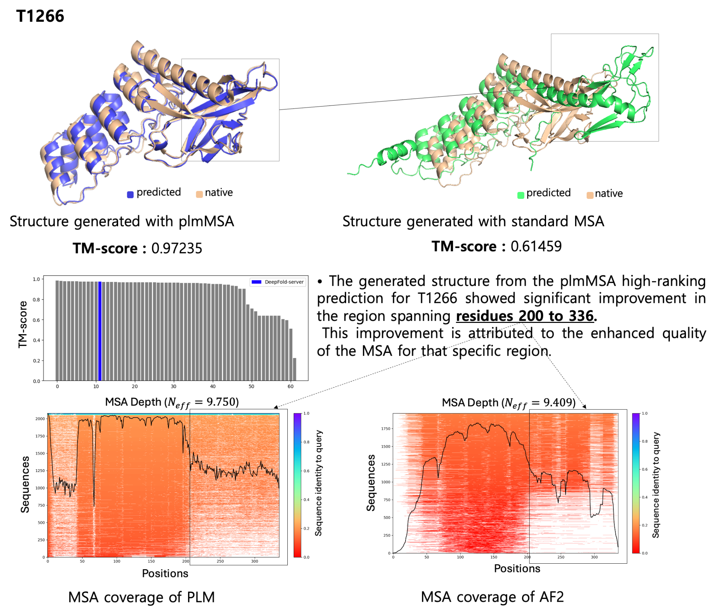
DeepFold: Protein 3D Structure Prediction in CASP16

